Slide 1


Slide 2
How is it free?
Notes:
Explain that Banzai is 100% free for local educators and students because YOU [the presenter] covers the cost. As a proud community partner, YOU [the presenter] funds everything from the online platform and resource library to the physical workbooks. [Feel free to mention another internal reason here for partnering with Banzai and your local schools]

Slide 3
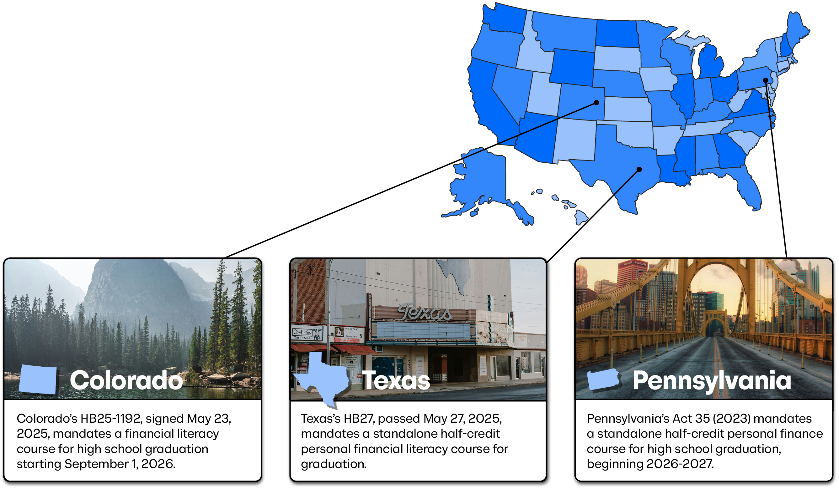
Curriculum
banzai.org/curriculum
Notes:
Explain that Financial literacy is quickly transforming from a nice-to-have elective to a strict graduation requirement across the nation.
Highlight recent mandates like Colorado's HB25-1192 (effective late 2026), Texas's standalone half-credit requirement under HB27, and Pennsylvania's Act 35.
Banzai’s curriculum is explicitly built to align with state standards, taking the guesswork out of lesson planning for busy educators.
Teachers can easily see how Banzai maps to their local requirements by visiting banzai.org/curriculum. Just click your state, enter your grade level, and instantly view exactly how Banzai fulfills your specific standards.

Slide 4

Elementary Personal Finance
Counting Currency
Income
Interest & Fees
Borrowing Money
Savings Goals
Notes:
Designed for elementary-aged students to introduce basic money habits early.
The interactive simulation covers basic financial foundations like counting currency and earning an income. With the core activity being Lemonade Tycoon: an online simulation game where students manage their very own virtual lemonade stand to find out if they can make a profit with it.
Throughout both the online and offline activities, students learn about trickier concepts like interest, fees, borrowing money responsibly, and prioritizing savings goals.

Slide 5
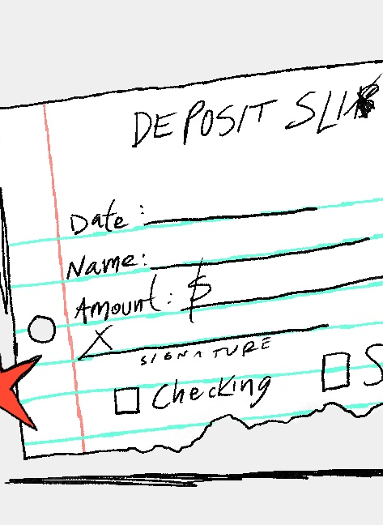
Middle School Personal Finance
Budgeting
Credit Cards
Auto Insurance
Risk Management
Checking Accounts
Income Tax
Consumer Smarts
Banking
Notes:
Perfect for middle school students who are beginning to interact with real money systems.
With a total of four online games (and growing) and even more learning resources like worksheets, articles, etc., Middle School Personal Finance moves into transactional skills like opening and navigating checking accounts, banking, and budgeting.
It introduces real-world financial realities early, including credit cards, auto insurance, risk management, and consumer smarts. It even touches on income tax.

Slide 6

High School Personal Finance
Mortgages & Auto Loans
Tax Returns
Renter’s Insurance
Credit Scores
Identity Theft
Life Insurance
Notes:
Tailored for high schoolers who are on the cusp of true financial independence, High School Personal Finance and its 6 core simulated experiences, focuses on upcoming landmark life decisions like navigating mortgages, auto loans, and filling out tax returns.
If you want lessons that dives deep into structural adult finance topics like renter's insurance, life insurance, and credit scores, High School Personal Finance’s activities do that effortlessly.

Slide 7

Digital Citizenship
Password Strength
Phishing
Fake News
Privacy
Social Media
Catfishing
Scams
Mental Health
Cyberbullying
Notes:
Life literacy isn't just about cash, it’s also about navigating the digital landscape safely.
Digital Citizenship, with its five core games & experiences, teaches students grades 3-12 about password strength, phishing, catfishing, online scams, fundamental privacy settings, while delving into how data is used and tracked online via a digital footprint. And let’s not forget the thing we all fear in youth these days—how the digital age affects your students both mentally and physically.
These activities openly tackle the social realities of modern youth, analyzing cyberbullying, social media behaviors, and overall digital wellness.

Slide 8

College and Careers
Cost of College
Paying for College
Scholarships
Grants (FAFSA)
Alternatives to College
Choosing a Career Field
Soft skills
Notes:
College and Careers offers six main online experiences where students proactively calculate the true costs of higher education and explore options for paying for college.
While decoding Financial Aid, College and Careers explains the differences between scholarships and federal grants like the FAFSA.
For students who aren’t college-bound, these online experiences, partnered with other articles and handouts, outline alternatives to college, choosing a career field, and building necessary workplace soft skills.

Slide 9

Entrepreneurship
Quickbooks Simulations
How Much Can My Business Make?
Sales Tax
Financial Statements
Balance Sheets
Notes:
Entrepreneurship is made of over four core interactive simulations focusing on what it takes to start, run, and scale a business.
It features native QuickBooks simulations to give students hands-on bookkeeping experience. And covers fundamental business dynamics like sales tax, projection modeling ("How much can my business make?"), financial statements, and balance sheets.

Slide 10









Article Library
Insurance
Retirement
Buying a Home
Taxes
Life Changes
Borrowing and Credit
Smart Living
Starting a Business
Budgeting
Notes:
Beyond the games, Banzai features a massive Article Library filled with clear, jargon-free explanations.
As a whole, the Banzai curriculum covers essential milestone life categories including retirement, buying a home, taxes, insurance, and managing unexpected life changes.
Banzai helps you teach practical strategies for borrowing and credit, starting a business, and smart living.

Slide 11
Workbooks
Elementary Personal Finance
Middle School Personal Finance
High School Personal Finance
Digital Citizenship
College and Careers
Notes:
Let them know that Banzai offers physical, beautifully printed workbooks to complement the online platform.
Workbooks are available for Elementary, Middle, and High School Personal Finance, alongside booklets for Digital Citizenship and College and Careers.
Like the software, assure teachers that these are completely paid for and shipped directly to the school at no cost to the teacher.

Slide 12

Privacy Policy
Fully compliant with FERPA, COPPA, PPRA, and state student privacy laws.
Banzai only collects what is necessary to deliver the Banzai program securely—not personally sensitive student data.
A Banzai account only requires a username and password.
Notes:
Reassure teachers that safety and data compliance are structural priorities for Banzai.
The Banzai platform only collects what is necessary to deliver the Banzai program securely—not personally sensitive student data.

Slide 13
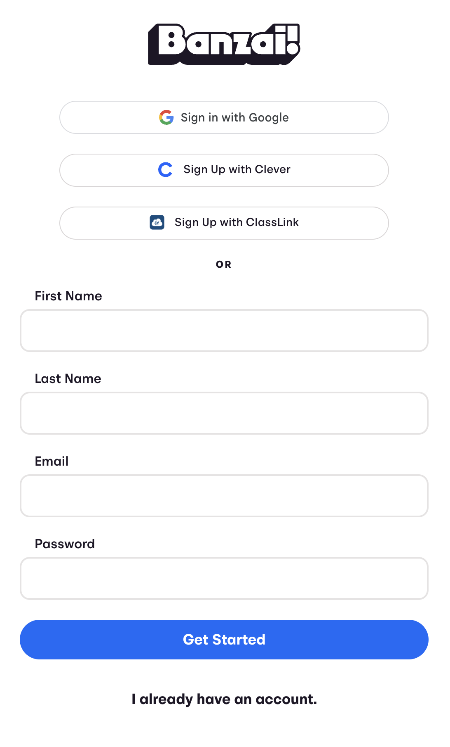
Signing Up
Go to banzai.org
Select “Sign Up”
Choose “I am a Teacher”
Sign up with Google or fill out the form
Notes:
Reassure them that signing up takes less than 60 seconds.
Direct them to go to banzai.org, select "Sign Up", and click "I am a Teacher".
They can quickly sign up using an existing Google profile or standard email form fill after entering the school they work for.

Slide 14


Integration
Clever
Classlink
Google
Notes:
Banzai integrates seamlessly with the primary EdTech tools schools already rely on.
Full single-sign-on (SSO) and classroom roster compatibility with Google, Clever, and ClassLink. No extra passwords for students to lose.

Slide 15
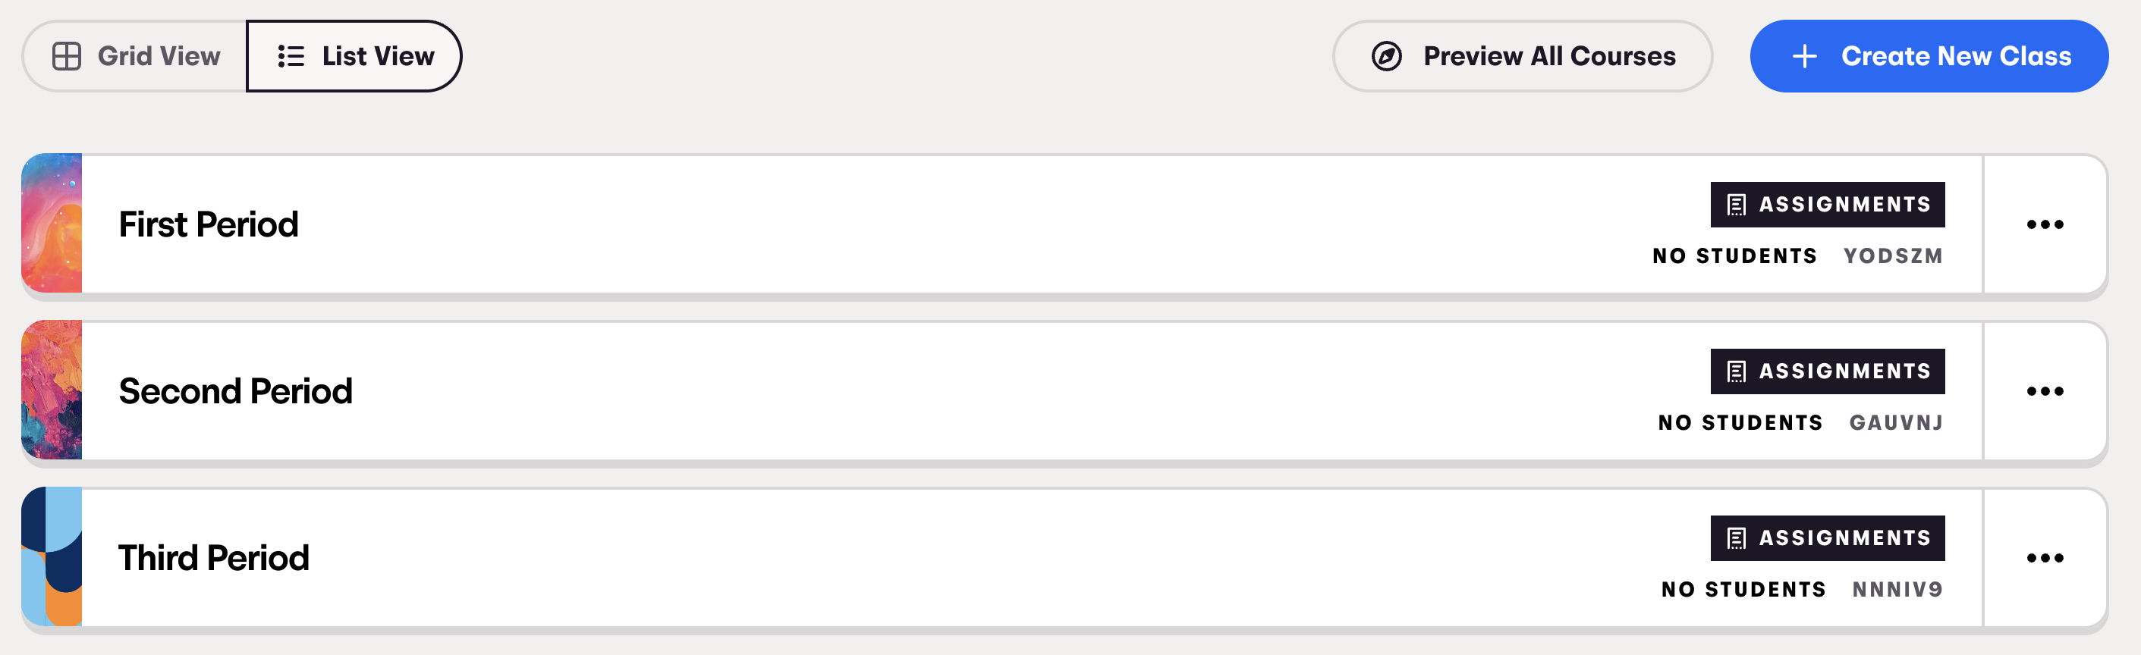
Teacher Dashboard
Home Screen
Create new classes
Customize class settings
Notes:
Show off the clean, easy-to-navigate Teacher Dashboard.
From this home screen, teachers can create new classes in seconds and seamlessly customize their settings.

Slide 16
Teacher Dashboard
Grading
Track student progress
View scores
Notes:
There are two ways to bring Banzai activities to your students: through the open-access library or by logging into your teacher dashboard.
By utilizing the teacher dashboard, Banzai takes care of the tedious administrative tasks for you:
Automated Grading: The software instantly grades pre- and post-tests so you don't have to.
Effortless Tracking: Monitor individual student progress in real time from one central place.
Actionable Insights: View specific simulation scores to see exactly where a student is struggling or thriving.

Slide 17
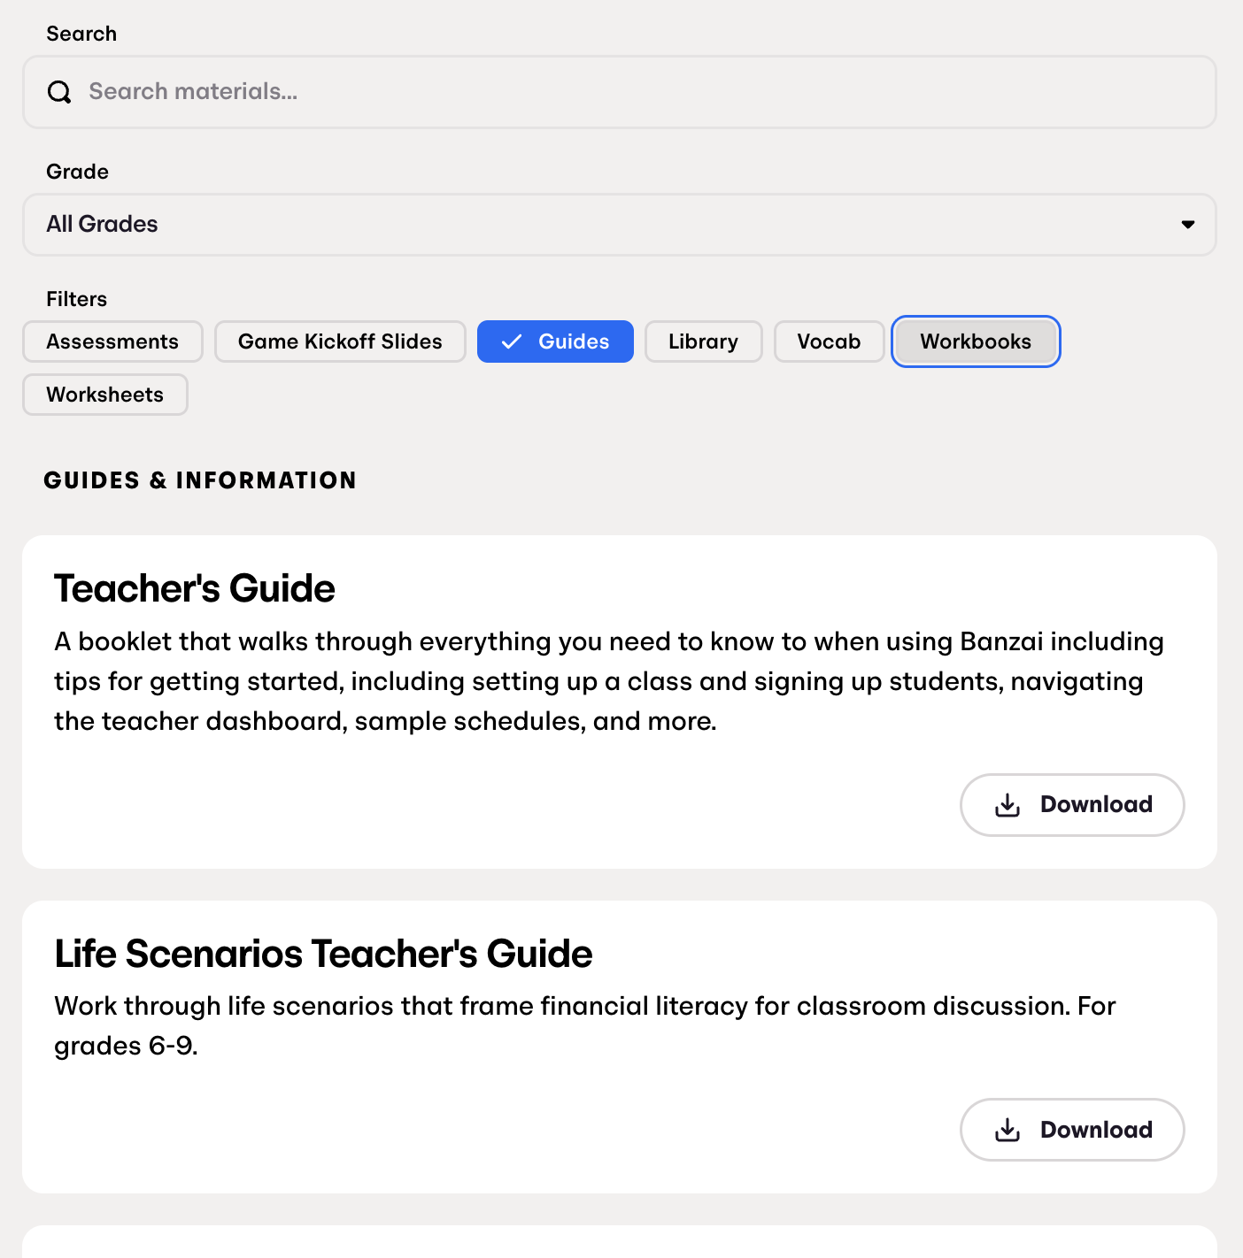
Teacher Dashboard
Toolkit
Workbooks (pdf)
Teacher’s Guide
Worksheets
Answer Keys
Article Library
Notes:
Highlighting the deep library of supplemental teaching resources hosted on the dashboard.
Teachers get access to digital workbook PDFs, comprehensive Teacher’s Guides, ready-to-print worksheets, and complete answer keys. It also functions as a bridge to the full article library.

Slide 18
Teacher Dashboard
Community Partner
Connect with your Community Partner
Request a guest speaker
Notes:
Remind teachers that you are a resource for financial discussions, and that you will even come into the classroom and give financially-driven presentations or workshops.
Teachers can use their dashboard directly with you and/or explicitly request a guest speaker to come to the classroom (either in-person or virtually) to share expert financial insights.

Slide 19



Integration
ADA
COPPA
FERPA
Accessible
Compliant
Compliant
Notes:
The Admin Checkbox: Administration often requires rigorous credentialing before tools enter the classroom. Banzai has this covered natively.
Gold Standard Compliance: The platform is certified ADA accessible for visually impaired students and is fully COPPA and FERPA compliant for data safety.

Slide 20

Banzai Contact
Email: support@banzai.org
Phone: 1-888-822-6924
Chat: banzai.org
Scan QR code to schedule a demo.
calendly.com/banzai
Notes:
If a teacher encounters an error, Banzai offers live support via email (support@banzai.org), or telephone (1-888-822-6924).
Instruct teachers or coordinators to scan the on-screen QR code to immediately schedule a customized 1-on-1 demo via Calendly.

Slide 21
Questions?
Notes:
Closing: Open up the floor for any questions from the audience.
Final Call to Action: Thank them for their time and remind them that they can get their classrooms registered and workbooks ordered today by visiting banzai.org!

Slide 22
Thank You!

