Slide 1


Taxes
Ages 13-18
Your Logo Here

Slide 2
Sponsor Intro
Hi, my name is [YOUR NAME].
I work as [JOB TITLE] at [FINANCIAL INSTITUTION].
Your Logo Here
Notes:
Introduce yourself to the class and explain a little bit about your role.
• Go over a typical day in your position and what
products or services your institution offers.
• Explain why you sponsor Banzai.
• Feel free to invite the class to ask questions about
you, your role, your financial institution, etc.

Slide 3

Income Taxes
Notes:
• Introduce the topic briefly. Ask the students how much they understand about taxes and how they work. Tell them that taxes are mandatory fees that individuals and companies need to pay the government. Explain that there are different types
of taxes including income tax, property tax, sales tax, etc., but that you’ll be focusing on income tax.

Slide 4
We’re going to discuss…
What Are Income Taxes?
Explaining Tax Brackets
Tax Forms & Who Pays Taxes
Where Does Tax Money Go?
When Are Taxes Due?
Important Due Dates
Your Logo Here
Notes:
This slide serves as a table of contents that introduces the presentation. These are the specific topics you’ll cover in the order you’ll present them in.

Slide 5
What are Income Taxes?
Federal
State
Your Logo Here
Notes:
Explain that an income tax is a fee collected by the government based on the dollar amount that a business or individual earns.
• A tax is taken at both the federal and state levels, but there is only one filing process for both.
• Federal tax rates are generally higher than state tax rates, but state taxes could include more opportunities to deduct or subtract from the amount a taxpayer owes to given different circumstances.
For example, tax credits are given to some state residents based on whether or not they’ve purchased solar panels or other eco-friendly products.
• Large purchases such as purchasing a home are also tied to reducing the amount you owe in tax.

Slide 6
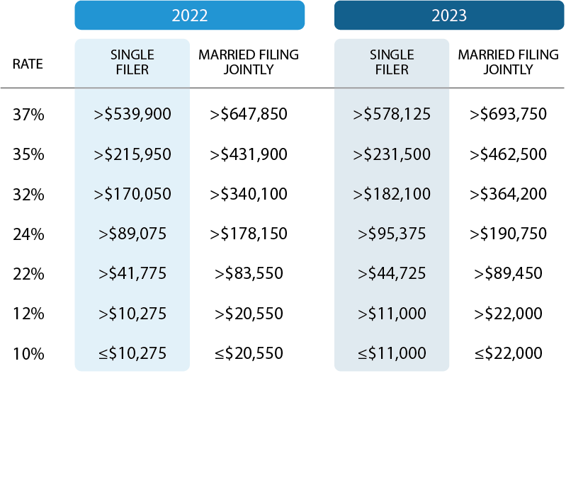
Explaining Tax Brackets
Notes:
Explain to the students that tax brackets can differ based on the tax year, the year you’re filing taxes for, or your tax status—whether you’re single, married, have a family, etc.
• A tax status is a category that taxpayers choose to file as based on their familial or economic situation. There are four main tax statuses: single, head of household, married filing jointly or qualifying widow, or married filing separately.
• Tax brackets break up income into various chunks. Each chunk is taxed at a specific rate. A person falls into one or more tax brackets based on their tax status and how much money they make. For example, a single person that makes $0-$10,275 a year would pay 10% of that income to the federal government because they fall into only one tax bracket.
• Explain that not everyone will pay just one percentage of their income on taxes, some could pay multiple. A marginal tax rate is defined as the percentage a taxpayer paid on their last tax dollar. Let’s say the first tax bracket of 10% gets cut off at $10,275, someone who makes $14,000 a year will only pay 10% of the first $10,275 they make. After subtracting that amount from their overall income, that taxpayer is left with the marginal tax rate of 12% for the remaining 3,725 owed.

Slide 7
Tax Forms & Who Pays Taxes?
Minimum income required
W4
W2
Your Logo Here
Notes:
Explain to the class that all U.S. citizens are required to pay income taxes, so long as they fit the requirements established by the IRS. Generally, those requirements are that citizens be a certain age and make a minimum amount of money.
• The W4 is a form that every employed individual is required to fill out at the start of any new job. This form declares your status and the number of dependents you have so that your place of employment can predict how much they’ll need to
withhold from each paycheck. This money is put toward what you will owe in taxes, meaning you will
either get a refund if they withheld too much or need to pay extra if they didn’t withhold enough.
• The W2 is a form that everyone should receive either in December or January of each year
that declares how much an employee made and the amount of taxes that have been withheld
throughout the year. The W2 form is used when filing taxes.

Slide 8
Where does Tax Money Go?
Major health programs
Medicare
Medicaid
Your Logo Here
Notes:
The federal taxes you pay are used by the government to invest in the country and to provide goods and services for the benefit of the American people. The biggest categories of expenditures are: major health programs, such as Medicare and Medicaid and social security.
• Medicare: Medicare is a federal health program that applies to individuals 65 or older and those who have qualifying disabilities.
• Medicaid: Medicaid supports eligible low-income adults, children, and families by giving them
access to health coverage.

Slide 9
Important Tax Dates
January
April 15th
October 15th
Your Logo Here
Notes:
Explain that the IRS issues a date that taxpayers can start filing their tax return in January. This date differs
year to year.
• April 15th (Tax Deadline) is the normal tax filing deadline. If the fifteenth lands on a weekend or holiday, it’s typically delayed until the following business day.
• October 15th is the Tax Extension Deadline. In order to get an extension on tax filing, a person would need to complete and mail in a form—the 4868 form or the Application for Automatic Extension of Time To File U.S. Individual Income Tax Return. No extensions can be processed after the first tax deadline in April, so it’s important to get the application submitted early.

Slide 10
Resources
Coach: Your Tax Return Pre-Game
Calculator: Federal Income Tax Calculator
Handout: Income Taxes
Your Logo Here
Notes:
Your Tax Return Pregame is a Banzai Coach that walks users through different aspects of taxes. It can take anywhere from 2-10 minutes to finish and gives the class a good definition of important tax terms like filing statuses, deductions, etc.
• Depending on how the presentation goes, you may want to give the class something to interact with. The Federal Income Tax Calculator is a good way to demonstrate how much tax is taken out of different income brackets. Pull up the Federal Income Tax Calculator and let students take turns directing you which income to put in.
• Help students prepare for their first job by passing out the How to Fill Out a W4 worksheet and
helping them complete it. Be there to answer any questions about the seemingly complicated W4
form. (You could use this in conjunction with Slide 6).

Slide 11
Conclusion
Now that you understand what federal income taxes are, practice how to…
Define tax statuses and brackets
Fill out tax forms like the W4
Understand when and how to file
Your Logo Here
Notes:
Understanding how taxes work is important and all of you will be expected to start practicing it the minute you get hired for your first job. As long as you prepare for that day now, you’ll be one step ahead in your finances.
• Ask if you can answer any questions.
*This is a great opportunity to ask the audience to fill out the handout provided in this file

Slide 12

Thank you!
Your Logo Here

