Slide 1


Paying for College
Ages 13-18
Your Logo Here

Slide 2
Sponsor Intro
Hi, my name is [YOUR NAME].
I work as [JOB TITLE] at [FINANCIAL INSTITUTION].
Your Logo Here
Notes:
Introduce yourself to the class and explain a little bit about your role. Go over your typical day, some of the things your financial institution offers (products or services relevant to the class), why you sponsor Banzai for their class, or why you think financially preparing for college is important. Consider inviting the class to ask questions about you, your role, your financial institution, etc.

Slide 3

Paying for College
Notes:
Introduce the topic briefly. Ask the students if any of them have a plan for college, and if they know how they are going to pay for it. Let them know that being unsure is okay and that it is a big step that can take a while to plan out. Tell them college is a great opportunity to prepare them for lifelong success, but it can cost a lot of money.
Understanding how much college will cost will help them make a plan on how to pay for it.

Slide 4
We’re going to discuss…
Finding Colleges
Costs of College
Scholarships
Grants and FAFSA
Student Loans
Working While Learning
College Alternatives
Your Logo Here
Notes:
This slide serves as a table of contents that introduces the presentation. These are the specific topics you’ll cover in the order you’ll present them in.

Slide 5

Finding the Right College
What qualities are most important to you?
Notes:
There are thousands of colleges to choose from, and their costs vary by tens of thousands of dollars. Ask the students what colleges they are interested in. After they answer, ask them why they chose that college (some students might say they are not going to college, let them know that you will talk about alternatives to college soon). Tell them that they will
need to narrow down their choices using the attributes of a college that are most important to them.
Here are some attributes of a college that are important to consider.
• Distance from home (this is a good one to show that students will value attributes differently).
• Programs the college provides in the field they want to study
• Course load and difficulty
• Activities and opportunities close by (such as sports teams, hiking, internships, shopping, etc.)
• Prestige - Some colleges look better on resumes than others, but it’s important to remind
them that this isn’t true for all professions.
Finish by letting them know one of the most important considerations is cost (which has probably
been brought up already.)

Slide 6
Cost of College
Tuition $11,000-$45,000 per year
Room and Board $9,000-$14,000 per year
Miscellaneous $500-$1000 per year
Overall $20,000-$60,000 per year
Your Logo Here
Notes:
The cost of college varies wildly. Ask the students what they expect college to cost in each category (tuition, room and board, miscellaneous). You can make it a game to see who can guess closest.
(1) Tuition - Tuition is the price that is most set in stone. The average cost of tuition and fees for the 2021-2022 school year is $43,775 at private colleges, $28,238 for out-of-state students at public schools and $11,631 for in-state residents at public colleges.
• Community Colleges are significantly cheaper.
• Students can spread tuition out by going part time.
• Full time students might be able to reduce the number of semesters they need to graduate by taking more classes each semester.
(2) Room and Board - Students have more control over this, but costs vary less between schools. The average annual room and board costs are: Public two year college $9,330, Public four-year college $11,950, Private four-year college $13,620.
• Students who live at home while going to college save to reduce their room and board costs.
• Living on campus reduces the costs for transportation.
• Explore all of the options. What seems impossible at first can become doable with a few adjustments.
(3) Miscellaneous - Ask the students what additional costs they might come across. Here are some categories to suggest:
• Books
• Fees
• Transportation
• Entertainment
• Laundry
• Socializing
These expenses are usually small but add up quickly. Emphasize the importance of adding them to the overall budget. Cost of Miscellaneous can be $500-$1,000 per year.
(4) Overall College Costs - $20,000-60,000 per year

Slide 7
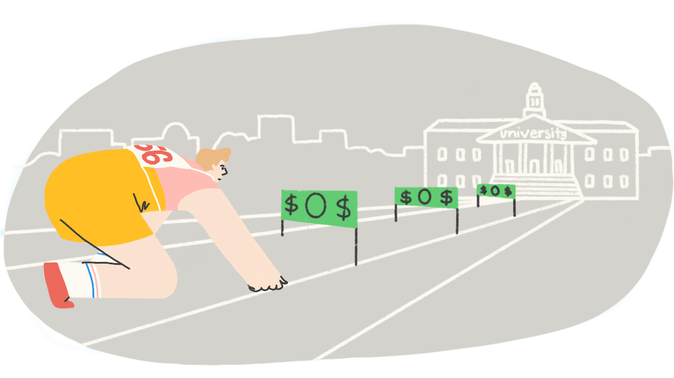
Scholarships
Notes:
Let the students know that you recognize that it’s a lot of money, but there are many options available to help manage the costs. The first option is scholarships. A scholarship is a cash award given to a student to help them pay for school. This money doesn’t need to be paid back and it can come from colleges, companies, organizations, or even private donors.
Over one-million scholarships are given out each year. Some have specific requirements like living in a certain area or being a member of an underprivileged group. The easier the scholarship, the more likely it is that many people will apply for it. Suggest they try to apply for as many as they can, especially scholarships that require some work like an essay.
Applying to local scholarships is also a good way to increase their chances of receiving one. Some colleges provide scholarships for current students based on their grades, athletic/artistic achievements, or financial need. Suggest talking to their school guidance counselor for more information on scholarships. Recommend or hand out materials for applying for your Financial Institution’s scholarships if you have one.

Slide 8

Grants and FAFSA
Notes:
Let the students know that the federal government provides grants to students based on need. The Free Application for Federal Student Aid (FAFSA) is an
application for financial aid made up of scholarships and grants that the government awards to students based on their needs.
Unfortunately, many students who would qualify for FAFSA funds don’t even complete the application. Last year $3.75 billion in financial aid went unclaimed by the high school graduates class of 2021. That means more than 800,000 students were eligible but didn’t claim their fair share of FAFSA grants. The average amount awarded hovers around $3,900.

Slide 9
Student Loans
Federal Loans
Private Loans
Your Logo Here
Notes:
Tell the students that FAFSA is also used for calculating student loans. Student loans allow you to pay for a significant portion of your college expenses, but need to be paid back with interest after you graduate and/or stop going to college. Warn them to only take out what they can responsibly pay back. Student loan debt might be a significant financial burden that outweighs the benefits of getting their degree. There are two kinds of student loans:
• (1) Federal Student Loans - These are the first type of student loans the students should consider. The federal government allows for a certain amount of money to be borrowed for
undergraduate postgraduate schooling. These loans come with protections and different programs that allow reduced payment and loan forgiveness.
• (2) Private Student Loans - These help cover costs if federal loans and other options aren’t enough. These loans will vary depending on the financial institution you get them from and won’t have all the same protections as Federal Loans. Here is an opportunity to discuss the loans your institution provides and how to take out loans responsibly.

Slide 10

Working While Learning
Notes:
Of course the students can always use their own money to pay for school. Some students are able to save hundreds to thousands of dollars by working part time jobs before finishing high school. Family members or friends might also provide money to go towards their education. A 529 plan can be set up for any student and used for qualifying educational
expenses.
Here is an opportunity to show them how to set up a 529 plan or other savings account with your financial institution. Let the students know that they can also work while going to school. College is demanding but many students are able to balance part or full time jobs while they learn. Some Colleges provide work-study programs or other job opportunities which will work with their school schedule or provide reduced tuition. Students should be aware that college is stressful, and having a job will add to that stress. Their mental health is important and they shouldn’t take on more than they can handle.

Slide 11

Alternatives to College
Notes:
Let the students know that College isn’t the only option they have when they graduate. If any students brought up that they weren’t going to college before, ask them what their plans are, or ask the class if anyone is considering a college alternative. Here are some popular alternatives you might discuss:
• Working a job to save up for future education
• Pursue a career that doesn’t require a degree
• Joining the military
• Going to a trade school
• Doing humanitarian work
College is only one of several ways to have a successful future.

Slide 12
Resources
Budget Calculator
Cost of College Coach
Your Logo Here
Notes:
Depending on class participation and discussion throughout the presentation, you may have extra time. These resources are helpful ways to go over paying
for college. First, you can use the Budget Calculator to outline fixed costs (like tuition, fees, etc.). Then, add variable expenses and other costs like food and entertainment. Adjusting the numbers can show how saving a little each month can go a long way. You can also ask the class to participate by providing values.
Second, the Cost of College Coach session will walk students through various costs of college. You can make up answers or ask the class for feedback.

Slide 13
Paying for College
Choose a College
Find the Cost
Make a Plan to Pay
Your Logo Here
Notes:
Paying for college is intimidating, but millions of people have found a way to do it. Let the students know that the odds are in their favor to find a way to
pay for college or other post high school endeavors. They can take their time. It doesn’t have to be accomplished or figured out all at once.

Slide 14
Thank you!
Your Logo Here

