Slide 1


Life Scenarios
Your Logo Here
Grades 7-12

Slide 2
Sponsor Intro
Hi, my name is [YOUR NAME].
I work as [JOB TITLE] at [FINANCIAL INSTITUTION].
Your Logo Here
Notes:
Introduce yourself to the class and explain a little bit about your role.
You could go over your typical day, some of the things your financial institution offers (products or services relevant to the class), why you sponsor Banzai for their class, or why you think financial literacy is important.
Consider inviting the class to ask questions about you, your role, your FI, etc.

Slide 3
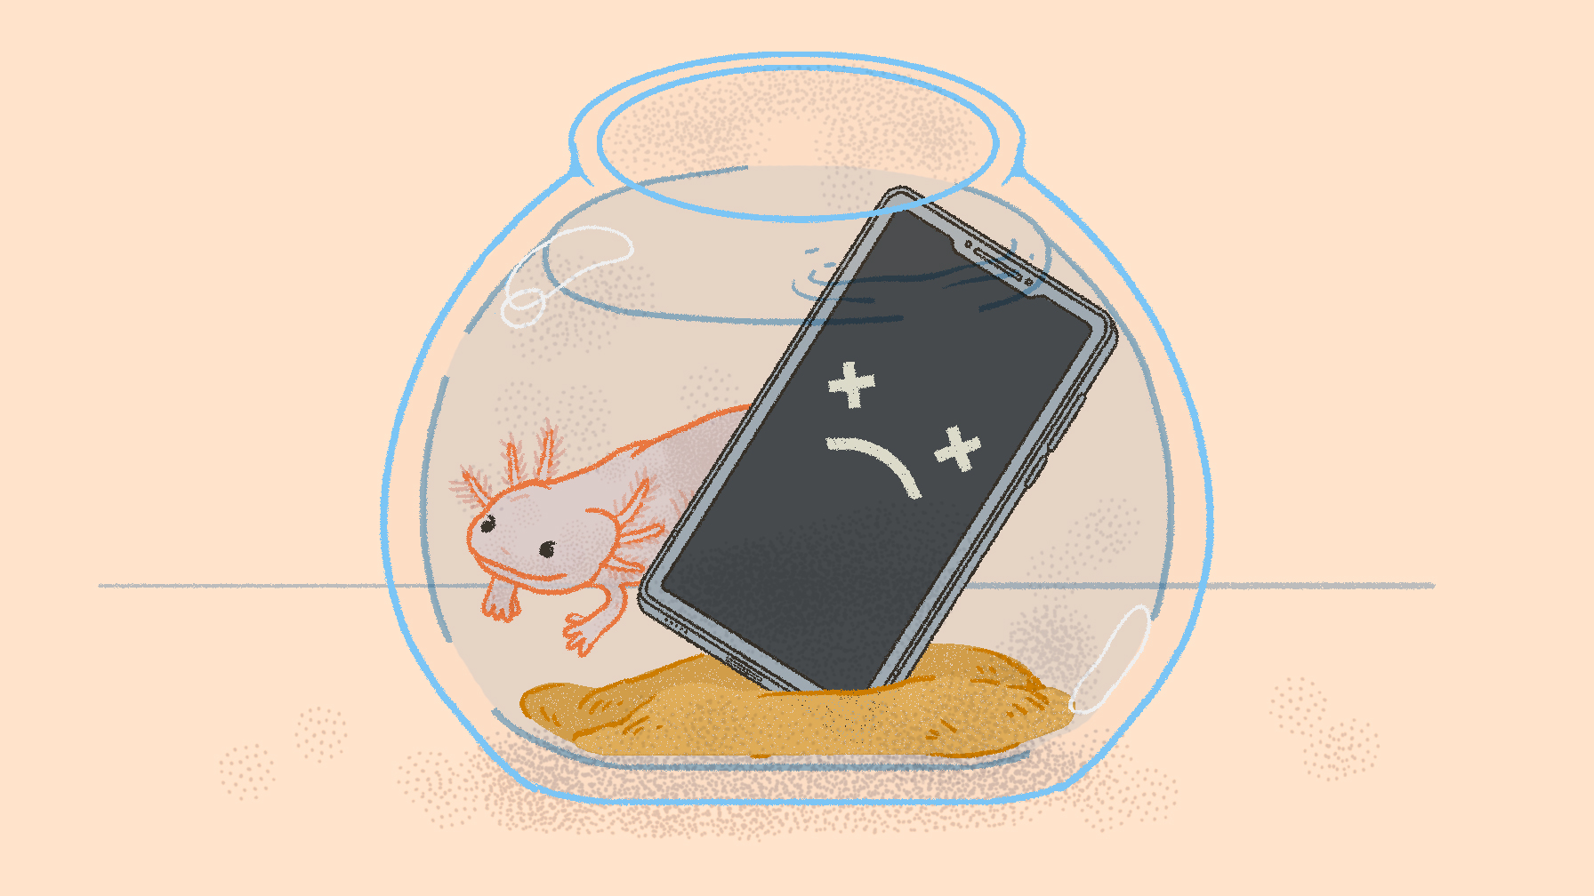
Life Scenarios
Notes:
Introduce the topic briefly.
In the Life Scenarios game, students tackled realistic financial dilemmas while saving money for their future fund.
Today we will go over some of the topics covered in the game, including financial basics like income, expenses, and budgeting, as well as more complicated topics like credit cards, auto loans, and insurance.

Slide 4
What we’re going to discuss…
Setting Goals
Budgeting
Spending
Borrowing
Income & Taxes
Your Logo Here
Notes:
This slide serves as a table of contents and can be used to introduce the presentation.
These are the specific topics you’ll cover in the order you’ll present them in.

Slide 5
Setting Goals
Making and Keeping Savings Goals
Savings Goals
Risk Management
Your Logo Here
Notes:
Finding motivation to save money can be difficult, especially if there are lots of options for spending it. Saving money with a purpose can help students identify their priorities and keep savings on track.
Ask students for some examples of goals they could save for. This could include buying a car, saving for post-secondary education, travel, and more.
To save with a purpose, they can break that big goal into manageable chunks and work towards it. It can also be helpful to keep the money in a separate account, so they aren’t tempted to spend it. Savings accounts are great for this. As a bonus, they also earn interest on deposits.
Ask the students if they have any questions about savings accounts.
One thing that can derail savings is financial emergencies.
Ask students what unexpected scenarios they might encounter, and how they could make a financial plan for those emergencies.

Slide 6
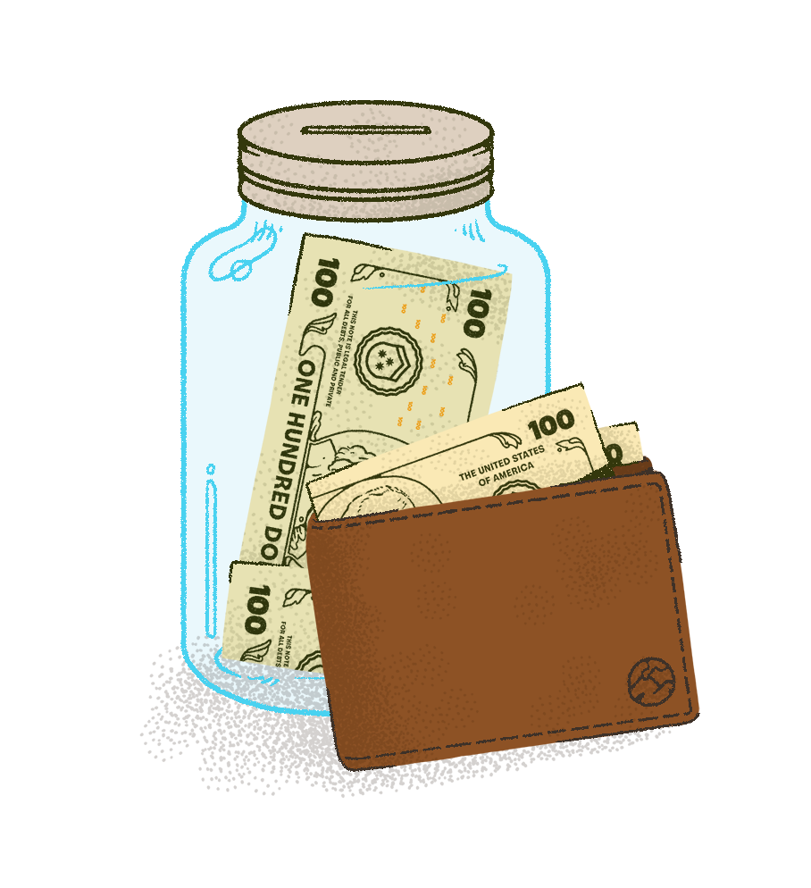
Budgeting
Notes:
Budgeting is an important part of setting financial goals. Budgets have fixed and variable expenses. Fixed expenses are those that stay the same, like a mortgage or car payment. Variable expenses can change and are usually things people have more control over, like money they spend on entertainment or at the grocery store.
Ask students what expenses they should start with if they need to trim their budget.
One of the key takeaways in Life Scenarios is that budgeting involves trade offs. In the game, students choose between repairing the car and buying a new one, staying with their existing lease or moving, and other choices. With most of these decisions, neither the cheapest option or the most expensive option is automatically the best. Instead, it depends on what aligns with their budget and priorities.
Ask students to share examples of budgeting trade offs they make.
(Fixed Expenses, variable expenses, emergency expenses, trade offs and priorities)

Slide 7
Spending
ATM Withdrawals
Checking Accounts and Debit Cards
Tips
Overdrafts
Your Logo Here
Notes:
Spending money can happen with cash or cards. Money kept at a financial institution can be withdrawn as cash from an ATM or in person with a teller. With a checking account, account holders are issued a debit card to use directly at the point of sale.
Remember that an item rarely costs only what the sticker price says. There are often taxes added to a purchase, and if a service was provided, don’t forget to add a tip. Financial institutions typically charge a fee for overdrafts—and of course you have to pay for the purchase, too.

Slide 8
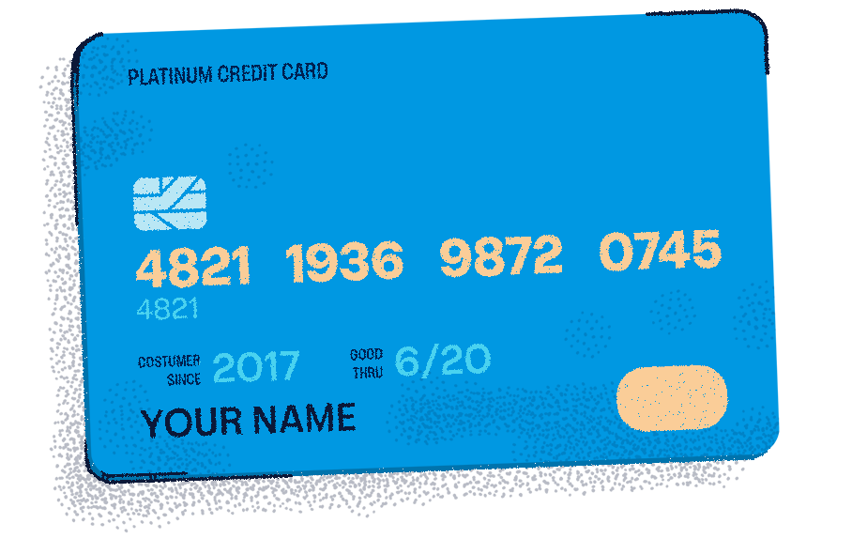
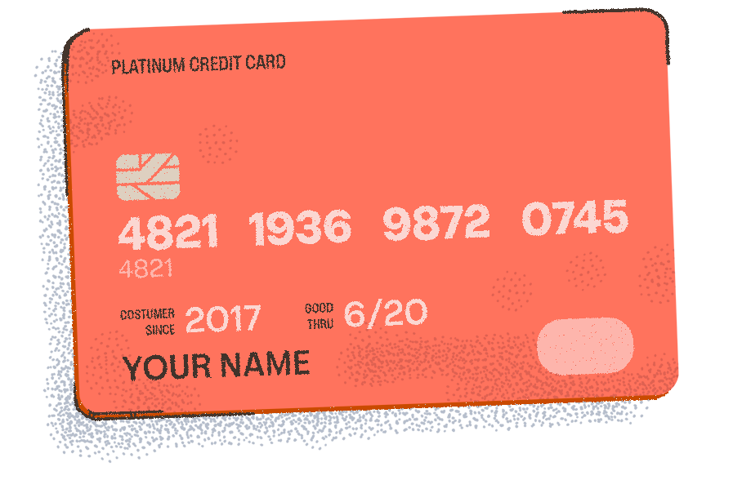
Borrowing
Notes:
Borrowing comes in many forms. In the game, students may borrow money in the form of an auto loan or used a credit card.
In the game, students may borrow money with an auto loan or use a credit card. Sometimes, people borrow money to pay for emergencies.
Ask the students for their thoughts on borrowing money.
No matter what the money is used for, borrowing comes at a cost. That cost is called interest, and it’s the amount charged for borrowing money. When you repay a loan, part of your payment goes to interest and part of it goes to the principal, or initial amount borrowed. Some borrowing may include other fees. For instance, certain credit cards also charge annual fees for use.
Ask students if they have questions on interest or borrowing money.

Slide 9
Income & Taxes
Income Taxes
Sales Taxes
Your Logo Here
Notes:
Income is subject to taxes paid to the federal or state government. This money goes towards services and programs the government provides and is compulsory—that means everyone has to pay taxes.
Required taxes are added together as withholdings on a paycheck and automatically deducted.
In the game, students also paid sales taxes on purchases for things like groceries and entertainment and even paid car registration tax.
Ask students what impact taxes have on budgeting.

Slide 10
Resources
What is Interest? Article
Planning for Expenses Article
Your Logo Here
Notes:
Depending on class participation and discussion during the presentation, there may be extra time. These resources are helpful for in-depth discussions. First, the “What is Interest?” article explains the difference between simple and compound interest, as well as nominal rate and annual percentage rate. Use the Simple vs. Compound Interest calculator to illustrate the difference.
Second, use the Budget calculator inside the Planning for Expenses article to split a hypothetical income into monthly and yearly expenses and create a sample budget.

Slide 11
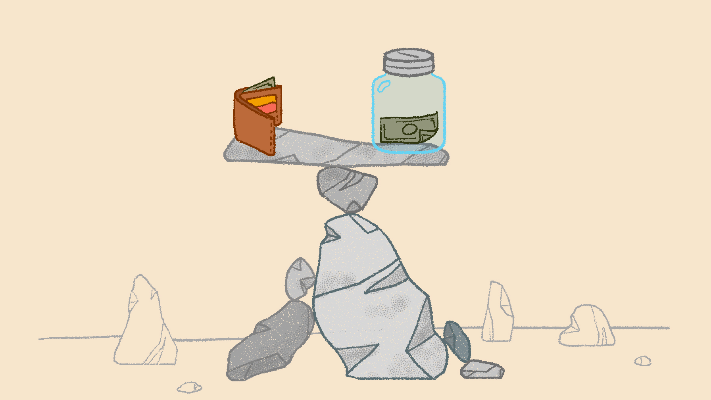
Conclusion
Notes:
Tell students that thinking through life scenarios ahead of when they happen helps them be financially prepared for the future. It may feel overwhelming, but education now can save them from missteps in the future.
Ask the students if they have any questions about savings accounts, interest, or setting financial goals.
You may want to offer to return if they want more information about a specific topic.

Slide 12

Thank you!
Your Logo Here

