Slide 1


Lemonade Tycoon
Grades 3-6
Your Logo Here

Slide 2
Sponsor Intro
Hi, my name is [YOUR NAME].
I work as [JOB TITLE] at [FINANCIAL INSTITUTION].
Your Logo Here
Notes:
Introduce yourself to the class and explain a little bit about your role.
Go over a typical day in your position and what products or services your institution offers.
Explain why you sponsor Banzai.
Feel free to invite the class to ask questions about you, your role, your financial institution, etc.

Slide 3
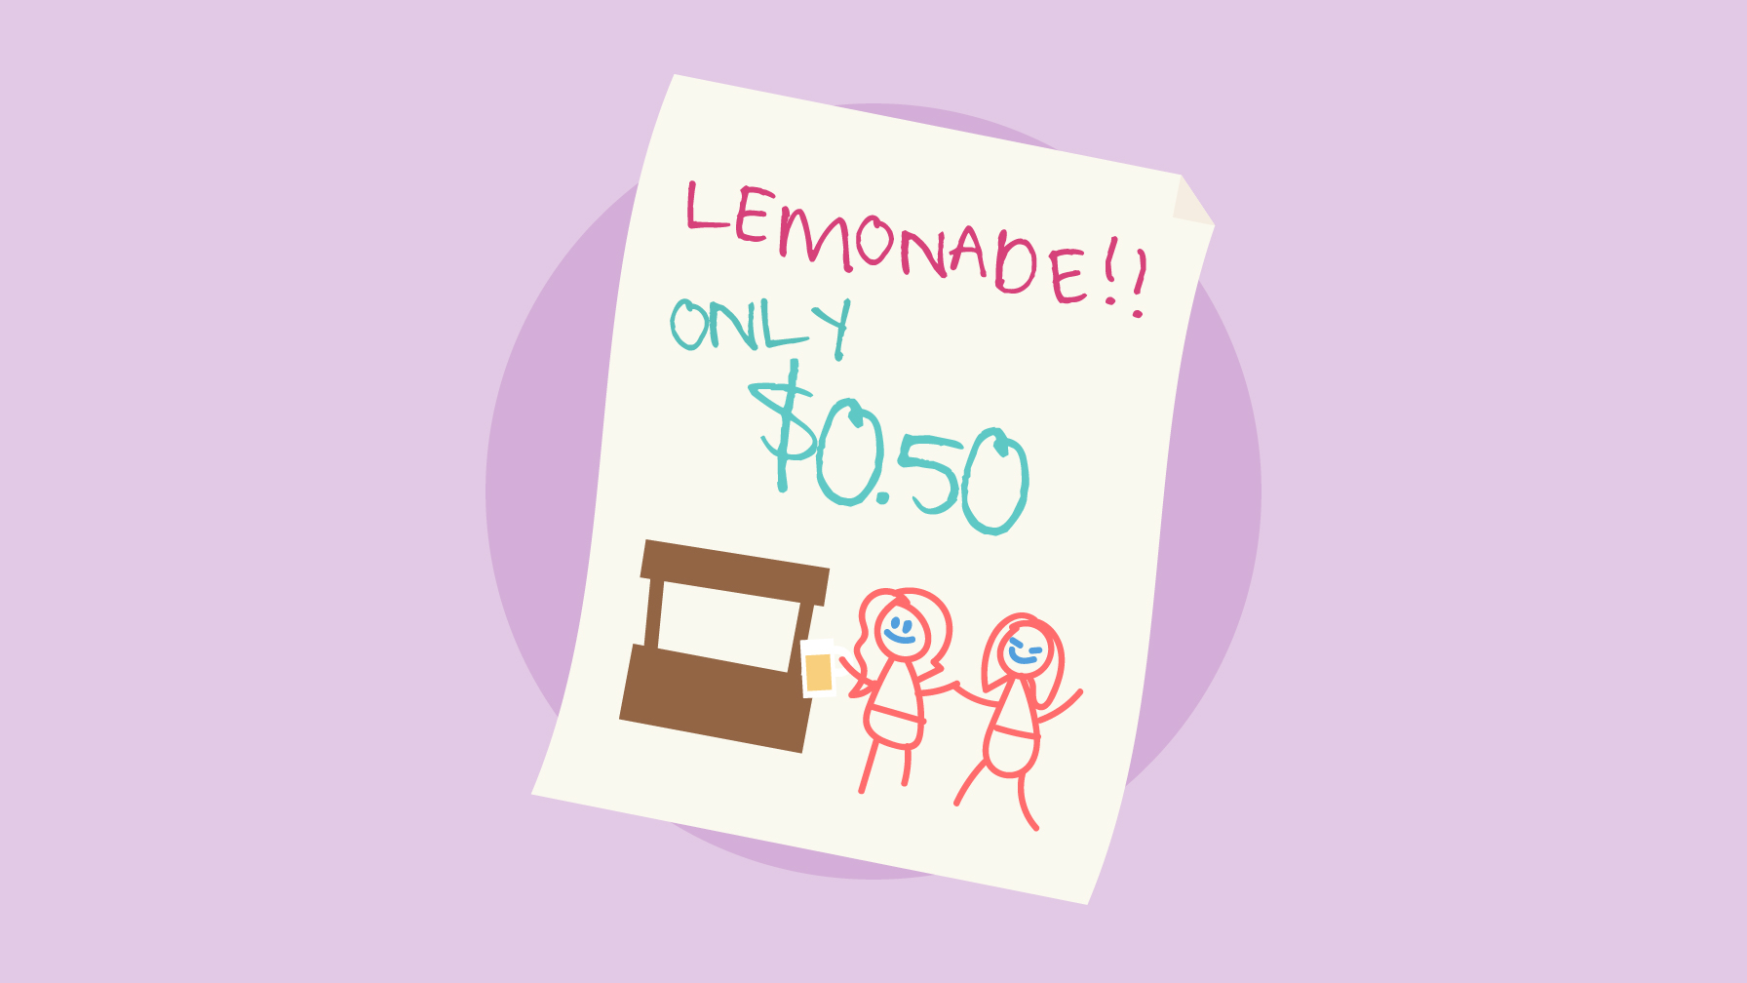
Lemonade Tycoon
Notes:
In this presentation, you’ll discuss financial principles students learn by playing Lemonade Tycoon.
In the game, students own and operate a lemonade stand. To win, they must manage a budget, borrow and pay back money, and navigate unexpected expenses and scenarios.

Slide 4
What we’re going to discuss…
Income & Expenses
Loans & Debt
Financial Goals
Savings Accounts
Your Logo Here
Notes:
This slide serves as a table of contents that introduces the presentation. These are the specific topics you’ll cover in the order you’ll present them in.

Slide 5

Income & Expenses
Notes:
Income is money you earn from work you do. Other words for income are earnings, salary, pay, and wage. A few examples of income for kids their age
are allowance and birthday money. In the game, the player also earned income from a lemonade stand. Ask students if they can think of other ways they can make money, or income.
Expenses are what you spend money on. Expenses can also be called costs, expenditures, and bills. Ask the students what they like to spend money on—what are their expenses?
If the students ran their own business, they’d also have business expenses. These are important expenses for their job. For example, a lawnmower for a lawn-mowing business or lemons and sugar for a lemonade stand business. Ask students for other examples of business expenses.

Slide 6
Loans & Debt
Money borrowed from someone else with the expectation that you’ll pay it back
Debt is money you owe to someone
Your Logo Here
Notes:
Sometimes paying for expenses requires a loan. Loans can be called credit or an advance. It is money
borrowed from someone else with the expectation of paying it back. The paying it back part is key.
Ask students to think about a time when they have loaned an item or money to someone. Did they want
it back? Did they get it back?
Any amount owed on a loan is debt. In the game, Mom loaned money to the player to buy more supplies for the lemonade stand. Taking the loan was also taking on debt. Ask students if they have other ideas for getting the money needed for more supplies. Ideas include planning ahead and setting aside money made from the business or using their allowance, or using less
expensive supplies.

Slide 7
Financial Goals
Saving with a purpose
Setting financial goals
Your Logo Here
Notes:
Making money is great, but it’s easy to lose motivation to work hard without a financial goal. A financial goal can be anything students are saving
for. It’s saving with a purpose.
Ask students if they chose in the game to save for a bike or a hoverboard. Why did they make that financial goal? Did they achieve it? Then ask students to share some personal financial goals do they have anything they are saving for now

Slide 8

Savings Accounts
Notes:
Savings accounts are a special place to keep money for later. This could be money students are saving for a
rainy day or money for a specific goal. Students could store the money in a piggy bank, in a dresser drawer,
or even under their mattress. But in a savings account the money earns interest. Interest is an amount charged for borrowing money or paid to someone for lending it. This means that in a savings account, money grows over time.
Another benefit of depositing money with a financial institution is a greater sense of security.
Money put in an account is called a deposit. When you take the money out, that is a withdrawal.
If appropriate and offered by your financial institution, share information on special savings accounts for first-time or young savers.

Slide 9
Resources
Your First Account Article
Interest & Savings Calculator
Your Logo Here
Notes:
Depending on class participation and discussion during the presentation, there may be extra time. These resources are helpful for in-depth discussions. The “Your First Account” article discusses the difference between checking and savings accounts,
what you need to open an account, and touches on FDIC and NCUA insurance.
Second, use the Interest and Savings calculator to demonstrate how money grows in savings accounts and how interest works. Ask students for starting and monthly amounts to enter into the calculator, and provide some numbers of your own as well.

Slide 10

Conclusion
Notes:
A big part of financial literacy is knowing how to make smart money decisions. The more students can learn about money management—even if they are only practicing in a game—the more prepared they’ll be to make winning choices in real life.
Ask the students if they have any questions about savings accounts, interest, or setting financial goals. You may want to offer to return if they want more information about a specific topic.

Slide 11

Thank you!
Your Logo Here

