Slide 1
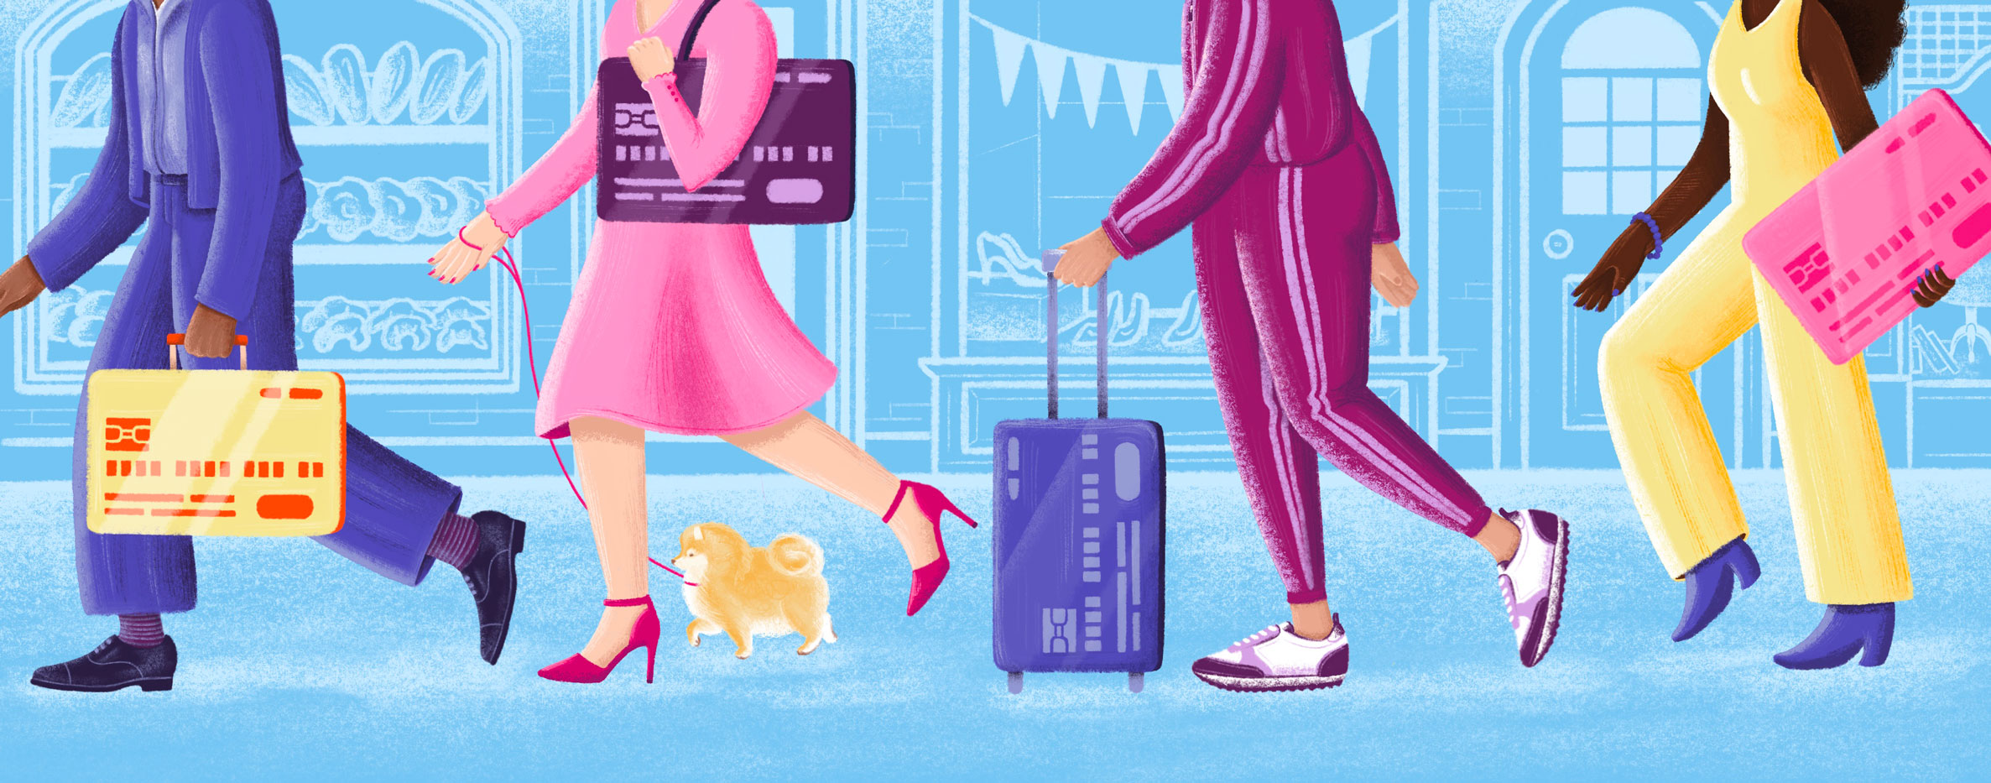

An Introduction to Credit
For ages 16+
Your Logo Here

Slide 2
Sponsor Intro
Hi, my name is [YOUR NAME].
I work as [JOB TITLE] at [FINANCIAL INSTITUTION].
Your Logo Here
Notes:
Introduce yourself to the class and explain a little bit about your role.
You could go over your typical day, some of the things your financial institution offers (products or services relevant to the class),
why you sponsor Banzai for their class, or why you think financial literacy is important.
Consider inviting the class to ask questions about you, your role, your FI, etc.

Slide 3
Credit is the ability to borrow money with the promise to pay it back with interest.
Notes:
The basic idea of credit is pretty simple. But, there are a few key principles you’ll need to understand in order to build a solid foundation before you start to borrow.

Slide 4

We’ll talk about…
Vocab terms
Interest
Credit scores
Loans and credit cards
Benefits and risks of credit
Notes:
This slide serves as a table of contents and can be used to introduce the presentation.
These are the specific topics you’ll cover in the order you’ll present them in.

Slide 5
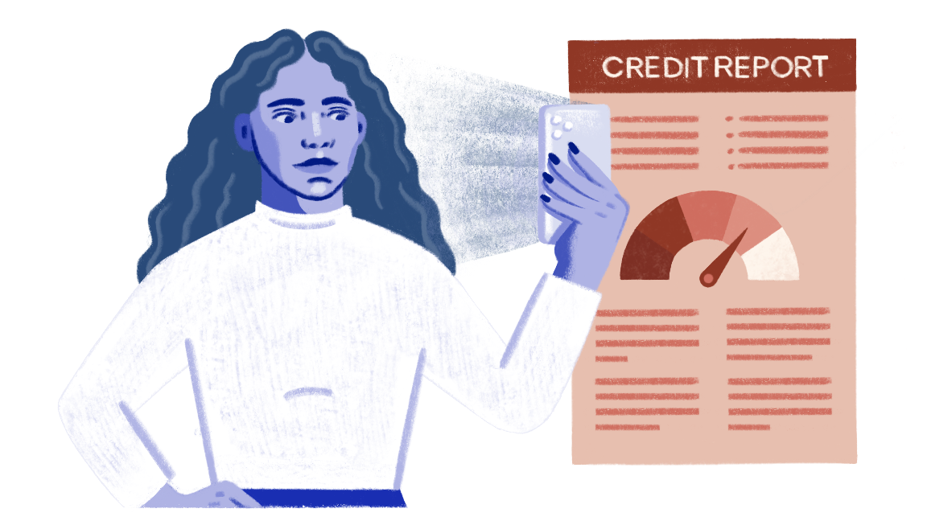
Credit Vocab
Principal
Interest Rate
Term
Minimum Payment
Notes:
Go through each term and explain that these are commonly used when discussing credit.
Consider asking the students to define each term as you go down the list. These are definitions you can use to support their answers or fill in the blanks.
• Principal: The amount of money originally borrowed.
• Interest rate: The percentage of the principal that must be paid on top of returning the original amount borrowed, usually shown as an APR (Annual Percentage Rate).
There are two common types of interest:
Simple interest only builds on the principal.
Compound interest builds on the total principal and interest.
• Term: The amount of time until all the principal and interest needs to be repaid.
• Minimum Payment: The lowest amount you’ll need to pay toward the debt each month.

Slide 6
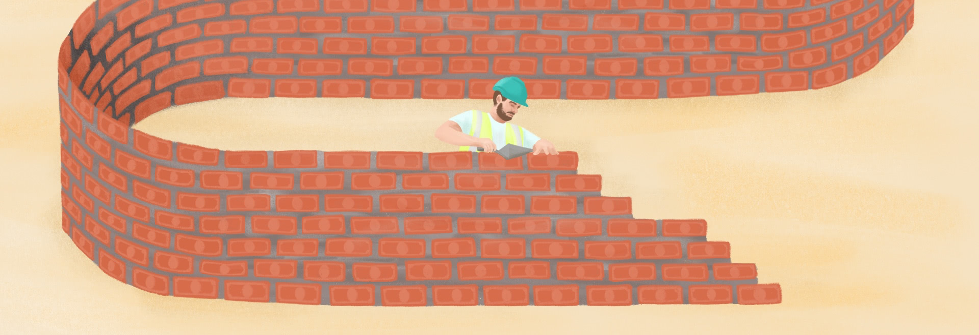
Save on interest by paying debt off as quickly as possible.
Notes:
Paying your debt off as quickly as possible is the best way to save on interest and make borrowing more affordable. Let’s look at some examples.
Open the Debt Payoff Calculator. Ask students to recommend various amounts for each slider.
Discuss the difference that adding even just a little to your monthly payment can make.

Slide 7
Your credit score is a reflection of your borrowing history shown as a number between 300 and 850.
Notes:
The last building block to your credit foundation is your credit score.
A credit score is a number that potential lenders will use to determine whether they should lend you money, how much, and at what interest rate.
In other words, it’s a number that represents your creditworthiness.
It’s based on how you’ve used credit in the past, so it is influenced by how much you’ve borrowed, your payment history, inquiries into your credit, etc.
Ask the class for examples of things that might negatively impact their credit score; here are some examples to help: missed payments, credit utilization, asking for too many loans/credit cards closely together, a loan in collections.
Next, ask for examples of things that would positively impact their score: making payments on time, age of credit history, number of accounts, etc.
If your score is high(a good score is generally considered to be 680 or higher), that means you are a trustworthy borrower and can likely qualify for more money or lower rates.
If it’s low (a poor score is generally anything below 579), lenders may be more hesitant to work with you.
There are a few other instances where your credit score may be used to determine if you can do something and at what cost, such as if you’re trying to rent a place to live or get auto insurance.
Next, let’s talk about two different types of borrowing that you would need credit for.

Slide 8
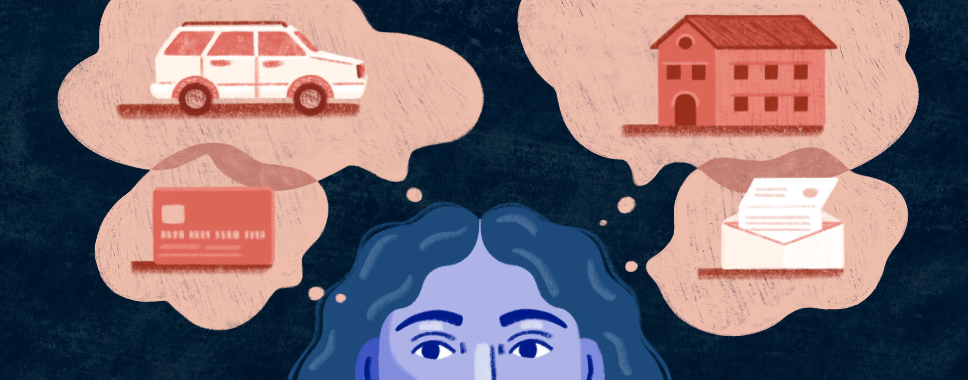
Loan:
A one-time sum of money borrowed and paid back slowly.
Notes:
Loans are typically large sums of money usually used for big purchases that are often paid back over multiple years.
Ask the students to think of common types of loans/reasons to take out a loan (auto, mortgage, student, personal, etc.)
You’ll almost always apply for and get a loan from a financial institution like [insert name of your FI].
Loans are typically paid back in monthly payments and can use simple or compound interest.
Be wary of places that promote quick loans with no or bad credit or payday ‘advances’. They may be easy to get, but these types of loans often have extremely high-interest rates (think 300-600+%), which makes them super expensive. They can also damage your credit score.

Slide 9
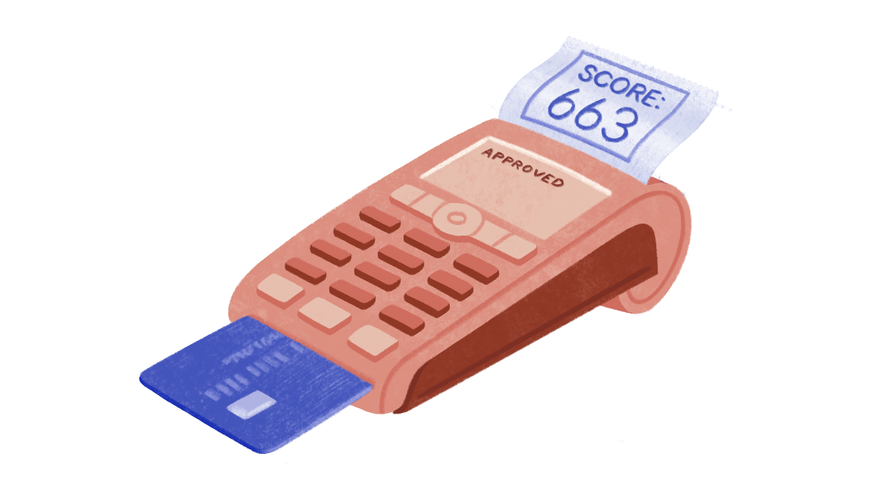
Credit Card:
A card that allows you to buy things now and pay for them later (with interest).
Notes:
Ask the students if anyone can explain how a credit card works.
With a credit card, you can borrow and pay back money up to a certain amount (your credit limit).
As long as you stay under that limit, you can continue to do this for as long as you have the account with your lender.
You can apply for a credit card from a financial institution or a specific credit card company (such as Visa or Discover).
Credit cards typically use compound interest with payments due every month. Unlike loans, it’s possible to avoid interest with most credit cards. If you pay the full amount off before it’s due (usually the next month), you won’t accrue any interest.
If you only pay the minimum, you will. Depending on the card, you may also need to pay a yearly fee to maintain your account.

Slide 10
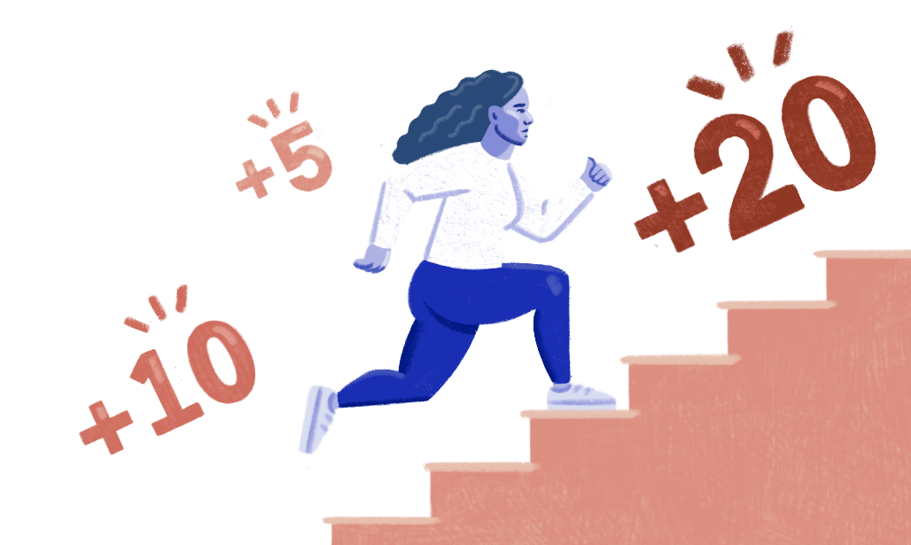
Benefits of Using Credit:
Large purchases become possible
Your credit score can increase
You can earn rewards
Notes:
Ask the students if they can explain what these benefits are before you do or think of any others.
Makes large purchases possible - Few people can afford the full cost of big expenses, such as a house, all at once.
Credit allows you to make those purchases now but spread the cost out over a longer period of time.
Your credit score can increase - Using credit can help you to build your credit score because it adds to your credit history.
This, in turn, means that you can then borrow again with even better terms.
You can earn rewards - Credit cards often allow users to earn rewards. That could mean cash back, travel miles, discounts on common purchases, and more.

Slide 11
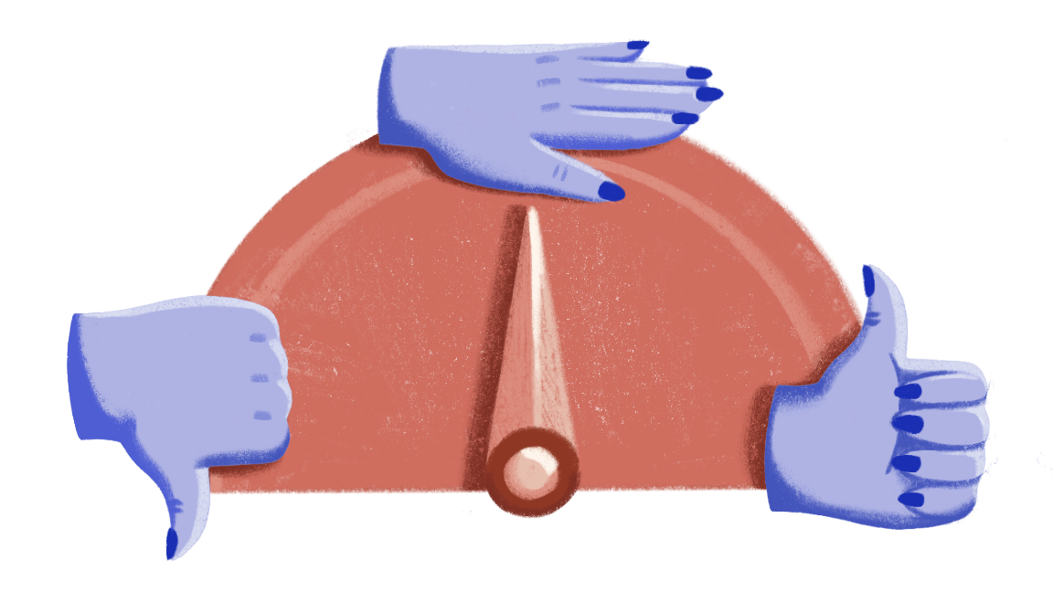
Risks of Using Credit:
Interest is expensive
Your credit score can decrease
Debt is dangerous
Notes:
Ask the students if they can explain what these risks are before you do or think of any others.
Interest is expensive - Again, borrowing money isn’t free. Interest means that you are paying back
more than you borrowed—sometimes a lot more.
Your credit score can decrease - You need to be careful. If you miss payments or pay less than the minimum, it can do serious damage to your score,
which will make it harder or more expensive to borrow in the future.
Debt is dangerous - If you aren’t constantly vigilant or if you find yourself in an unexpected situation, it can be easy to borrow more than you can afford to pay back. If you have to pay multiple minimums a month, even if they’re small, it adds up quickly. The temptation, then, to continue to use credit to make up the difference can create a dangerous slippery slope into debt.

Slide 12

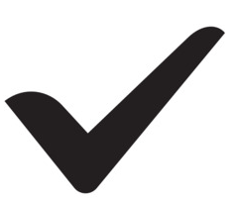
Credit Checklist:
Do your own research
Don’t borrow too much
Pay on time
Pay more than the minimum
Notes:
So, how do you use credit wisely? Follow this simple checklist:
1. Always research the terms of the credit you intend to use carefully so that you fully understand all of the specifics. Don’t be afraid to ask questions.
2. Don’t borrow too much. When it comes to credit cards, a wise rule of thumb is to not spend more than you can instantly pay off if needed. With loans, you’ll want to be sure you can continue to make your payments even if your situation changes (such as if you lose your job). You should factor enough money to cover your minimum payments for at least six months into your emergency fund.
3. Pay on time. You don’t want to get hit with unnecessary late fees or damage your credit because of a late payment.
4. Pay more than the minimum. Adding just a little to each payment can save you a lot of interest in the long run.

Slide 13
Review
Vocab terms
Interest
Credit scores
Loans and credit cards
Benefits and risks of credit
Any questions?
Your Logo Here
Notes:
Recap everything you talked about in the presentation briefly and encourage the students to ask questions.

Slide 14
Thank you!
Your Logo Here

