Slide 1


Financial Institutions
Grades 6-12
Your Logo Here

Slide 2
Sponsor Intro
Hi, my name is [YOUR NAME].
I work as [JOB TITLE] at [FINANCIAL INSTITUTION].
Your Logo Here
Notes:
Introduce yourself to the class and explain a little bit about your role.
Go over your typical day, some of the things your financial institution offers (products or services relevant to the class), or why you sponsor Banzai for their class.
Consider inviting the class to ask questions about you, your role, your financial institution, etc.

Slide 3
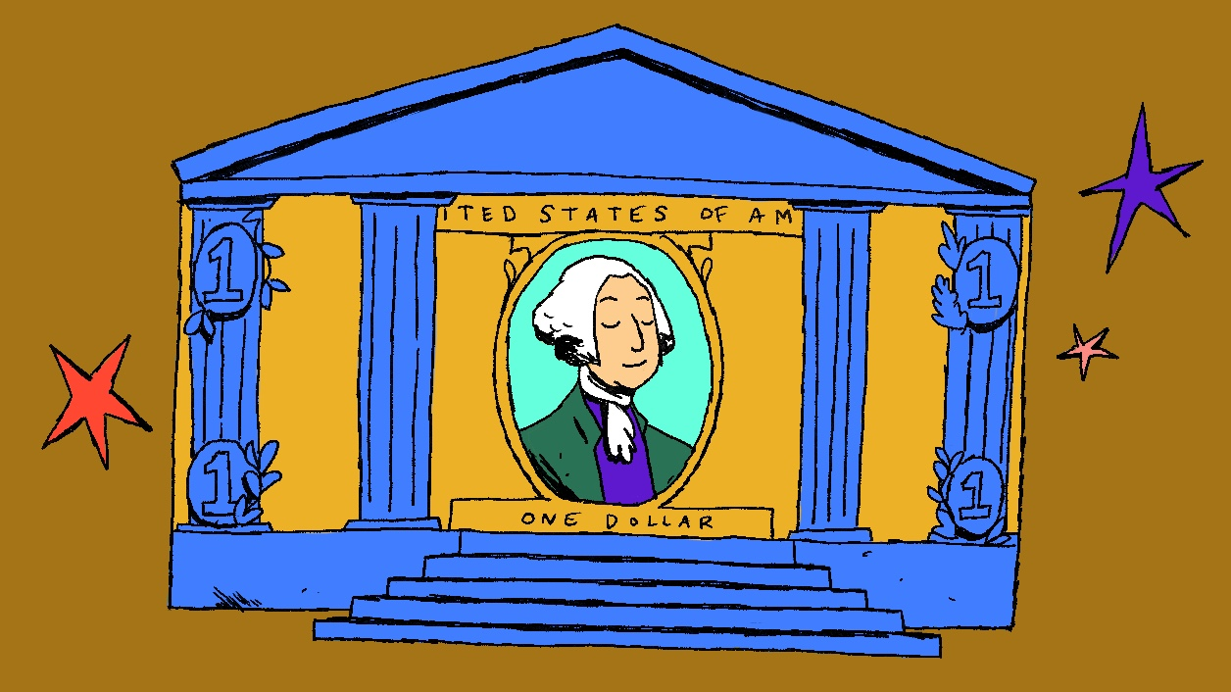
Financial Institutions
Notes:
Financial institutions are a pillar of society. Evidence of basic financial institutions date back as early as 1800 BC. These institutions originally loaned out seeds or supplies to farmers. Now, banks are a safe place to store and grow money.

Slide 4
What we’re going to discuss…
Interest
Checking Accounts
Saving Accounts
Certificates of Deposit
Loans
Federal Protections
Your Logo Here
Notes:
This slide serves as a table of contents that introduces the presentation. These are the specific topics you’ll cover in the order you’ll present them in.

Slide 5
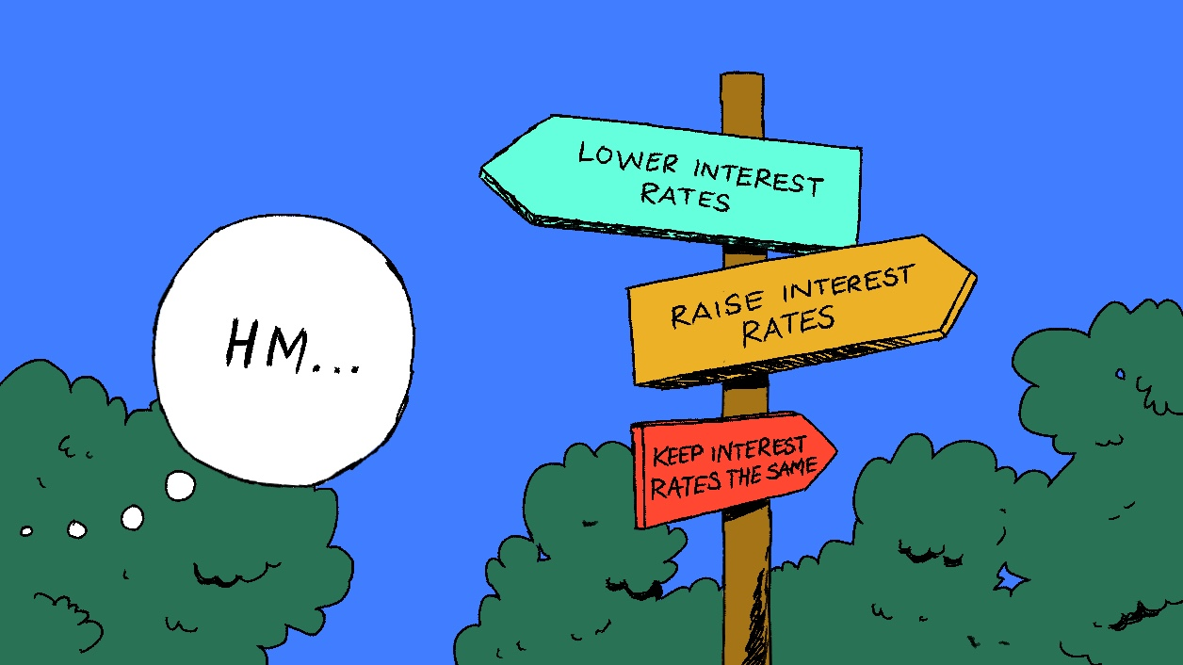
Interest
Notes:
Before we dive into the types of accounts and products offered by banks, it’s important to talk about interest. Interest is an amount of money that is either earned or owed. If you’re saving money, interest is earned. If you owe money, you’ll owe interest, too.
There are two kinds of interest: simple and compound. With simple interest, only the initial amount deposited or borrowed earns interest. With compound interest, the interest you earn is added to the principal and also earns interest.
Compound interest earned is typically represented as an Annual Percentage Yield, or APY, and it’s an accurate representation of what you earn with compound interest over a year.
Ask the students if they have any questions about the difference between simple and compound interest. If there is time, consider pulling up the Simple vs. Compound Interest calculator referenced on slide 10 to illustrate the difference.

Slide 6
Checking Accounts
Transaction Accounts
Debit Cards & Checks
Don’t Earn Interest
Your Logo Here
Notes:
Now that you know about interest, let’s talk about the most common and basic types of accounts: Checking and Savings. Checking accounts are transaction accounts, meaning you can use them to buy things. Account holders access the account directly through withdrawals, or can also use a debit card or checks to pay for things.
A debit card is swiped at checkout and money is instantly taken from the account. Checks go first to the receiver’s financial institution and then back to the original financial institution, so they take longer to “clear” or go through an account.
If you try to spend money that you do not have, there are two things that could happen. First, the transaction could be declined, so you cannot spend the money. Or, if you have overdraft protection, the transaction will go through but you’ll be charged an additional fee by your bank.
If you try to use a check but don’t have the money in your account, the check will bounce and you’ll be charged a hefty non-sufficient funds, or NSF, fee.
Checking accounts usually do not earn interest, although some may earn a small amount.

Slide 7
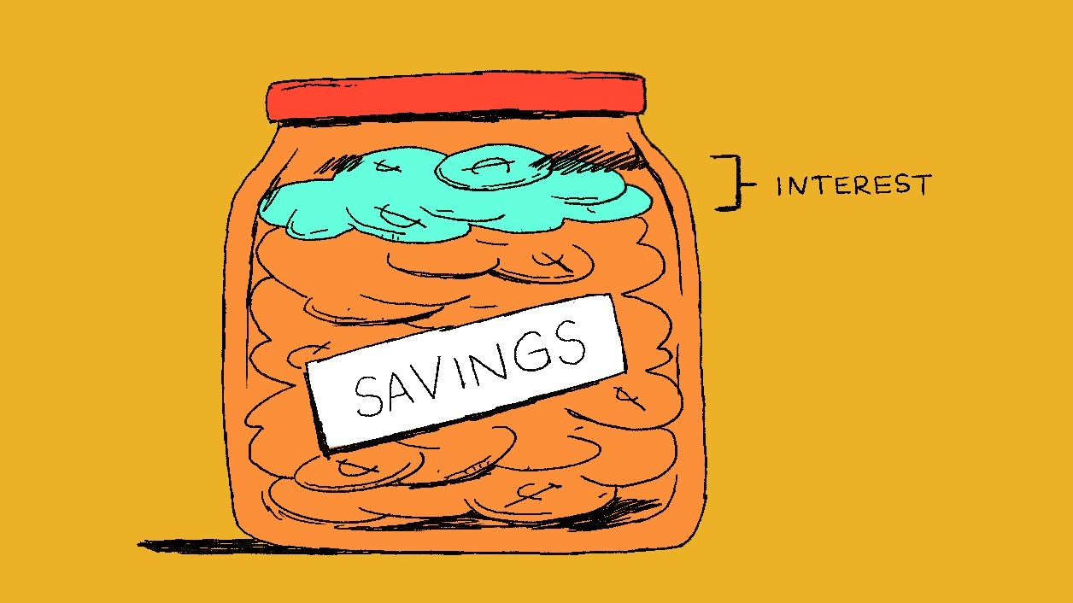
Savings Accounts
Notes:
Because savings accounts are designed to help you save money and earn interest, you can’t make purchases directly from them, and don’t receive a debit card or checks. Typically, you’ll need to withdraw the money from your bank to use it.
You can’t make purchases directly from a savings account, and don’t receive a debit card or checks. Typically, you’ll need to withdraw the money from your bank to use it.
The APY on savings accounts varies, but something like 0.1% or 0.5% isn’t uncommon. High-yield savings accounts can get interest rates of 3-4%, or even higher. But these accounts often have minimum deposit amounts. Keep in mind that the interest rate for savings accounts is variable—this means it can change.
There are different types of savings accounts, including accounts geared for first-time younger savers and high-yield savings accounts that offer a higher interest rate. If appropriate, include information about savings accounts that your financial institution offers. Ask the students if they have any questions about how savings accounts work.

Slide 8
Certificates of Deposit
Terms
Maturity Date
Guaranteed Returns
Your Logo Here
Notes:
A certificate of deposit (CD) is a savings option that requires account holders to leave money in a financial institution for a set amount of time, called a term, anywhere from 3 months to 5 years. The end of a term is called the maturity date, and after that date, account holders can withdraw their money plus the extra earned in interest. If you withdraw money before the maturity date, there are penalties.
CDs have a set APY, so you are guaranteed a specific amount of interest. They are a safe way to grow money faster than a checking account, but have less flexibility. Ask the students if they understand the benefits and risks of using a CD.

Slide 9
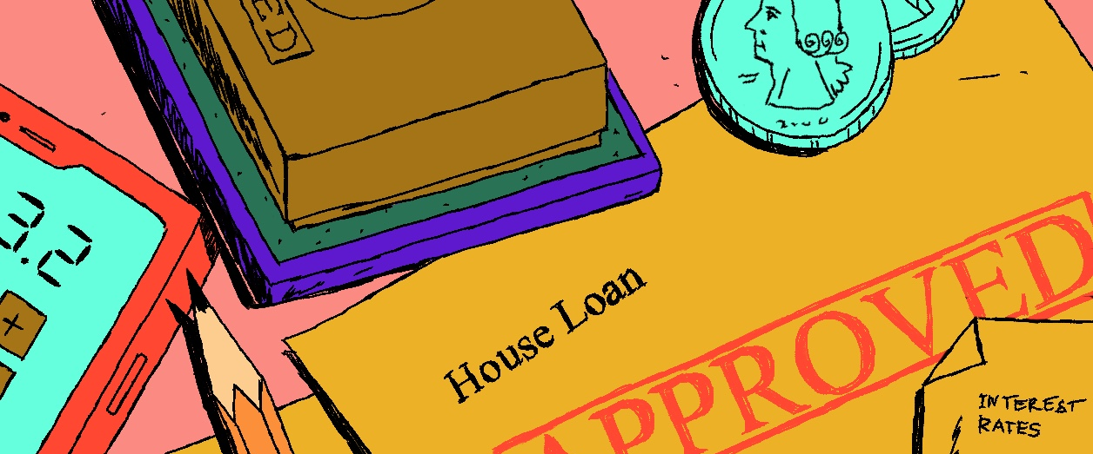
Loans
Notes:
As mentioned earlier, when you borrow money in the form of a loan, you’ll owe either simple or compound interest. Car loans, mortgages, and student loans typically use simple interest. Credit cards, savings accounts, and certificates of deposit usually use compound interest.
Financial institutions don’t automatically give loans to anyone who wants them. They look at factors like your credit score. Your credit score is a number between 300 and 850 that’s compiled by considering your borrowing history and represents your credit worthiness to potential lenders.
With a high credit score, you’ll likely qualify for a better rate on your loan and pay less interest overall. With a low credit score, you’ll probably have to pay a higher interest rate because you are considered a riskier borrower. Ask students if they have any questions about loans or how credit scores impact interest rates.

Slide 10
Federal Protections
FDIC Insurance
Your Logo Here
Notes:
Whether you choose a checking account, savings account, or CD, your money is protected by the Federal Deposit Insurance Corporation or FDIC. The FDIC is a federal government agency that insures deposits in banks and examines their safety for customers.
Each depositor at a bank is insured at least $250,000 per insured bank.

Slide 11
Resources
Simple vs. Compound Interest Calculator
Opening an Account Article
Your Logo Here
Notes:
Depending on class participation and discussion during the presentation, there may be extra time. These resources are helpful for in-depth discussions.
If you haven’t yet, use the Simple vs. Compound Interest Calculator inside the What is Interest article to explore the difference between simple and compound interest. Show the benefits of having compound interest work for you, like when you open a CD, instead of working against you, like with a credit card balance.
Second, the Opening an Account article outlines what is needed to open a checking or savings account for the first time. If appropriate, share details on accounts or products at your bank that benefit students.

Slide 12
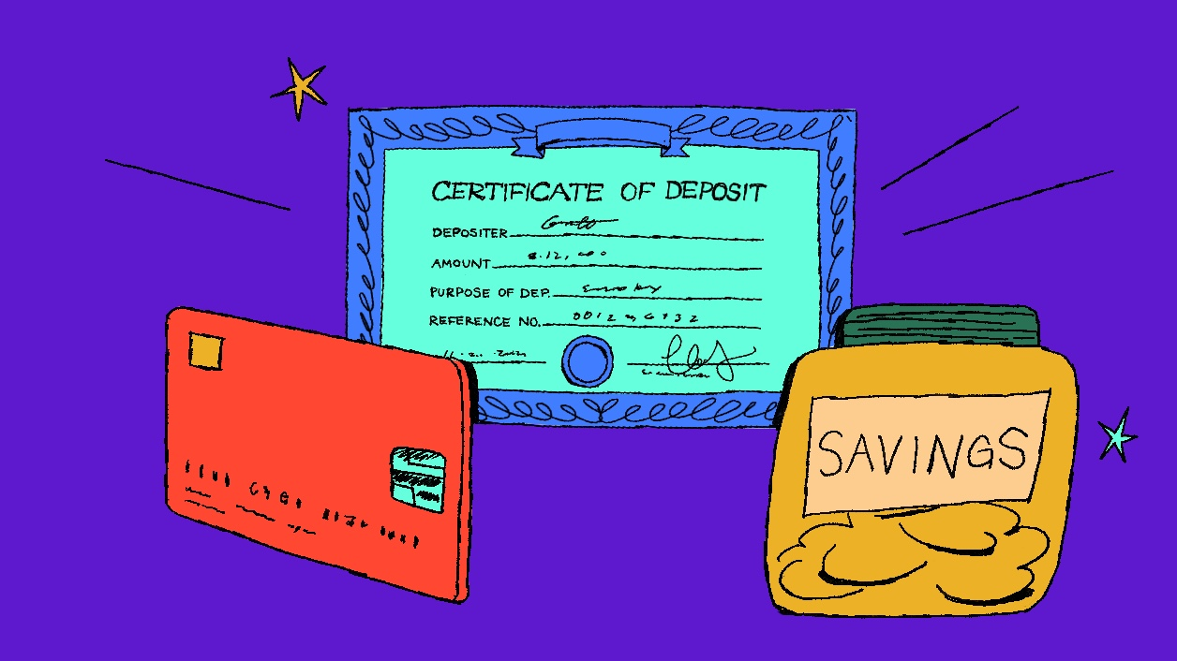
Conclusion
Notes:
Understanding how banks work is an important part of financial literacy. This includes knowing when and what financial products to use to grow money, borrow money, or simply keep money safe.
Ask the students if they have any questions about banking, accounts, loans, or interest.
You may want to offer to return if they want more information about a specific topic.

Slide 13
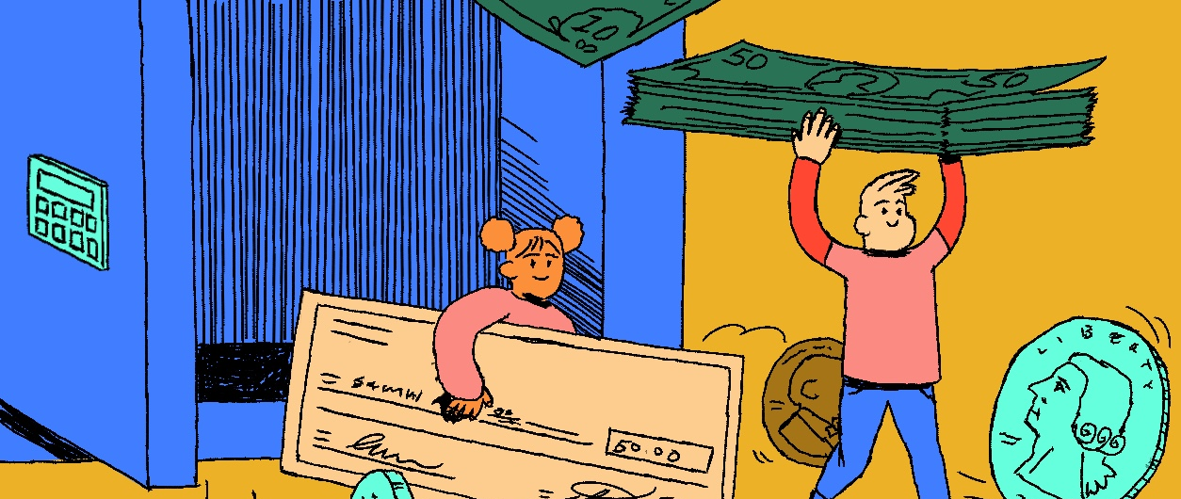
Thank you!
Your Logo Here

