Slide 1


Emergency Funds
Prevent a large-scale financial disaster.
Your Logo Here

Slide 2
Sponsor Intro
Hi, my name is [YOUR NAME].
I work as [JOB TITLE] at [NAME OF YOUR FINANCIAL INSTITUTION].
Your Logo Here
Notes:
Introduce yourself to the class and explain a little bit about your role. You could go over your typical day, some of the things your financial institution offers (products or services relevant to the class), why you sponsor Banzai for their class, or why you think financial literacy is important. Consider inviting the class to ask questions about you, your role, your FI, etc.

Slide 3
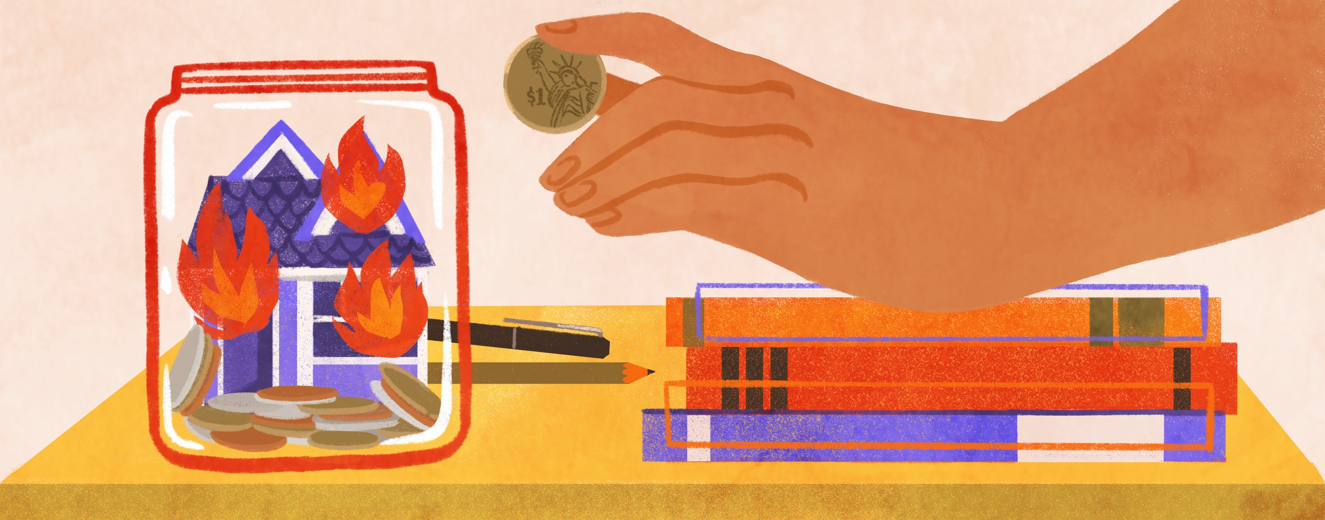
Emergency Funds
Notes:
Introduce the topic briefly. An emergency fund is a pool of money set aside to cover unexpected expenses or to cover regular expenses if your income suddenly changes (if you lose a job, get sick, etc.).

Slide 4

We’re going to discuss…
When to use your emergency fund.
How much should be in it.
Building an emergency fund.
Where do you keep it.
Ladder to Safety
Resources
Notes:
This slide serves as a table of contents and can be used to introduce the presentation. These are the specific topics you’ll cover in the order you’ll present them in.

Slide 5

Notes:
Emergency funds are essential to financial wellness. Ask the class why emergency funds are so crucial. The answer? Emergencies happen to everyone. These are unexpected costs that can put you in a terrible financial situation if you’re underprepared. In fact, emergency expenses are one of the main reasons people overdraw their accounts, go into debt, or withdraw from retirement savings before they’re retired.
An emergency fund is an amount of money that you set aside and ONLY use to cover unexpected expenses (or essential expenses if you lose regular income). Building and using an emergency fund effectively can help you avoid burdensome debt and negative impacts to your credit. Said another way, without an emergency fund, the ups and downs of life could keep you from reaching your financial goals.

Slide 6

When can I use my emergency fund?
Remember the 3 U’s.
Unexpected
Urgent
Unavoidable
Notes:
We know that an emergency fund is money set aside to help with emergencies—but what constitutes an emergency? Explain to the class that when an expense comes along that they’re tempted to use emergency fund savings for, it’s important to ask these three questions.
(1) Is the expense unexpected? Ask the class why that might be a consideration. If they’re reluctant to answer or need help, explain that expected expenses should be planned for. Car registration, for example, is a large expense that occurs every year. It’s wise to plan ahead for this expense and save for it. Ask the class for examples of expected expenses. What about unexpected expenses?
(2) Is the expense urgent? It’s possible that you’ll encounter an unexpected expense that you won’t need to pay for right away. In that case, you can save money to cover the expense rather than dipping into your emergency fund. Ask the class for examples of expenses that are unexpected but not urgent. You can provide an example, too: car repairs when you have backup transportation (bus, bike, carpool). You can ask them to consider urgent, unexpected expenses as well: your fridge breaks suddenly, you lose your job unexpectedly, unanticipated health care costs (like an urgent surgery or dental treatment).
(3) Is the expense unavoidable? Another way to think of this is whether or not the expense is necessary. Is there a way to get around paying for this emergency expense? Without going into debt, can you manage a way to avoid paying for it with your emergency fund? If so, leave your emergency fund alone. Ask the class to provide examples of circumstances in which they would have to use their emergency fund—this would be any unexpected, urgent, and necessary expense (regular expenses when you lose your job unexpectedly, new tire after a blowout when the car is your only way to get around, etc.).

Slide 7
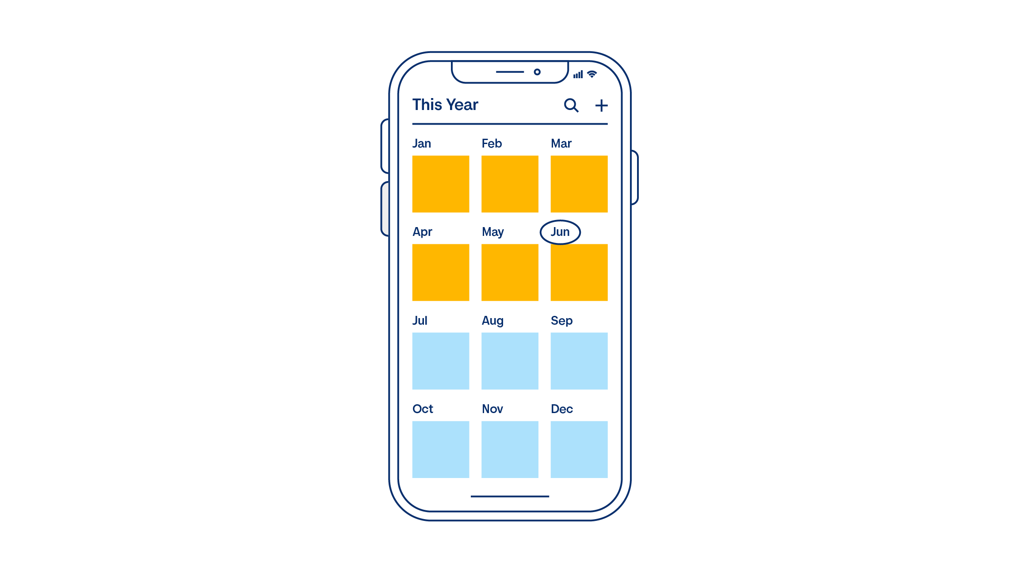
How much should I save?
Short-term goal: $500-1000
Long-term goal: 3-6 months of net income
Notes:
Explain to the class that it’s impossible to predict the cost of an unexpected expense, so how big an emergency fund should be is generally up to a few rules of thumb. To start out, it’s important to save at least $500 in your emergency fund— that’s enough to cover most car repairs and make a significant dent in other expenses.
A larger goal should be to save 3-6 months worth of regular net income—or at a minimum, the cost of essential expenses for 3-6 months. Ask the class why that might be. You can explain that not only will this create a sizable fund to pull from for one-time emergencies, it’ll create a cushion in the case of lost or reduced income.

Slide 8

Building an Emergency Fund
Budgeting
Saving
Kickstart Your Fund
Notes:
Tell the class that the first step to building an emergency fund is to create a budget. List your monthly income and all your monthly expenses, then divide your expenses into categories and designate money to each category.
If you have time, you can demonstrate how to create a budget with the Banzai Budget Calculator (https://teachbanzai.com/wellness/resources/ budget-calculator or hyperlinked in the slide). After you create your budget and know how much you have available to save, you then need to create a dedicated savings goal. You can add a designated category to your budget that’s specifically for your emergency fund. If you have other saving goals, you can still work toward them by splitting up your saving money into multiple categories—an emergency fund should not be combined with other savings. This is an amount of money that is set aside to *only* be used for emergencies.
There are also ways to kickstart your emergency fund. Ask the class if they can think of ways to quickly hit a short-term emergency fund savings goal. For example, they can sell things online (it’s amazing how quickly that can add up!). Another way to get money quickly could be taking on a part-time job, freelancing, or getting work in the gig economy to earn extra income

Slide 9
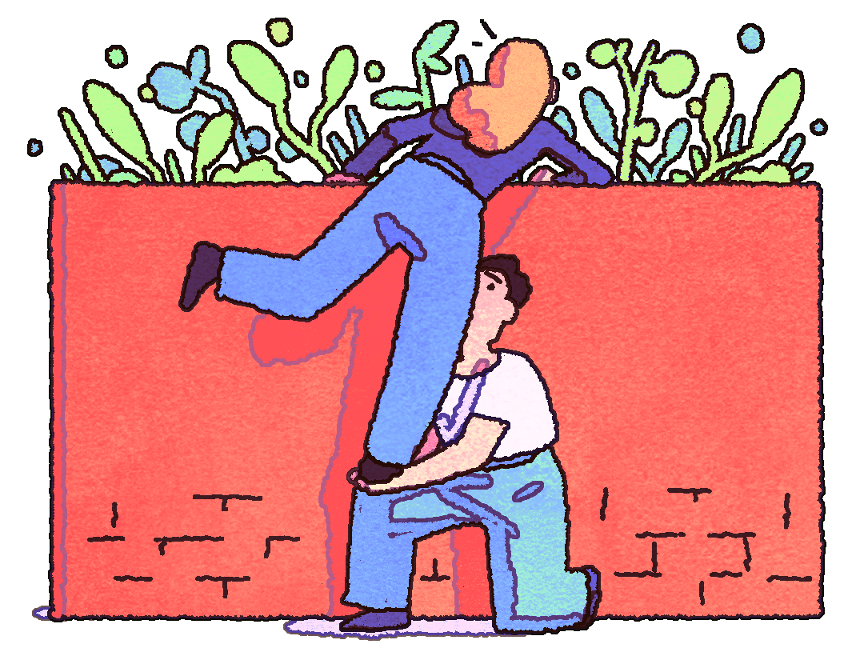
An emergency fund should be easy to access.
Notes:
Ask the class why it’s important for an emergency fund to be easily accessible. The answer is simple! You never know when you’ll face an emergency, and if you have an urgent expense, you’ll need access to funds right away. This means that it matters what type of account you use for an emergency fund.
*This is a good opportunity to discuss the types of accounts you offer at your financial institution and how they might work for an emergency fund.
A standard savings account is often a good place to store an emergency fund. Ask the class why this might be. The answer, of course, is that a savings account is easily accessible while still providing some interest. What could be a drawback of using a standard savings account? Some may argue it’s too accessible, which means it might be tempting to dip into it when you don’t actually need to.
You could also use a CD (certificate of deposit). Ask the class what a CD is? It’s very possible they won’t know. Explain that a CD is a product that many financial institutions offer that provides a bigger interest rate in exchange for leaving a deposit untouched for a predetermined period of time. In other words, the interest rate is much higher for a CD than a standard savings account (your money will grow faster) but you can only access the money after a set amount of time. Ask the class what are some pros and cons of using a CD for an emergency fund. They should be able to see that a CD is not easily accessible, and that’s a big no-go for emergency funds. But the higher interest rate will help them build the emergency fund faster.

Slide 10

Can you use CDs for an emergency fund?
Maybe...with laddering.
Notes:
While CDs aren’t easily accessible, their high interest rates are attractive. One way to use CDs for an emergency fund is to use a technique called laddering. This means to divide your emergency fund into several different CDs that mature at different times, so the money will be accessible in each fund at a different time. Ask the class if they think this is a good idea? Some considerations:
The funds aren’t so easily accessible that you’re tempted to use them for non-emergencies.
You still won’t be able to access the funds at any time.
You could keep some of the emergency fund in a standard savings account that’s easily accessible while laddering the rest in CDs to earn higher interest.

Slide 11

Prioritize:
Emergency fund or paying down debt?
Notes:
Ask the class: In the case of limited funds, what should be your priority: paying down debt or saving for an emergency fund? Debt can keep you from reaching financial goals or maintaining good credit, but without an emergency fund, you may need to use credit cards or loans in times of emergency. For that reason, it’s important to prioritize creating an emergency fund of at least $500-$1000 before aggressively tackling debt.

Slide 12


Resources
Emergency Fund Calc
Emergency Fund Coach
Notes:
Depending on class participation and discussion throughout the presentation, you may have extra time. These resources are helpful ways to further explore emergency funds; spend as little or as much time on these resources as makes sense.
The first resource, the Emergency Fund Calculator, estimates how long it may take to build a robust emergency fund based on income and a budget. You can demonstrate how this might work with a modest monthly salary (like $1500) or a realistic adult monthly income ($4,000 or so). You can also ask the class to participate by providing a number. Select if you’d like to save for 3- or 6-months worth of income and hit “next.” Enter an amount for current savings, you can enter anything from $0 up to the goal savings amount. Hit “next.” Finally, enter a realistic budget (you can get feedback on specific expenses from the class) and click “finish.”
The second resource is a much longer and detailed Coach session. You can make up answers, ask the class for feedback, or use these provided inputs:
Do you have any dependents? No.
Mortgage / Rent: $2000
Choose: I have another expense to add.
Utilities: $300
Choose: I have another expense to add.
Groceries: $500
Choose: I’m done, let’s move on.
Altogether, your monthly essential living expenses total $2,800. That sounds right

Slide 13
One Last Time!
Use the emergency fund when expenses are urgent, unexpected, and unavoidable.
An emergency fund should be accessible.
Robust savings goal? 3-6 months of income.
Questions?
Your Logo Here
Notes:
Here is one last opportunity to explain the importance of an emergency fund or go over any final details. The class may also ask you questions. You can guide the class by asking for questions relating to the presentation or any question regarding personal finance.

Slide 14
Thank you!
Your Logo Here

