Slide 1


Buying a Home
Mortgages Basics
Your Logo Here

Slide 2
Sponsor Intro
Hi, my name is [YOUR NAME].
I work as [JOB TITLE] at [FINANCIAL INSTITUTION].
Your Logo Here
Notes:
Introduce yourself to the participants and explain a little about your role. You could also go over some of the things your financial institution offers or your experience when it comes to helping people buy a home.

Slide 3

Buying a Home
Your Logo Here
Notes:
Buying a home is a huge part of the American dream, but there’s a lot that goes into the mortgage process. Today we’ll go over some specifics to help you understand and prepare for a mortgage application.

Slide 4
We’ll talk about…
The Basics
Down Payments & PMI
Types of Mortgages
The Process
Pre-approval
The Application
Closing
Notes:
This slide serves as a table of contents and can be used to introduce the presentation. These are the specific topics you’ll cover in the order you’ll present them in.

Slide 5
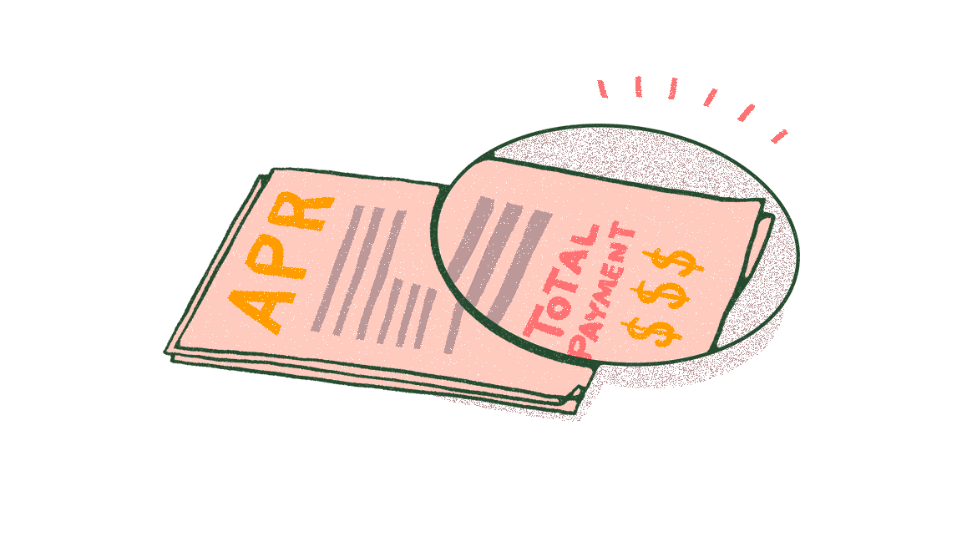
The Basics:
Mortgage terms
APR
Interest Rates
Notes:
There are a few basics you’ll need to understand before you begin the home buying process.
Mortgage terms: The mortgage term is how long a borrower has before everything must be paid back. The most common options are 15 or 30 year terms, but others may be available.
APR (Annual Percentage Rate): This number represents your yearly cost of borrowing. It accounts for interest, fees, points, and more. It’s a more accurate representation than just the interest rate of what you’ll have to pay.
Points: Also known as prepaid interest, points are the interest that you prepay when
you close. Buying points is a way to lower your interest rate. Each point costs 1% of your mortgage and often lowers your rate by 0.25%, though that amount is not guaranteed.
There are two types of interest rates:
Adjustable: Your rate will change with the market, meaning it could go up or down
throughout your mortgage term.
Fixed: Your rate will stay the same throughout your mortgage term, no matter how the market changes.

Slide 6

Down Payments and PMI
Notes:
One of the biggest hurdles to buying a home is the down payment. This is a percentage of the total home cost that you’ll need to pay upfront. The lowest amount you can pay depends on what kind of mortgage you are trying to get. For
example, an FHA loan typically requires at least 3.5% while a VA loan requires no down payment at all. Regardless of what’s required, the more you can pay, the better. Paying more means that you own more of your home, your mortgage payment will be smaller, and you’re better protected from becoming “upside down” in your home, or owing more than it’s worth. Depending on the type of mortgage you get, you’ll likely be required to purchase Private Mortgage Insurance (PMI) if you put down less than 20%. This will protect the lender in case you become unable to make your payments.

Slide 7
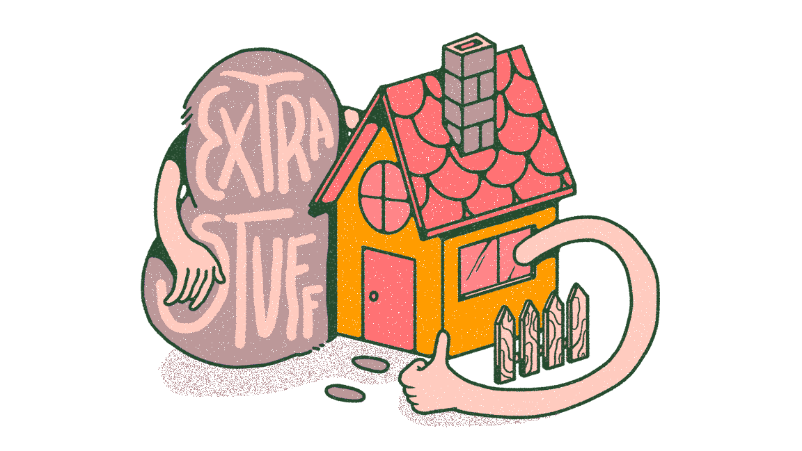
Types of Mortgages
Notes:
Let’s go over a few of the most common types ofhome loans.
Conventional mortgage: Not backed by the government. It will usually have fairly simple, straightforward terms and lower closing costs. However, you may have higher interest rates or need to pay a higher down payment (often at least 3-5%). This loan is usually best for people with strong credit, as it will affect your interest rate.
Government-backed loans:
FHA Loan: Backed by the FHA and meant for low to middle-income borrowers. It typically has a lower down-payment (usually 3.5%). You’ll need a credit score of 500 or higher to qualify.
USDA Home Loan: Backed by the US Department of Agriculture and only available in
certain rural and suburban areas. If your new home is in an eligible area and you meet income requirements (there are caps for how much you can make depending on the area), you won’t need to pay a down payment.
VA Home Loan: Backed by the US Department of Veteran’s Affairs and, thus, only active service members, veterans, and some spouses. Typically borrowers won’t need a down payment or mortgage insurance for this loan. Borrowers generally need a 650 credit score or higher to qualify.
Any questions about these types of mortgages or any others you may have heard of? If there’s time, send the Mortgage Type Activity that allows users to review the pros and cons of common types of mortgages.

Slide 8
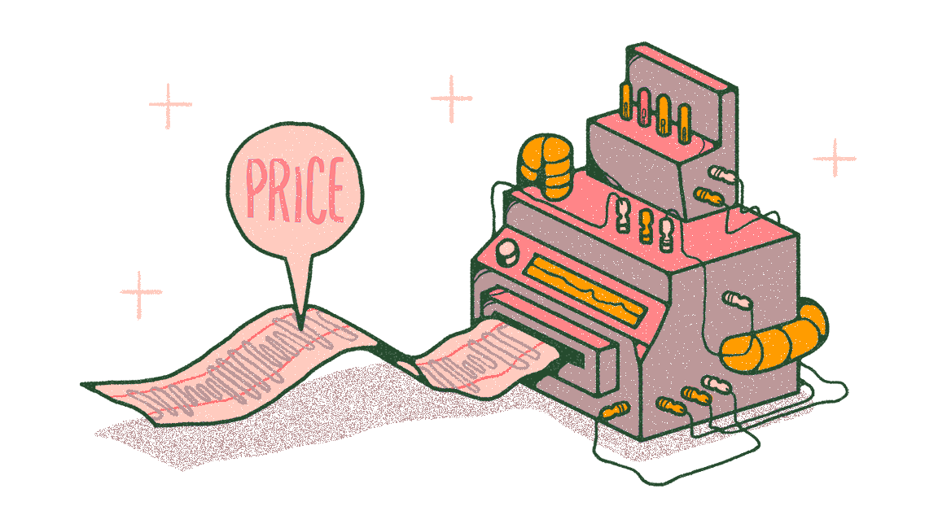
Get an idea of what you can afford.
Notes:
Now that you have a better understanding of how a mortgage works, let’s form a baseline for what you can afford.
Depending on time, send one of these resources:
Mortgage Estimation Calculator - Only takes a few minutes, allows users to get an idea of the total mortgage they can afford based on their monthly payment.
•
What Mortgage Can I Afford? Coach - Takes 5-10 minutes to complete, walks users through estimating what they can afford for their monthly payment, what that means for their total mortgage, and will review things like PMI and other basics.
Encourage participants to ask questions as they work through the calculator or Coach or after they finish.
You can use this initial estimate to help inform your search by taking it to housing sites. This will allow you to get an idea of how far your money will go in your desired area. If it isn’t quite as far as you’d hoped, you may want to make some adjustments to your budget or do some additional saving before you’re ready to take the next steps. Once you’re ready, there are a few more things you’ll want to consider before you begin serious house hunting

Slide 9
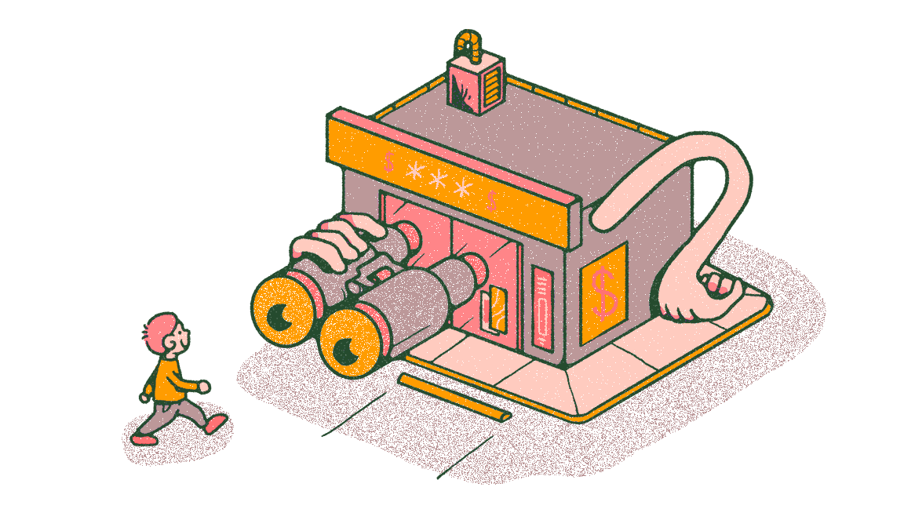
Pre-Approval
Notes:
A pre-approval is an agreement from a lender that, as long as specific conditions are met, you’ll most likely be approved to borrow a defined amount at a certain rate. In order to get pre-approved, you’ll have to fill out a mortgage application. If you are
pre-approved, you’ll be given a letter that you can show to sellers to prove that you are serious. It may be hard to get your offer accepted if you don’t have one so, when you’re ready to start your search, you should do this first. Your pre-approval
will usually be valid for 60-90 days.
Note: A pre-approval is not the same as pre-qualification. Pre-qualification can help you know whether you are on track to be approved or not, but won’t add as much leverage to your offer.

Slide 10
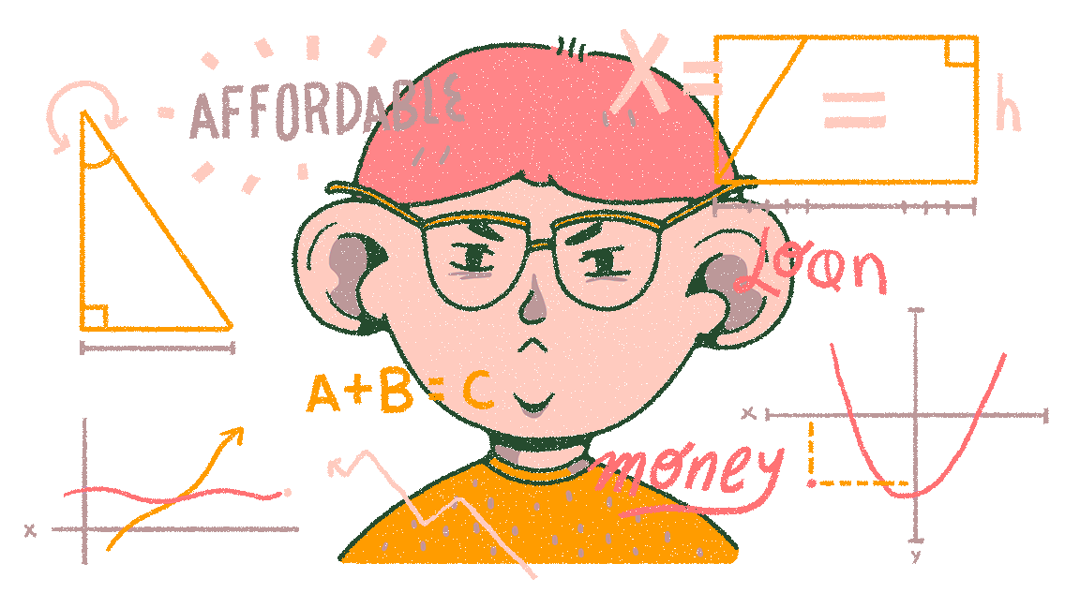
The Mortgage Application
Notes:
To determine if you qualify for a mortgage, the lender will need all of your (and your co-borrower’s, if you have one) personal and financial information, including bank statements, tax returns, pay stubs,and more. They’ll also consider various factors
such as your DTI (debt to income ratio: how much debt you have compared to how much income you have), LTV (loan to value: how much you’re borrowing compared to how much the house is worth), and credit score. To finalize everything, an underwriter will review your application, credit score, personal information, and previous pre-approval to give you one of four possible outcomes: approved, conditionally approved, suspended, or denied

Slide 11
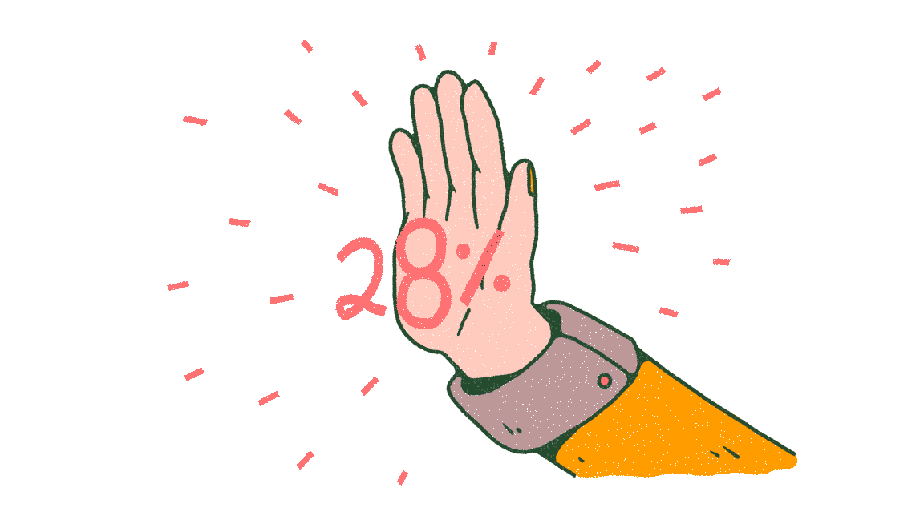
Improve your odds of approval.
Notes:
Boost your credit score. Get your report and check it, look for errors or places that you can make the biggest impact.
Lower your DTI by paying off/down as much debt as you can.
Save up for a higher down payment. The less risky you are, the better.
Look into a house that is less expensive. Even if you feel confident that you can make
payments for a house at the top of your price range, your lender may not agree.
Don’t make big purchases before you are approved, it can be a red flag to lenders that you aren’t careful with your money.
Any questions about how to improve your odds or the mortgage application process in general?

Slide 12
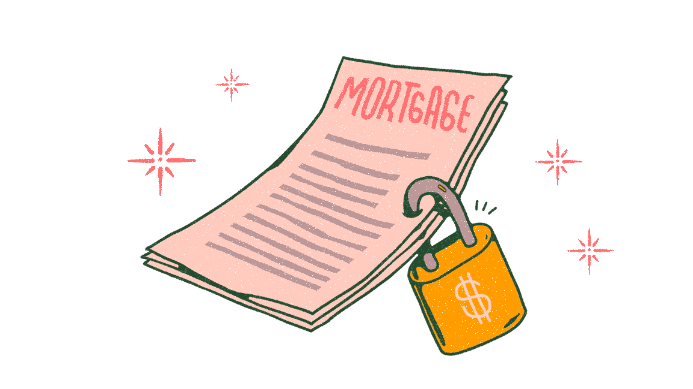
Closing
Notes:
Closing is when you seal the deal. At this stage, you’ll need to come prepared having reviewed the closing documents and, likely, with proof of homeowners insurance. If you agree to all of the terms, you’ll sign all of the documents to make everything official and pay your down payment, closing costs, and any pre-payments. Finally, when it’s all said and done, you’ll get the title and keys to your new home.

Slide 13
Getting a mortgage through us:
Notes:
Fill this slide in with any information you’d like to give the attendees about getting a mortgage through your financial institution. This can include websites to go to, specific tips, people to contact for questions, etc.

Slide 14

Review
The Basics
Down Payments & PMI
Types of Mortgages
The Process
Pre-approval
The Application
Closing
Notes:
Review the main points you discussed throughout the presentation.

Slide 15
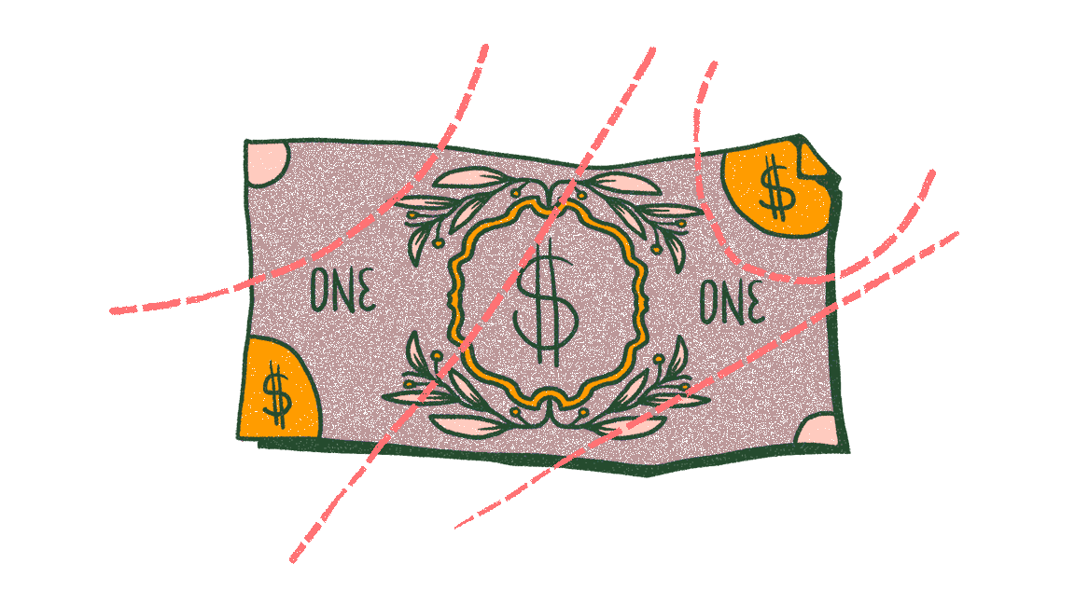
Buying a Home Collection
Notes:
Click on the collection and showcase a few of the resources available there (such resources could include the Buying a Home article, Credit Scores article, or Mortgage Affordability Calculator). Encourage the participants to ask questions. You may even offer your email so that participants can reach out to you after the presentation.

Slide 16
Thank you!
Your Logo Here

