Slide 1


Budgeting Basics
Give every dollar a purpose.
Your Logo Here

Slide 2
Sponsor Intro
Hi, my name is [YOUR NAME].
I work as [JOB TITLE] at [FINANCIAL INSTITUTION].
Your Logo Here
Notes:
Introduce yourself to the class and explain a little bit about your role. You could go over your typical day, some of the things your financial institution
offers (products or services relevant to the class), why you sponsor Banzai for their class, or why you think financial literacy is important.
Consider inviting the class to ask questions about you, your role, your FI, etc.

Slide 3
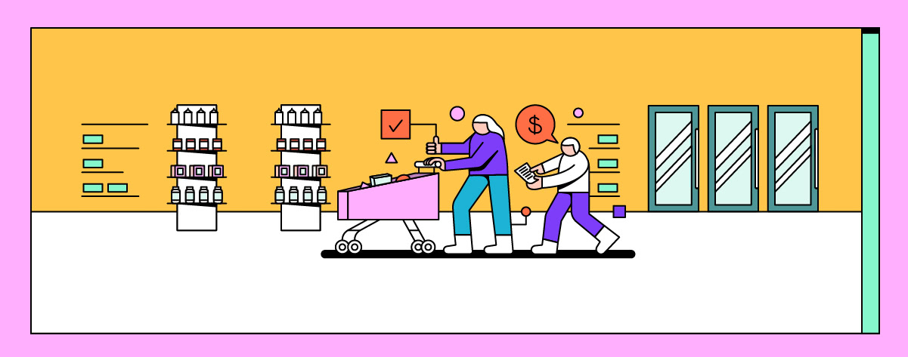
Budgeting
Your Logo Here
Notes:
Ask students what the word “budgeting” makes them think of. Does it have positive or negative connotations? Does it feel like something that
doesn’t really apply to them yet? Why or why not? Explain that budgeting definitely applies to them and, if done right, can be a big positive in their lives. Let them know that you’ll be discussing why that is and, by the end, they’ll have created a budget that they can use every day.

Slide 4
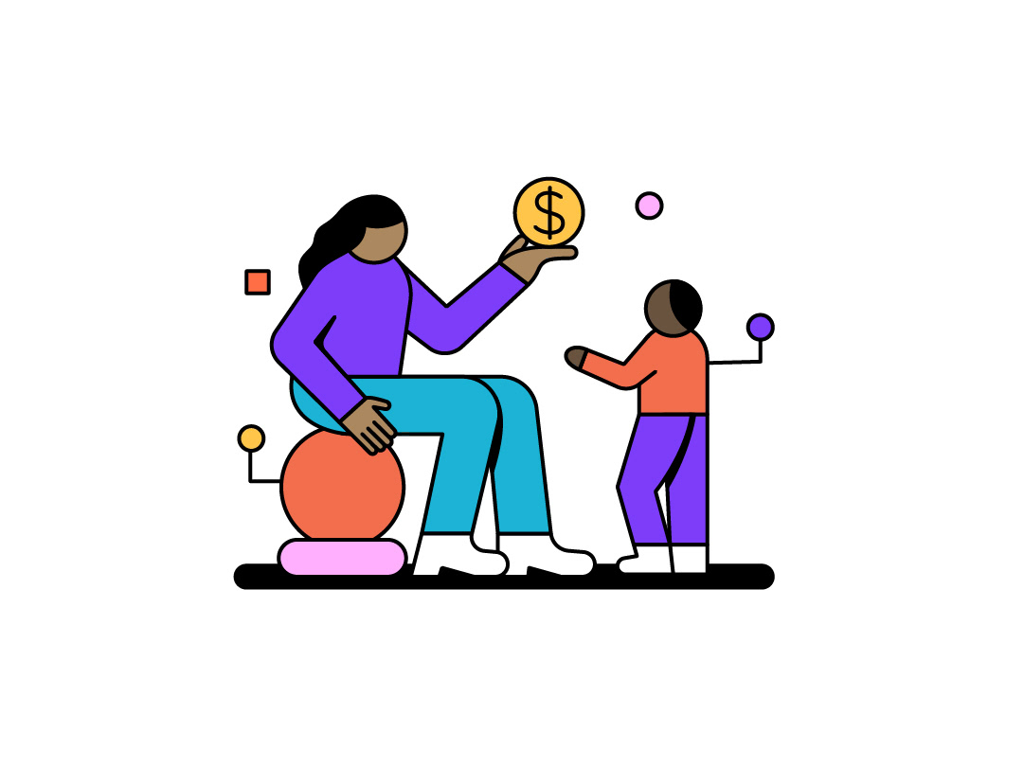
We’ll talk about…
What a budget is
Why you need a budget
Zero-based budgeting
Creating a budget
Notes:
This slide serves as a table of contents and can be used to introduce the presentation. These are the specific topics you’ll cover in the order you’ll present them in.

Slide 5

A budget is a plan for your money.
Notes:
Explain that a budget is a plan for what you’re going to do with your money. A budget outlines how much you want to spend and save in different areas. For example, you could decide that you want to spend no more than $100 a month on food, $50 a month on gas, save $30 a month, and so on.

Slide 6
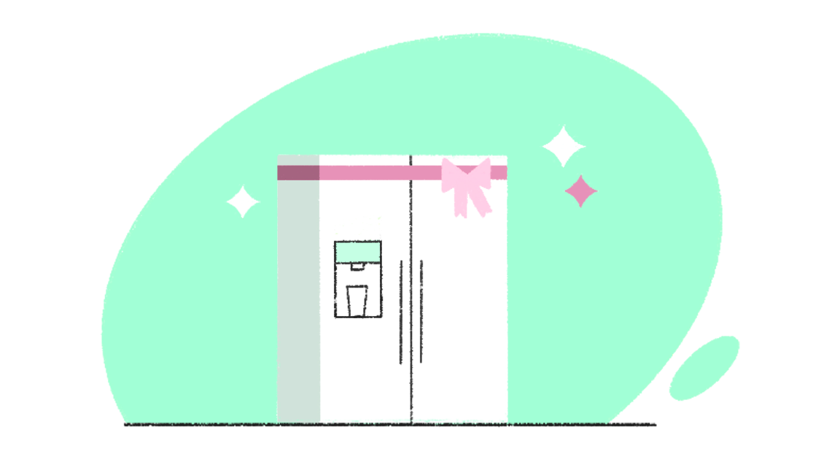
Why do you need a budget?
Prevent overspending
Reach savings goals
Notes:
It may be tempting to look at a budget as a series of restrictions that are only in place to ruin your fun. In reality, sticking to a budget is the secret to ensuring that you can buy the things you want, and it’s something you should start using right away
(1)Keep you from overspending - If you aren’t keeping track of where you spend your money, you won’t know how much you have and where your money is going. Without a budget, you may not see how expenses are adding up. Ask the class if they can think of any examples of small purchases that can add up to be more than you realize.
(2) Save for the things you want - Ask the class if they have financial goals. It could be something simple like new clothes or something bigger like a new phone or college tuition. Ask them to consider if they are working toward it or if it’s something for “someday.” Explain that having a budget can help turn that “someday” into something that they can reach.

Slide 7

Zero-Based Budgeting:
Income - Expenses - Savings = $0
Notes:
Zero-based budgeting is one of the most powerful budgeting methods. The idea is simple: income minus savings and expenses equals 0. In other words, every dollar of your income is accounted for and you have a plan for everything you earn.
Ask the students: Why do you think zero-based budgeting would be a benefit? (answers could range, but steer them toward things like then they know where their money is at all times, then you aren’t leaving anything unaccounted for, etc.)

Slide 8
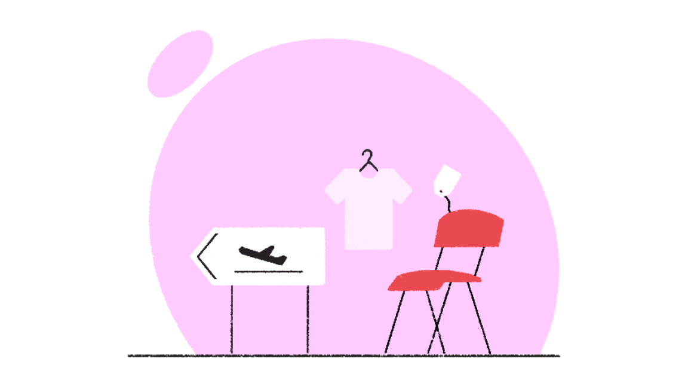
Your budget should be two things:
Flexible
Beneficial
Notes:
Creating a budget is all about setting limits and goals for yourself. Those limits can be generic or specific. For example, you can break everything
down into super-specific expenses (I only want to spend $20 a month on fast food, $50 a month on groceries), or you can keep it broad (I only want to spend $70 a month on food).
Regardless of the format you choose, a budget should be flexible. Things are always changing. Unexpected expenses are going to pop up, so you should have a plan for when they do. Your budget should help you with your goals, not add unnecessary stress. Make it as easy as possible to track your spending and set yourself up for success. Give a few suggestions for the students to track their money such as using a spreadsheet, apps, etc.

Slide 9

The 50/30/20 Rule
Needs: 50%
Wants: 30%
Savings: 20%
Notes:
The 50/30/20 Rule is a good way to create a baseline. It states that you should divide your income into three sections: 50% goes toward needs (or essential things that you cannot live without), 30% goes toward wants (fun things like eating out, buying new clothes, etc), and 20% goes into savings.
Example: Let’s take a look at what that would look like. Navigate to the 50/30/20 calculator. Take suggestions from the class for income and work through a few examples.
The 50/30/20 rule is just a starting point. You can and should adjust it to best suit your needs. For example, it’s possible that you won’t need to spend 50% of your income on needs, especially if you live with your parents and they pay for a lot of them (housing, electricity, etc.). Think about how you can move that money around. Don’t forget, though, that at least some of your money should go toward saving.

Slide 10

Budgeting Tips
Be honest about what is a need and what isn’t
Give your goals a specific number
Be realistic with your limits
Notes:
(1) Be honest - It can be easy to convince yourself that everything is a need, but there’s a difference between buying food, which you need to live, and going out to a nice restaurant every night. Ask the students to think of ways they can tell the difference between a need and a want.
(2) Goals - If you have something that you want to save for, give it a specific number. You don’t just want concert tickets, you want $150 so that you can buy tickets. Once you have a concrete goal, you can start making steps to actually reach it.
(3) Be realistic - We’d all like to imagine that we’ll only spend $5 a month on gas but, in practice, that’s pretty hard to make happen. If you want to challenge yourself to spend less so that you can save, that’s great! But make sure that you are being realistic about what you can practically

Slide 11

Create your budget
Notes:
Now it’s time for you to actually put it into practice. We’ll start with a baseline of the 50/30/20 rule and you can make adjustments as needed.
Depending on time, you can send one of these two links out to the students or tell them the URL to go to. The calculator will give them quick numbers while the Coach will take a little bit longer, but will walk them through more specifics about what fits into each category. Encourage students to write their budget out on a piece of paper or in a word doc when they are done. They should only need a few minutes to complete this task but you can always move on and encourage them to finish later if you are running low on time.
50/30/20 Rule Calculator
50/30/20 Rule Coach

Slide 12

Congratulations, you now have a budget! Any questions?
Notes:
Ask the students about their experience creating a budget. Were they surprised by how much they could save or how much they were spending? Did they need to make more adjustments than they expected? Prompt them with these questions and encourage them to ask their own.

Slide 13
A budget is a plan for your money.
A budget allows you to save for what you want and maintain control over your spending.
Zero-based budgeting means you track all of your income, expenses, and savings.
The 50/30/20 rule can be a good place to start when making a budget.
Your budget should be flexible and beneficial.
Your Logo Here
Notes:
Go over all of the major points from the presentation, remind them why budgets are important and why they should incorporate one into their lives.

Slide 14
Thank you!
Your Logo Here

