Slide 1
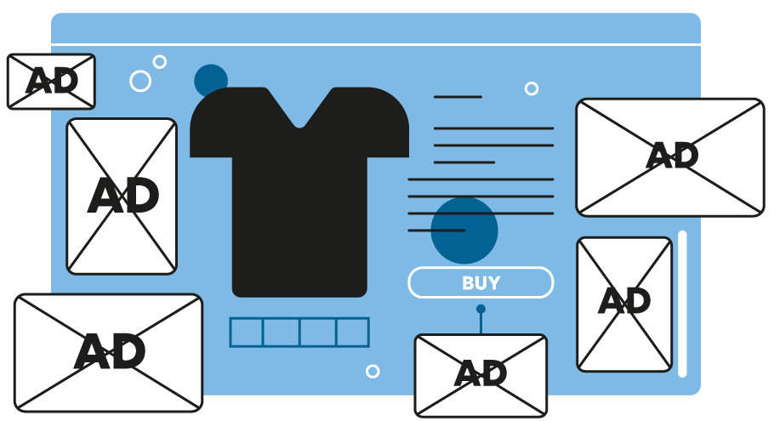

Be Mindful of Your Digital Money
Ages 13-18
Your Logo Here

Slide 2
Sponsor Intro
Hi, my name is [YOUR NAME].
I work as [JOB TITLE] at [FINANCIAL INSTITUTION].
Your Logo Here
Notes:
Introduce yourself to the class and explain a little bit about your role.
• Go over a typical day in your position and what products or services your institution offers.
• Explain why you sponsor Banzai.
• Feel free to invite the class to ask questions about you, your role, your financial institution, etc.

Slide 3
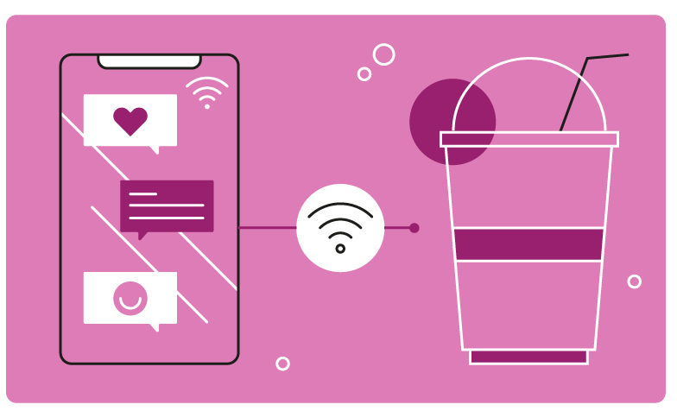
Be Mindful of Your Digital Money
Notes:
Introduce the topic briefly. Start by asking how much the students understand about the dangers of transferring money digitally and then ask the students how often they use payment apps like Zelle, Venmo, etc.
Explain that payment apps such as these have hidden dangers in them that put anyone at risk of losing more than they anticipated. Ask the students if they have lost money from one of these apps because of a scam or a simple typing mistake.

Slide 4
Presentation Overview
What Is a Digital Wallet?
Using Peer to Peer Payment Apps?
Common Peer to Peer Payment Scams
Investing Apps
Common Cryptocurrency and Investment Scams
How to Keep Your Money Protected
Resources
Conclusion
Your Logo Here
Notes:
This slide serves as a table of contents that introduces the presentation. These are the specific topics you’ll cover in the order you’ll present them in.

Slide 5
What Is a Digital Wallet?
Digital Wallets
Your Logo Here
Notes:
Explain that digital wallets are online payment tools that are usually in the form of an app.
Digital wallets link your payment methods—credit cards, debit cards, or other details from your connected bank account to the vendor with which the transaction is being made.
They enable online purchases, contactless in-store payments, and cashback and are accepted at most retailers. Apple Pay, Google Pay, Samsung Pay, Venmo, Zelle, and PayPal are some examples of a digital wallet.

Slide 6
Using Peer to Peer Payment Apps
Think before you send
Triple check for typos
Use passwords
Your Logo Here
Notes:
Ask students if they know what a P2P Payment App is. If they’re not sure, Explain to the students that Peer to Peer Payment Apps are considered digital wallets. And since they contain sensitive assets and information, they should be used with caution.
Think before you send- Think rationally about who you’re sending money to. Whether you’re sending money to a friend or a merchant, it’s important to make sure the receiver is who they say they are. Explain to the students that it’s important to know that you’re sending the money to the correct profile because when it’s gone, it’s gone—there’s nothing you can do to get the money back.
Triple check for typos- QR code scanners are often embedded into apps to prevent the flawed human nature of typing a user’s name or profile incorrectly. If you’re unable to scan a code to find a profile, be sure to triple check with the fund’s receiver that the account name you typed is correct.
Use passwords- There is a lot of sensitive information in digital wallets. If someone were to get access to it, they could transfer money to themselves or take part in credit card or debit card fraud. It’s important to protect all digital wallets with a password or any other form of verification.

Slide 7
Common Peer to Peer Payment Scams
The accidental payment
The falsely legitimate profile
A call or text for help
Your Logo Here
Notes:
Share with students some of the following peer to peer payment app scams.
The accidental payment: Scammers will “accidentally” send you money using stolen funds—funds that will eventually be flagged as fraudulent. Before they’re flagged, scammers will reach out to the victim and ask to have that money sent back. Let’s say you do send the funds back without verifying with the provider, then you could be down that same amount of money when the system catches on to the fraudulent money and flags it. Once the accidental payment is returned, the scammer will leave with the money and the original payment (now in the victim’s account) will be flagged. Tell the students that IF a random person ever requests to have funds returned to them, contact the provider first and see if they can help you take care of the matter before trying to send the funds back.
The falsely legitimate profile: Some people use business names as their account or profile by changing a letter or two. This means any time a buyer doesn’t double-check for typos, they could be accidentally sending the money to another person with a similar account name.
A call or text for help: Other scammers will tug at the emotions to try and get your money. For example, let’s say you get a text from a “friend” or a “friend of a close relative” asking for money to help themselves or a loved one.
You send the money and it turns out the person wasn’t really who they said they were.

Slide 8
Investment Apps
What are investment apps?
Crypto wallets
Do your research
Your Logo Here
Notes:
What are investment apps: Explain to students that apps like Robinhood, Acorns, Invstr, etc., are considered online investment platforms that require you to share bank account information or more personal info to set up an account. Ultimately apps like this hold on to specific assets like soon-to-be-invested money or an already vested balance from an investment that’s been made.
Crypto wallets: Crypto wallets are a type of online app that holds on to an individual’s keys or passwords used specifically to access their cryptocurrencies. Investment apps that offer crypto will manage a crypto wallet for you.
Do your research: Because investment platforms and crypto wallets are known to ask for and keep sensitive data at account setup, it’s important to research the app or apps that you’re thinking of getting involved with to make sure they’re legit.

Slide 9
Common Cryptocurrency and Investment Scams
Fake Apps
Giveaway Scams
Fake Celebrity Endorsements
Your Logo Here
Notes:
Ask the students if they’ve ever heard of ways someone has scammed others by using investments or cryptocurrency? Tell them that this particularly has become a huge problem as of late and it’s important to stay aware of some of the techniques.
Fake Apps: You might be surprised at the number of fake apps that are available for download on Google Play or the Apple App Store. Though these apps are usually found and removed quickly, it doesn’t mean that they aren’t impacting thousands before they’re discovered.
Giveaway Scams: This type of scam usually involves someone offering to match or multiply the cryptocurrency that’s sent to them. Clever wording can fool people into transferring funds quickly so as to not miss a “once-in-a-lifetime opportunity” to double their money fast.
Fake Celebrity Endorsements: Crypto scammers often create flashy websites that seem sophisticated enough to trust. On top of that, they often list endorsements on their websites from trusted business people, celebrities, influencers, etc.

Slide 10
How to Keep Your Money Protected
Watch out for
Promises of guaranteed returns
Whether or not they’re registered with the SEC or FINRA
An offer of free money, etc.
Your Logo Here
Notes:
Inform students that certain aspects of a supposed bargain are huge red flags.
For example, never trust apps that guarantee that your money will be returned or doubled. The reason why this in particular is a red flag is because a huge part of investing is not knowing if your investments will make you money.
Explain that the SEC or US Securities and Exchange Commission and the FINRA (Financial Industry Regulatory Authority) are like the federal government of all publicly registered investment companies. All SEC-registered apps have to abide by certain financial requirements, including acting as fiduciaries or an insider expert that’s federally required to put your best interests first while handling your money.
Tell the students that if they ever need to research if an app is legit, go to sec.gov and search the app or company’s name in the EDGAR database or visit brokercheck.finra.org.
Never accept or fall for the offer of free money. Whether this is cash or cryptocurrency, it doesn’t matter. Any opportunity that offers free money, especially one involving investing, is likely to end up being fake.

Slide 11
Resources
Course: Internet Safety
Coach: Are you Cyber Safe? For Teens
Article: Protect Yourself Online
Worksheet: Digital Money Management
Your Logo Here
Notes:
Internet Safety is a 40 minute Course created to help students master cybersecurity skills as they navigate a hypothetical social media app called Cybr.
Are You Cyber Safe? For Teens is a 10 minute Banzai Coach Session that lets kids test their cyber safety smarts with an interactive simulation.
4 Tips for Using Peer-To-Peer Payment Apps demonstrates how anyone can become more careful while using peer-to-peer payment apps.
Protect Yourself Online is an article that walks students through all the ways they can stay safe online.
This worksheet helps students get a hands-on perspective of what tricks they might come across online and how they can protect their money.

Slide 12
Conclusion
Do you understand the importance of keeping your money safe?
Your Logo Here
Notes:
Ask the students
If they understand the importance of keeping their money safe?
What they plan to do differently now that they know the dangers?
What do you plan to do differently now that you know the dangers?
*This is a great opportunity to ask the audience to fill out the handout provided in this file.

Slide 13
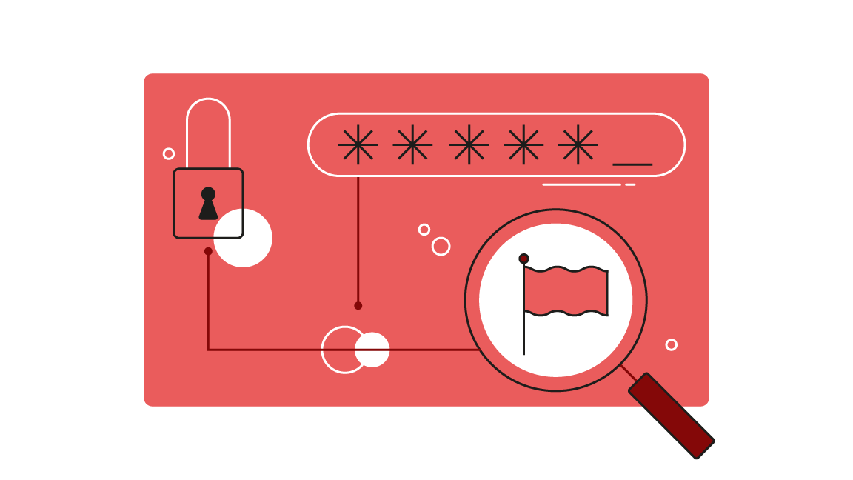
Thank you!
Your Logo Here

