Slide 1


The Basics of Saving
Your Logo Here

Slide 2
Sponsor Intro
Hi, my name is [YOUR NAME].
I work as [JOB TITLE] at [FINANCIAL INSTITUTION].
Your Logo Here
Notes:
Introduce yourself to the class and explain a little about your role. You could go over your typical
day, why you sponsor Banzai for their class, why you think financial literacy is important, or some
things your financial institution offers.

Slide 3
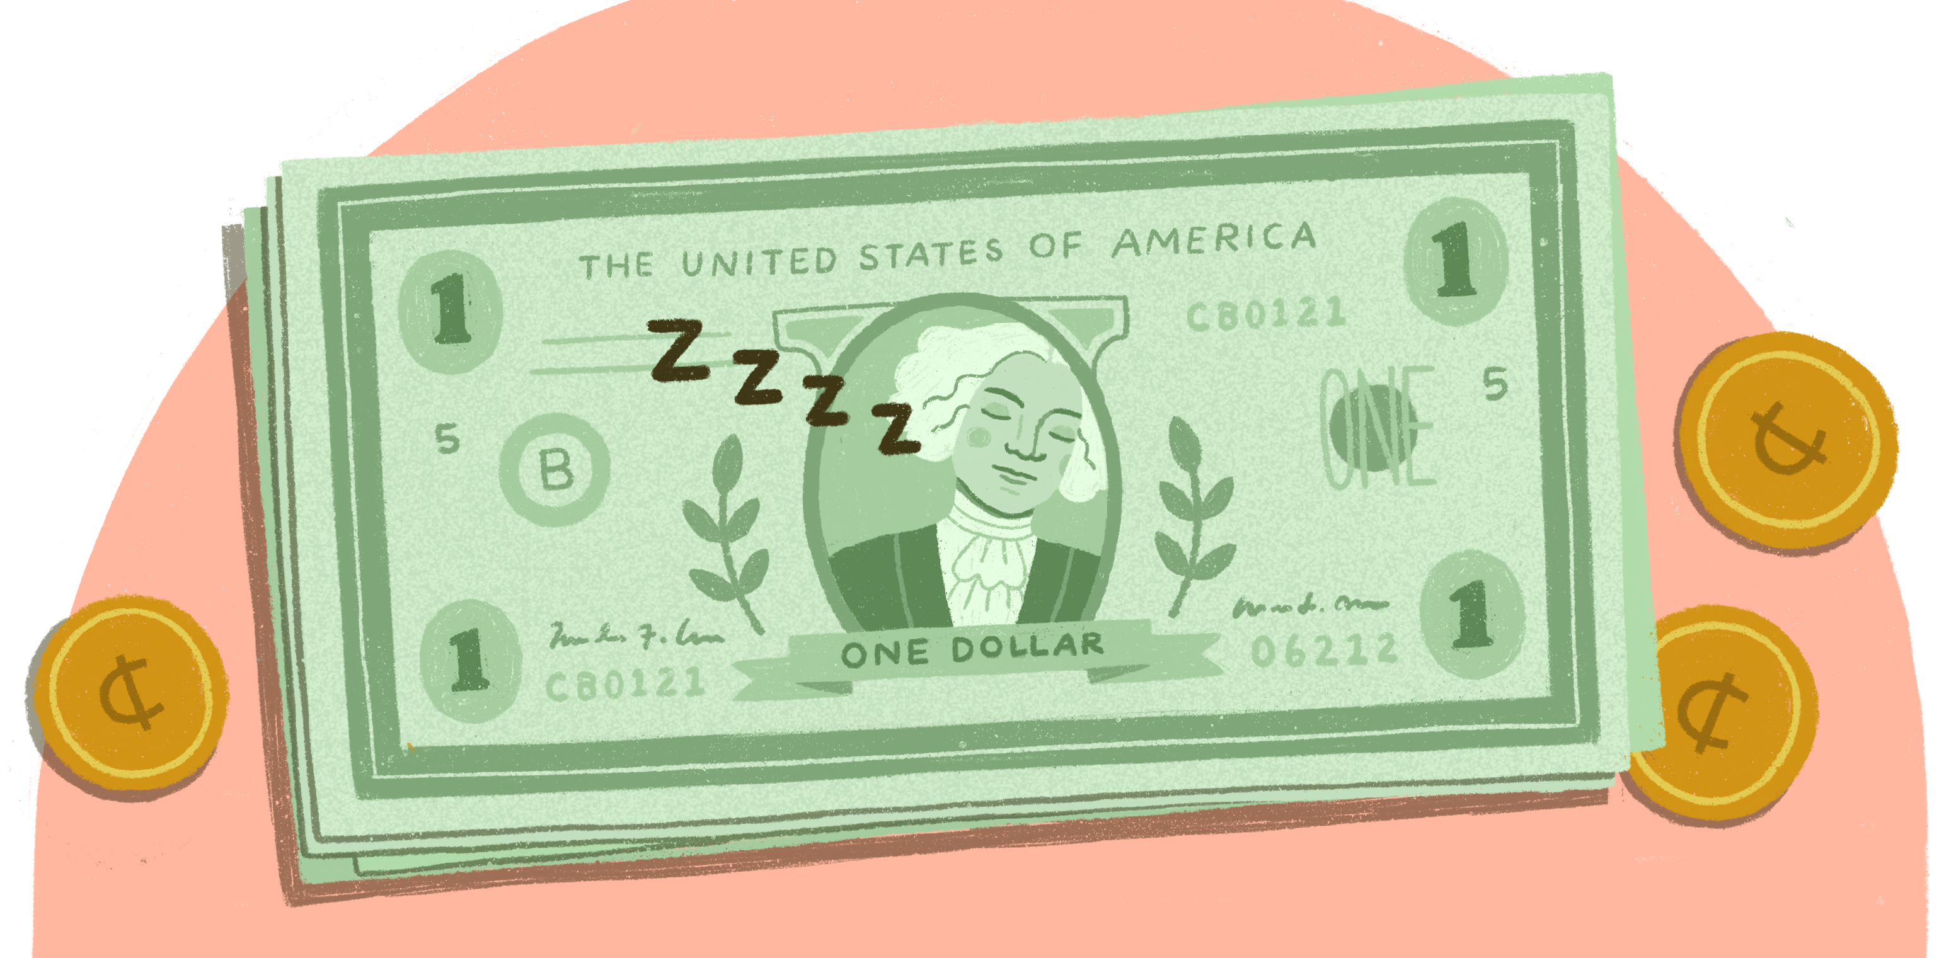
The Basics of Saving
Your Logo Here
Notes:
Saving is an essential part of creating a budget and setting yourself up for financial success. And
the best part is that you’re never too young to start! Today we’ll go over all the basics of savings—
some things may surprise you.

Slide 4
We’ll talk about…
Why you should save
Saving with a purpose
Goals
How to save
Notes:
This slide serves as a table of contents and can be used to introduce the presentation. These are
the specific topics you’ll cover in the order you’ll present them in.

Slide 5

Why is saving important?
Notes:
Saving is choosing not to spend some money now so that you can use it for something else in the
future.
Ask the students why they think saving is important. Steer them toward the idea that saving allows you to gather enough money to buy something big that you wouldn’t be able to buy otherwise. Help them brainstorm some ideas for what that could be (a game, a bike, etc.).
You can also touch on the dangers of not saving. Explain that if you never save any money, it will be really difficult or impossible to afford expensive things. And if you don’t save up an emergency fund, you could be in big trouble if something unexpected happens, like an accident or a natural disaster.

Slide 6
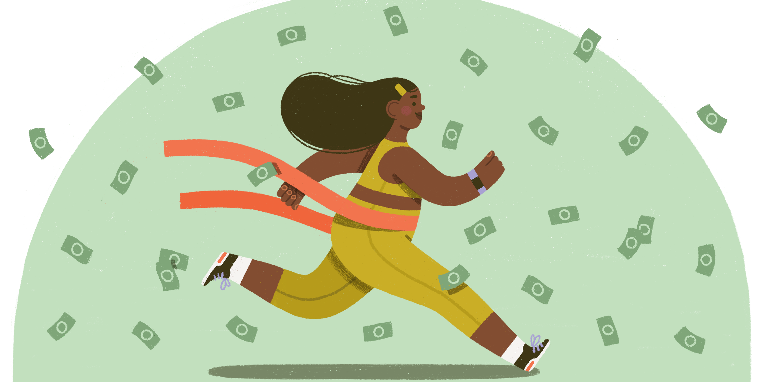
Save with a purpose.
Notes:
The best way to save is to work toward a goal. Don’t think of it as putting money away for no
reason. Saving will be much easier and more effective if you have a specific purpose in mind.
That purpose should have a fixed dollar amount and a timeline.
Instruct the students to get out a piece of paper and write down 1 or 2 things they’d like to save for
and a guess at the cost (you can also ask the students to think of goals if they don’t have paper).
Give them a few minutes to think and answer. You’ll probably need to help students come up with
ideas and estimate costs. Once the class finishes, ask a few students to read their goals to the class.

Slide 7
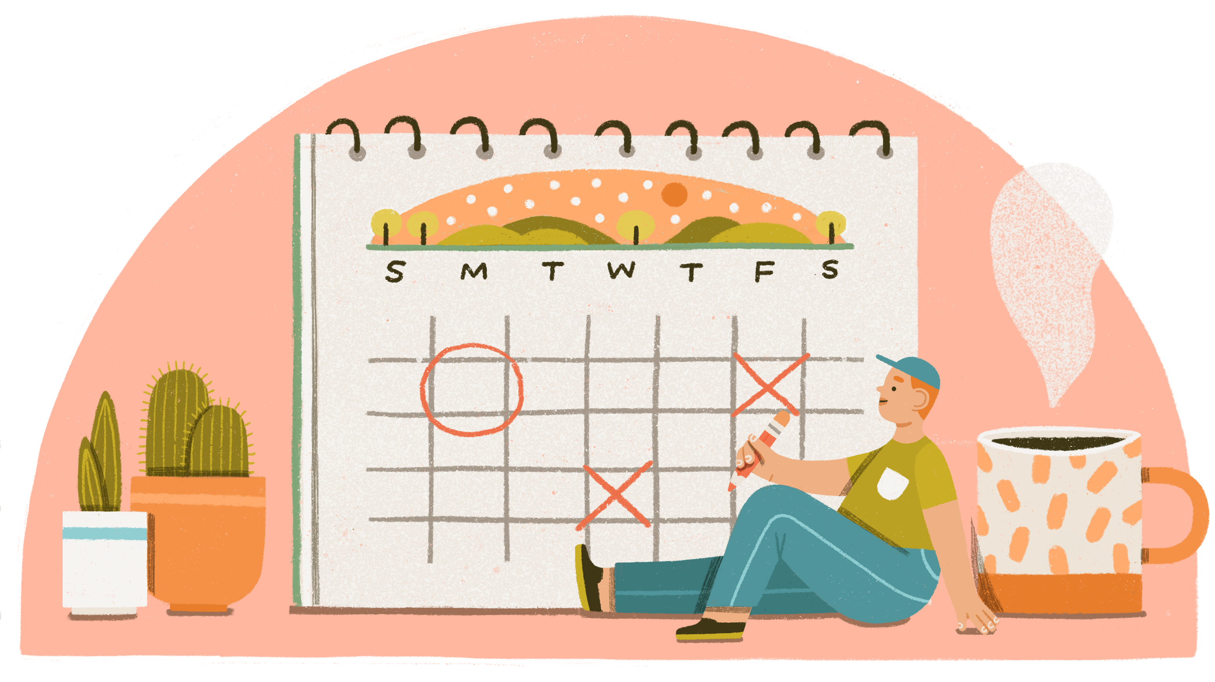
Saving Timelines
When do you want it?
What’s realistic?
Notes:
Ask yourself two questions: when do you want to reach your goal and what’s realistic? You may
want to reach it by tomorrow, but you need time to save. Consider whether your goals are short
or long-term.
A short-term goal will take a few months to years to save up for. Most of the things on your lists are probably short-term goals. Let’s walk through an example to practice creating a timeline:
Hank’s goal is to buy a $90 bike. He gets $10/week in allowance. How much would you suggest
he put into savings? Walk through how different amounts would impact his timeline (ex: $5/week
means he would save $90 in 18 weeks). What if Hank started a window-washing business and earned an extra $5 each week? How would that change things?
Give the students a few minutes to create their own timelines. Help anyone who gets stuck.
A long-term goal takes a really long time, sometimes decades! Long-term goals could be things
like buying a house, creating a retirement fund, or saving for college. Encourage the students to
think of one long-term goal.

Slide 8
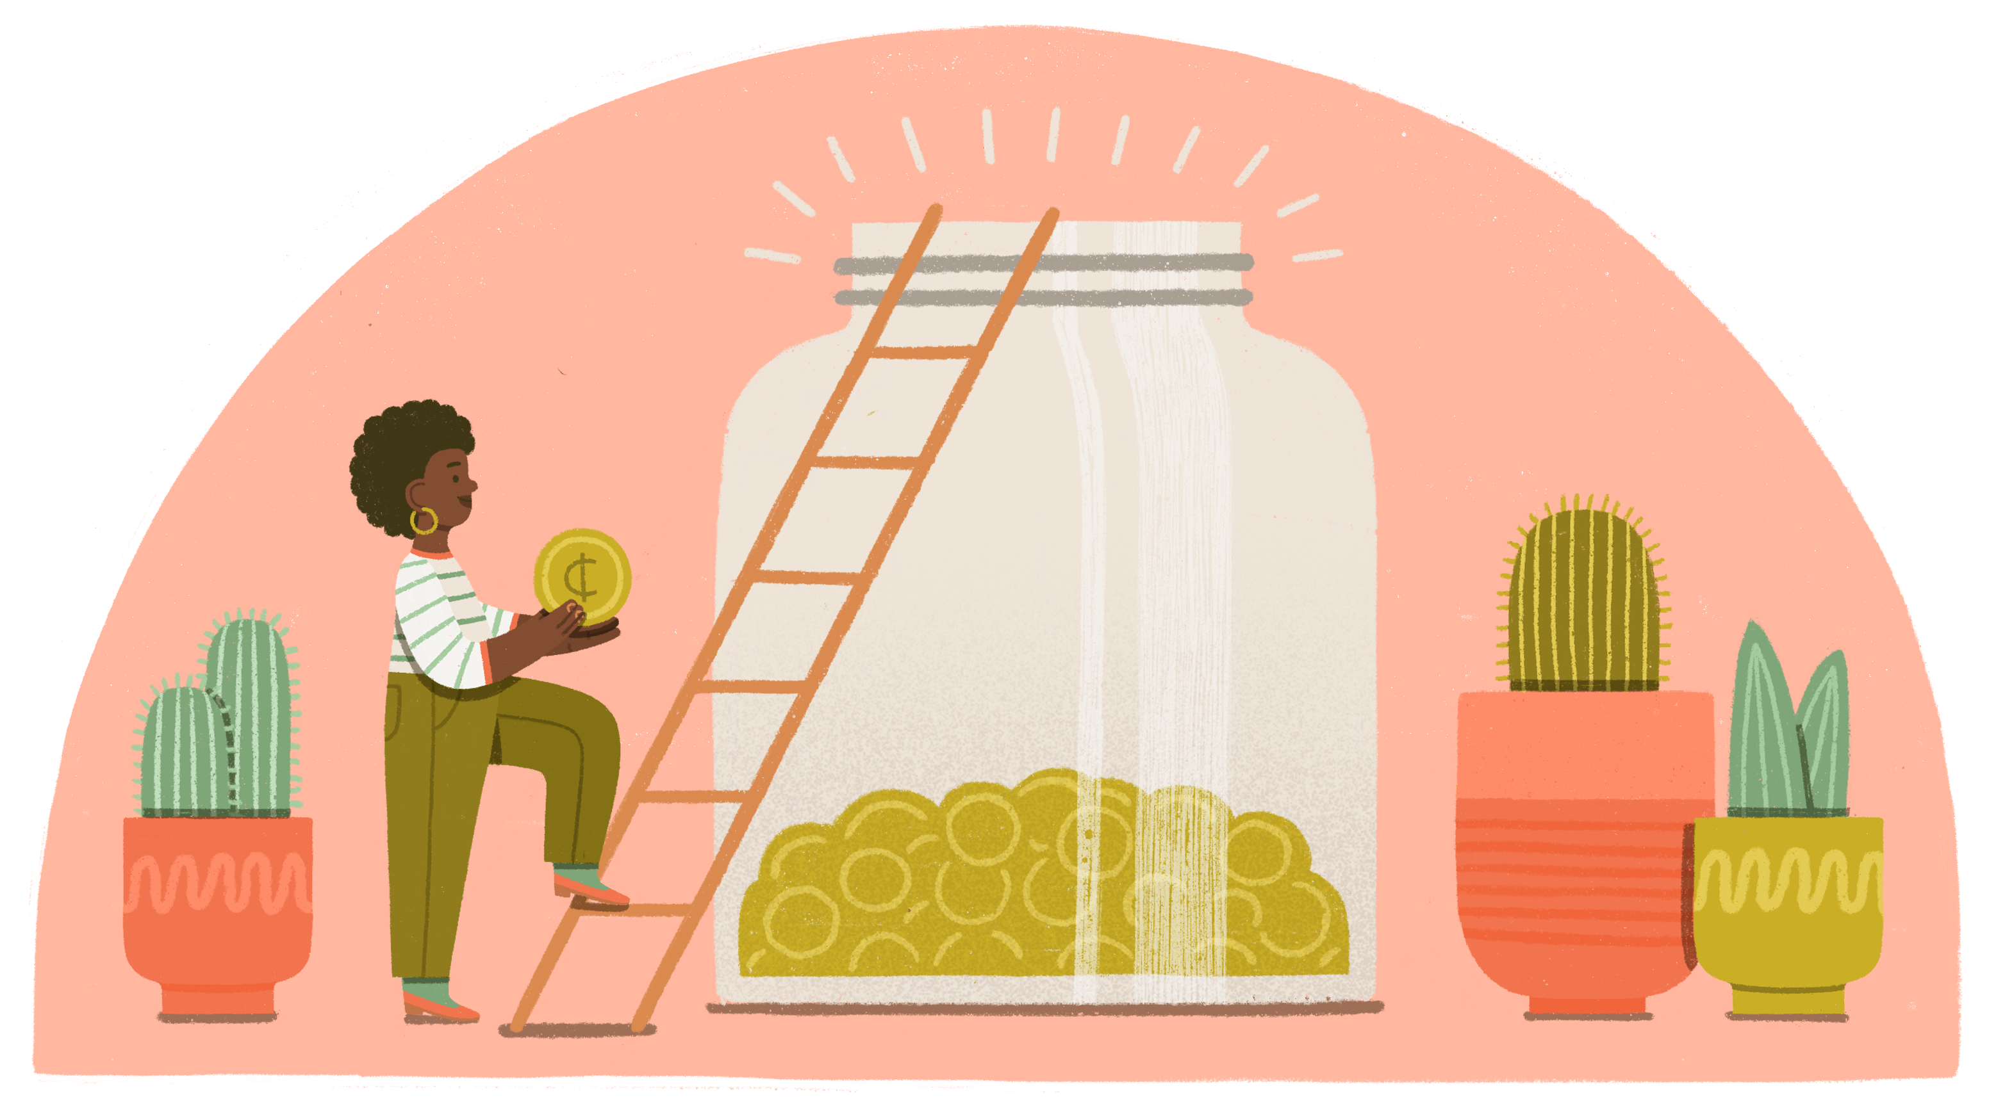
The 3 Jar System—one jar for…
Spending
Saving
Giving
Notes:
Now that you have your goals, you need a way to reach them. The 3 Jar System is a great way to get started with budgeting.
Every time you earn money, you divide it up into three jars: one for spending, one for saving, and
one for giving. You can dip into the spending jar whenever you want. The giving jar is for donating.
You can use it to support a charity you like or a family in your neighborhood. The savings jar is
where you put all of the money that you’re saving toward your goal. Keep the jars somewhere you
can see so that you remember to save.
Ask the students to imagine that they got $20 for their birthday and think about how they would
divide it up. Demonstrate an example ($5 into spending, $5 into giving, and $10 into saving) and
ask students to share other options. Note that deciding how to divide the money up can be tricky.
The next strategy can help with that.

Slide 9
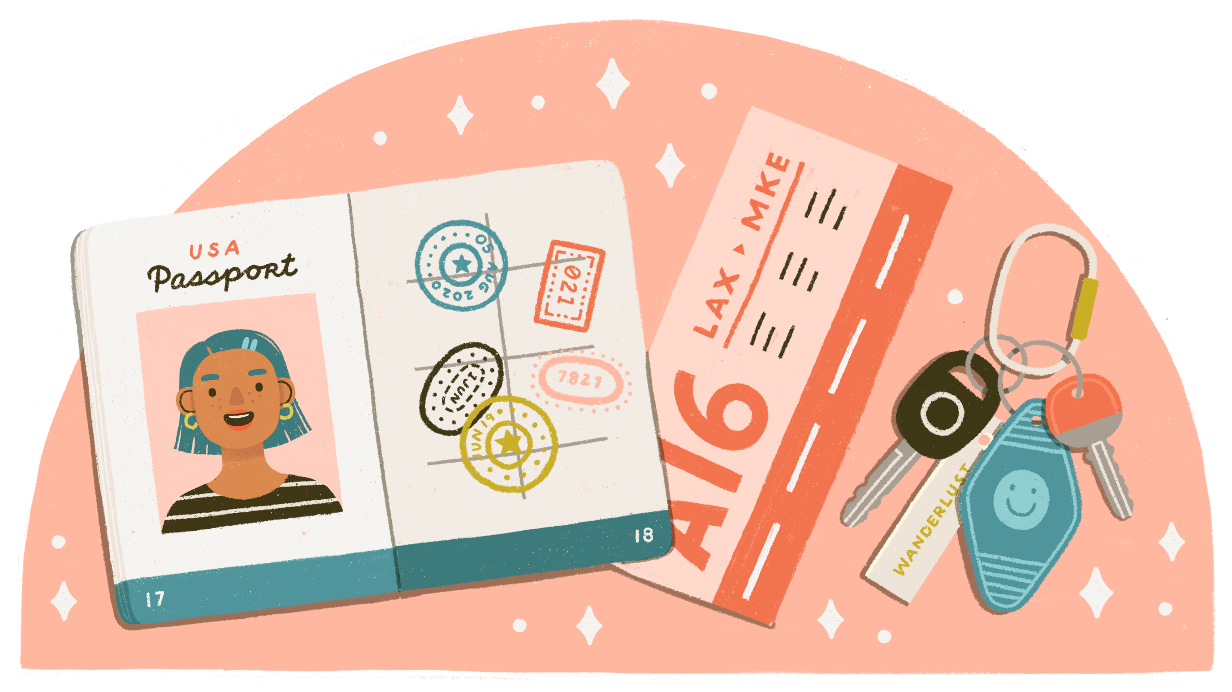
The 50/30/20 Rule
50% to needs
30% to wants
20% to savings
Notes:
The 50/30/20 rule is a popular strategy that helps you know how to divide your money.
50% of your money goes toward needs like food or clothes, 30% goes toward wants like treats at
the grocery store, and 20% goes to saving.
So, in our $20 example, you would put $10 toward needs, $6 toward wants, and $4 toward savings.
But, if you don’t have to pay for a lot of your needs, you may be able to save even more. Remember,the more you save, the sooner you’ll reach your goal!
Ask the students for more dollar amount examples and help them practice breaking it up with the
50/30/20 rule. For example: $10 would be $5 for needs, $3 for wants, and $2 for saving.

Slide 10
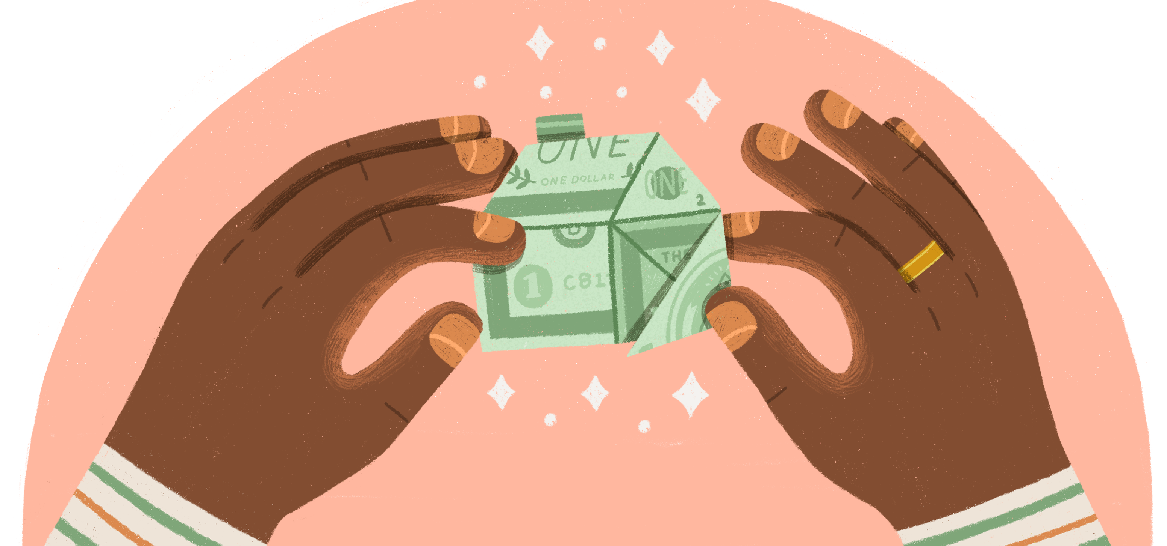
Savings Accounts
Notes:
There are lots of options for where to keep your savings. The three jar method recommends starting with jars, but you may also opt for a wallet or drawer. If you want to get serious about saving, the best place is a savings account at a bank or credit union like [your financial institution].
Savings accounts allow you to make sure your money is safe. This is because of the NCUA or FDIC,
which are government agencies that protect almost every financial institution. If anything were to
happen to your money, the government would pay it back to you, up to $250,000! If something
happens to your money that you keep in a jar, there’s no guarantee you’ll get it back.
*Note: there’s a slide later in this presentation that you can edit with the details of your Financial
Institution’s saving account options. You may consider going over those specifics then.

Slide 11

Interest
Notes:
The best thing about keeping your money in a savings account? Interest! Interest is money that
the financial institution pays you. You don’t have to do anything and your savings will grow! Interest works as a percentage. So the more money you have in your account, the more you’ll earn.
Show how interest works by opening the Savings Calculator in another tab. Tell the class that the
darker part of the graph represents interest and point to the”interest earned” number along the
bottom bar. Take suggestions from the class as you adjust the sliders to show how big of an impact
interest can have.

Slide 12
Savings accounts at [your institution] for YOU:
Fill
These
In
Notes:
Go over the savings accounts at your financial institution that would apply to these students.
Explain the process to open one.

Slide 13
Review
The importance of saving
Saving with a purpose
Creating a saving goal
Saving strategies
Savings accounts
Notes:
These are all the topics you discussed. Ask for questions.

Slide 14
More to see!
Opening Your First Account Article
50/30/20 Rule Calculator
Saving with a Purpose Coach
Notes:
If there’s time, open up a few of these resources and go over them with the students. If not, encourage students to look at these resources later.

Slide 15
Thank you!
Your Logo Here

