Slide 1
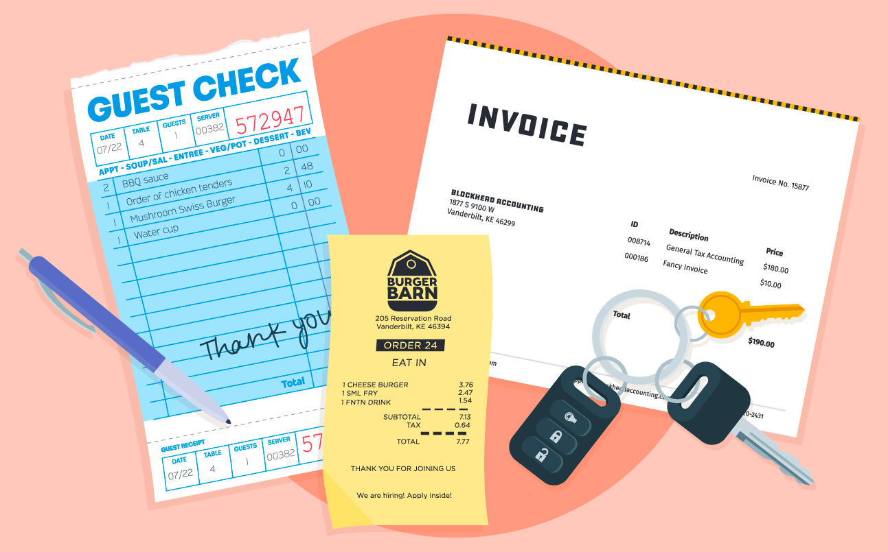

Advanced Budgeting
Grades 10-12
Your Logo Here

Slide 2
Sponsor Intro
Hi, my name is [YOUR NAME].
I work as [JOB TITLE] at [FINANCIAL INSTITUTION].
Your Logo Here
Notes:
Introduce yourself to the class and explain a little bit about your role.
Go over a typical day in your position and what products or services your institution offers.
Explain why you sponsor Banzai.
Feel free to invite the class to ask questions about you, your role, your financial institution, etc.

Slide 3

Advanced Budgeting
Notes:
In Advanced Budgeting, students take decision making to a new level as they save for their dream home.
This presentation gives an overview on setting goals, protecting credit, and navigating real-life obstacles like paying off credit cards and budgeting for monthly bills.

Slide 4
What we’re going to discuss…
Qualifying for a mortgage
Building healthy credit
Buying auto insurance
Avoiding identity theft
Your Logo Here
Notes:
This slide serves as a table of contents that introduces the presentation. These are the specific topics you’ll cover in the order you’ll present them in.

Slide 5

Qualifying for a Mortgage
Notes:
Qualifying for a mortgage isn’t as simple as selecting a house to buy and getting money from the bank. A lender looks mainly at a borrower’s income, credit report, and down payment. It is recommended that a mortgage payment be no more than 30% of a borrower’s gross monthly income. For example, with a monthly income of $5,000 borrowers should be looking at a mortgage of around $1,500.
One way to lower the monthly payment is with a larger down payment. This can also help you avoid paying Private Mortgage Insurance, or PMI.
Lenders will also assess a buyer’s debt-to-income ratio (DTI)—that’s a calculation of how much debt you have compared to your income.
Your monthly payment includes the loan principal, which is the cost of purchasing the home, plus interest, amortized into payments over 15, 20, or 30 years.
Ask students what questions they have about qualifying for or paying back mortgages.

Slide 6
Building Healthy Credit
Credit Report
Credit Score
Hard Inquiry vs. Soft Inquiry
Your Logo Here
Notes:
Your credit report is a detailed list of everything that factors into your credit score, which includes:
Payment history—if payments are on time
Amounts owed—the balance on all accounts
Length of credit history—how long accounts have been open
Credit mix—different types of credit
New credit—accounts opened in the last year
A credit score is a number based on your credit report between 300 and 850 that quantifies a person’s ability to use and repay credit. You only generate a credit report after you start using credit. Ask the students if they have a plan for building credit or any questions about reports and scores.
Anytime you apply for new credit, the lender will look at your credit score. This is called a hard inquiry and it negatively affects your credit for 1 year and stays on your credit history for 2 years. In contrast, a soft inquiry for something like a rental application or even a job interview does not impact your credit because you’re not applying for new credit.

Slide 7

Buying Auto Insurance
Notes:
Insurance is a service that provides protection against the unpredictable, like car accidents and broken arms. There are several types of auto insurance.
Liability insurance covers bodily and property damage to protect other people and their things. It is illegal to drive without liability insurance.
Collision coverage protects against damage costs accrued by the policyholder.
Personal injury protection is an optional coverage that protects against medical costs and lost wages after a car accident.
Comprehensive coverage protects against damage that isn’t caused by a collision, such as if a laptop was stolen from the covered vehicle.
Uninsured motorist coverage covers a collision with an uninsured driver who is at fault.
An insurance policy details the type and amount of insurance coverage. It also outlines the required deductible—that’s the amount a policyholder pays before insurance kicks in on covered costs. The deductible is in addition to the monthly cost of insurance. To receive coverage after an accident, you must submit a claim and pay the deductible. Ask students if they have any questions about the costs associated with auto insurance.

Slide 8
Avoiding Identity Theft
What is Identity Theft?
What to do?
Your Logo Here
Notes:
Identity theft occurs when someone steals your personal information and credentials to pose as you or steal from you. This fraud could be everything from opening a credit card account in your name, using your insurance to get medical treatments, giving police your name and address if arrested, or draining your bank accounts. Ask students if they understand the risks of identity theft.
It’s a best practice to check your credit report regularly for any suspicious activity, and report any issues to the Federal Trade Commission (FTC). The FTC is responsible for enforcing the Fair Credit Reporting Act, which requires each credit agency to give consumers a free credit report annually. So you can collect at least 3 reports every 12 months for free. Many credit card companies also offer free credit score monitoring. Any drastic changes are a red flag to check your credit report.

Slide 9
Resources
Managing Debt Article and Debt Payoff Calculator
Making and Spending Money Article
Your Logo Here
Notes:
Depending on class participation and discussion during the presentation, there may be extra time. These resources are helpful for in-depth discussions.
The Managing Debt article discusses debt payoff strategies including the debt snowball method, debt avalanche method, debt management plan, and debt consolidation.
The Debt Payoff calculator embedded in the article is helpful for demonstrating how long it takes to pay off different loan balances, adjusting the term, interest rate, and added monthly payments.
The Making and Spending Money article outlines sources of income, and the difference between fixed and variable expenses. With the Budget Calculator, input a monthly after-tax income, along with your monthly and yearly expenses to find out your net monthly and yearly income. There is also a Know Your Net Worth Coach that walks users step-by-step through assessing their net worth.

Slide 10

Conclusion
Notes:
Achieving financial goals requires complex decisions, careful planning, and smart budgeting. It’s a good idea to prepare now for the future. Ask students how the financial choices they make now could impact their future.

Slide 11

Thank you!
Your Logo Here

