Slide 1


The 50/30/20 Rule
A simple budgeting guideline.
Your Logo Here

Slide 2
Sponsor Intro
Hi, my name is [YOUR NAME].
I work as [JOB TITLE] at [NAME OF YOUR FINANCIAL INSTITUTION].
Your Logo Here
Notes:
Introduce yourself to the class and explain a little bit about your role.
You could go over your typical day, some of the things your financial institution offers (products or services relevant to the class), why you sponsor Banzai for their class, or why you think financial literacy is important.
Consider inviting the class to ask questions about you, your role, your FI, etc.

Slide 3

The 50/30/20 Rule
Your Logo Here
Notes:
Introduce the topic briefly.
The 50/30/20 rule is a simple rule of thumb that helps you budget your money.
This rule provides a way that you can divide up your money, making it easier to pay for your expenses while still saving money for emergencies or large purchases.

Slide 4

We’ll talk about…
What is the 50/30/20 Rule?
Needs
Wants
Savings
Building an Emergency Fund
Resources
Notes:
This slide serves as a table of contents and can be used to introduce the presentation.
These are the specific topics you’ll cover in the order you’ll present them in.

Slide 5
What is the 50/30/20 Rule?
Split your income up this way:
Needs: 50%
Wants: 30%
Savings: 20%
Your Logo Here
Notes:
The 50/30/20 Rule simply suggests you split your income up into three categories.
Half of it (50%) will go toward your needs, 30% will go toward your wants, and, finally, 20% will go toward savings.
Ask if the students know what income is or define it yourself. Income is money you recieve; this can mean payment for a job, cash gifts, or even money you find in couch cushions.
The rule works best with income you receive on a regular basis—like allowance or money you earn at a job— but applies to all income.

Slide 6
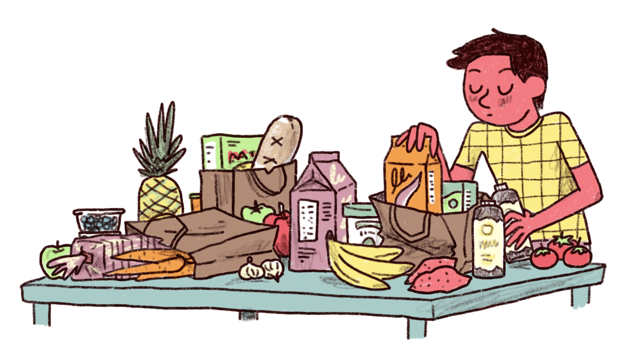
Needs (50%)
What are needs?
Can you think of an example of a need?
Notes:
The rule suggests you spend half of your income on needs.
When it comes to your budget, a need, sometimes called a necessity, is something you can’t live without.
In fact, not paying for a need will result in a severe impact to your life. For example, if you don’t pay for electricity, you won’t be able to use heat, wash clothes, store food in a fridge, and so on.
Ask the class if they can think of any needs.
If the class is reluctant to answer or needs help, provide a few examples: housing, food, transportation, and so on.
Ask the class what makes these things needs.
(You need a place to live to protect you from elements and provide comfort, you can’t live without food, you have to be able to get to school or a job.)

Slide 7
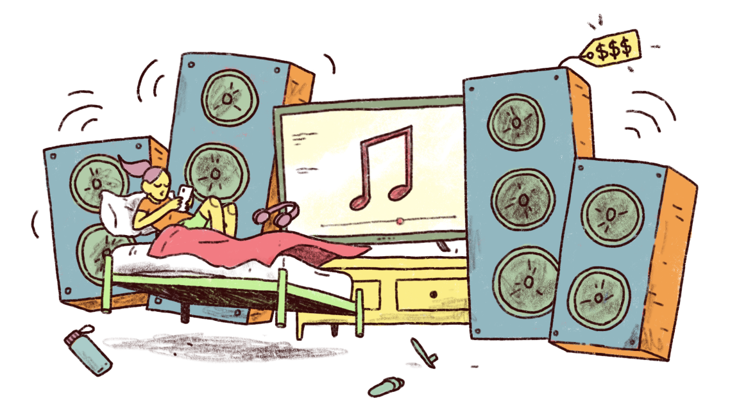
Wants (30%)
What are wants?
Can you think of an example of a want?
Notes:
Unlike needs, wants are things that you can live without.
In other words, they’re things you want, and what goes in this category is different for everyone.
Ask the class if they can think of examples of wants. You can provide examples, too, like eating out, subscriptions, video games, or even candy.
Ask the class why it’s important to spend some money on things you want.
(The answer? If we only pay for things we need, we’d be miserable!
We may even give up on budgeting altogether. Spending money on needs only can become unsustainable.)
It’s important to give yourself permission to buy things that you enjoy.
That being said, if you need more money for needs, you should take it from wants and not savings.

Slide 8

Saving (20%)
What does it mean to save money?
Can you think of something you might want to save for?
Notes:
Ask the class what it means to save money.
It’s not just spending less!
Saving is intentionally putting aside money to use in the future.
Ask the class what are some things they might save money for?
If the class is reluctant or needs some help, you can provide examples like saving to buy a car, go on a vacation, buy an expensive video game, or more.

Slide 9
More on Saving
Save with a purpose.
There are long-term and short-term saving goals.
Savings can grow with interest.
Your Logo Here
Notes:
(Bullet Point 1)
It’s not enough to just set money aside, you should have a clear goal in mind when you’re saving.
A goal will encourage you to keep saving—it’s motivating! It will also prevent you from spending your savings needlessly.
(Bullet Point 2)
Sometimes you’ll reach your goals quickly—within a few months or years—these are short-term savings goals.
Other times, your saving goals may take many years or even decades, these are called long-term savings goals.
Ask the class if they can think of examples of short-term savings goals.
Here are some examples you could provide if they’re stuck: travel, a wedding, home improvements, or an emergency fund.
You can let the students know the importance of an emergency fund, but you’ll cover it in more detail in just a moment.
Ask the class for examples of long-term savings goals (these might be harder for the students to imagine, but they’re incredibly important!).
Some examples could be saving for college or a retirement fund. It’s possible the students won’t know what a retirement fund is or why it’s important.
Explain that very few people want to work their entire lives, that’s why they retire.
But if you aren’t working, then you aren’t making any money. A retirement fund is a sum of money you can pull from to cover your expenses during retirement.
Saving for retirement early is key, since it can take many decades to save enough to live comfortably in retirement.
(Bullet Point 3) Finally, savings can grow with interest.
Ask the class if they know what interest is.
It’s a tough question! Explain to the class that interest is a percentage of the total balance that is added to your account just for keeping your money there.
This is a great opportunity to talk about saving accounts at your financial institution and give concrete examples of how often interest is paid.
Explain that interest makes it so that your savings will continue to grow—even if you don’t put any more money in the account.

Slide 10
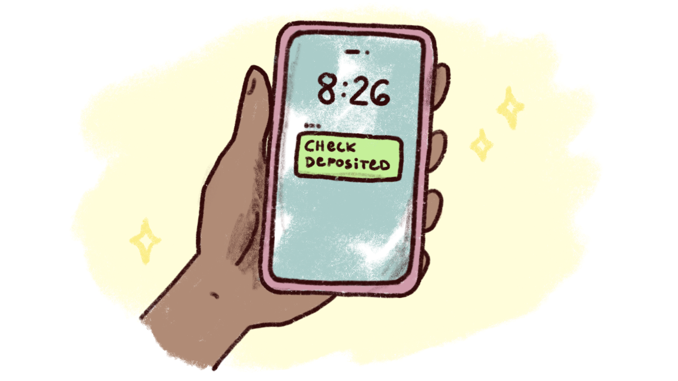
Building an Emergency Fund
What is an emergency fund?
How much should it be?
Notes:
As you might’ve mentioned to the class earlier, one example of a short-term savings goal is an emergency fund.
Ask the class if they know what an emergency fund is.
You can explain it as an amount of money that is set aside to cover unexpected expenses or regular expenses if your income changes (you lose a job, you get sick, etc.).
Unexpected things happen all the time. You could get in a car accident, wake up to a flooded basement, or even get your phone stolen at a restaurant.
An emergency fund covers these unexpected expenses so that you can continue to pay for your needs, wants, and savings as usual.
Ask the students for examples of emergency expenses. How much should be in an emergency fund? Afterall, it’s tough to predict the cost of an unexpected and unknown expense.
One rule of thumb is that an emergency fund should roughly equal 6 months of regular income. That means the amount in an emergency fund is different for everyone.

Slide 11
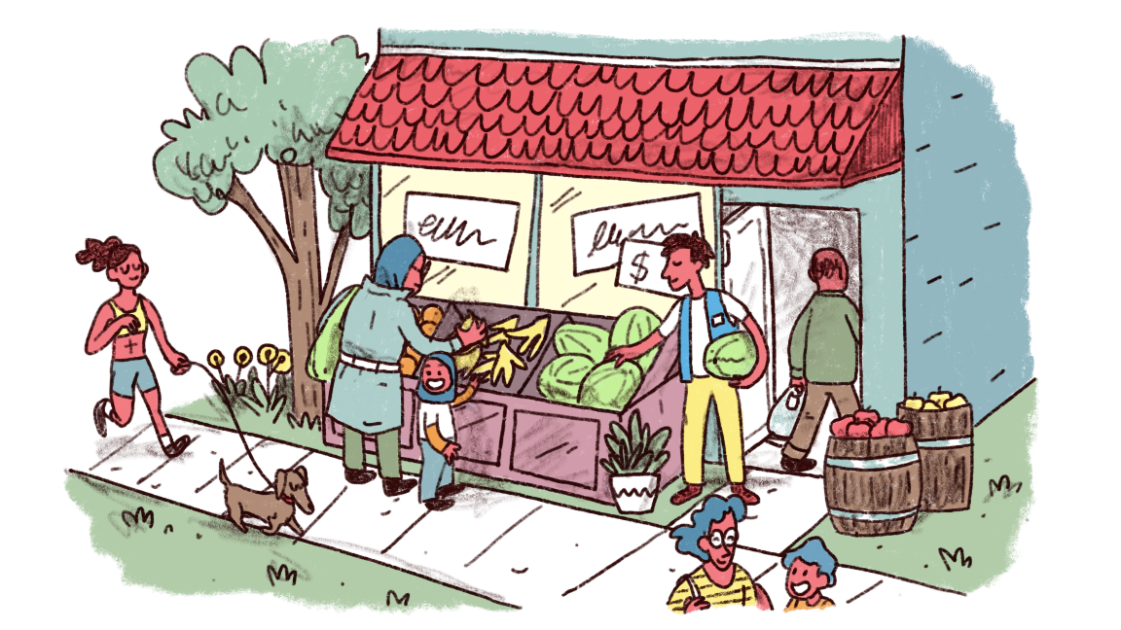
The 50/30/20 Rule is more like a guideline.
Notes:
Sometimes the 50/30/20 Rule isn’t the best way to organize your personal budget.
Perhaps you have to spend more than 50% on needs right now, or maybe you can afford to put 30% in savings instead of 20%.
The rule is simply one way to divide your budget, but you can adjust it to fit your needs.

Slide 12


I
Resources
50/30/20 Calculator
50/30/20 Coach
Notes:
Depending on class participation and discussion throughout the presentation, you may have extra time.
These resources are helpful ways to further demonstrate the 50/30/20 Rule; spend as little or as much time on these resources as makes sense.
The first resource, the 50/30/20 Calculator, is a quick way to see how much money will go into each category based on monthly income.
You can demonstrate how the rule will apply to a modest monthly allowance (like $40) or a realistic adult monthly income ($3,000 or so).
You can also ask the class to participate by providing a number.
The second resource is a much more robust Coach session.
The Coach session will walk you through creating a budget using the 50/30/20 Rule.
You can make up answers, ask the class for feedback, or use these provided inputs:
• Do you have some money right now? Yep.
• Do you earn money through a job or allowance? Yes!
• How much do you make every month? $1500
• Do you have other money on hand, aside from what you make/earn each month? Not right now

Slide 13

I
One Last Time!
Needs: 50%
Wants: 30%
Savings: 20%
Questions?
Notes:
Here is one last opportunity to explain the importance of budgeting, clarify the rule, or go over any final details.
The class may also ask you questions.
You can guide the class by asking for questions relating to the presentation or any question regarding personal finance.

Slide 14
Thank you!
Your Logo Here

