Slide 1
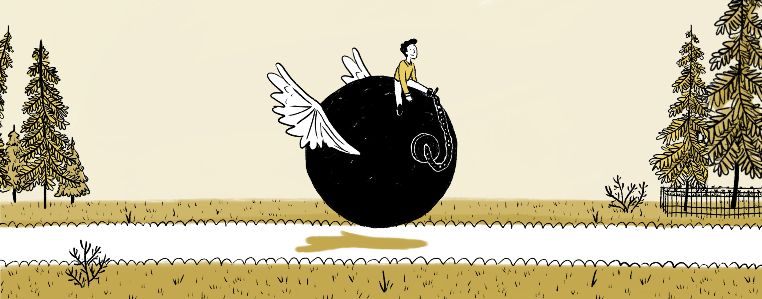

Get Out of Debt
Strategies and Tools for Your Life
Your Logo Here

Slide 2
Sponsor Intro
Hi, my name is [YOUR NAME].
I work as [JOB TITLE] at [FINANCIAL INSTITUTION].
Your Logo Here
Notes:
Introduce yourself to the participants and explain a little about your role. You could also go over some of the things your financial institution offers or why you are prepared to help with their situation.

Slide 3
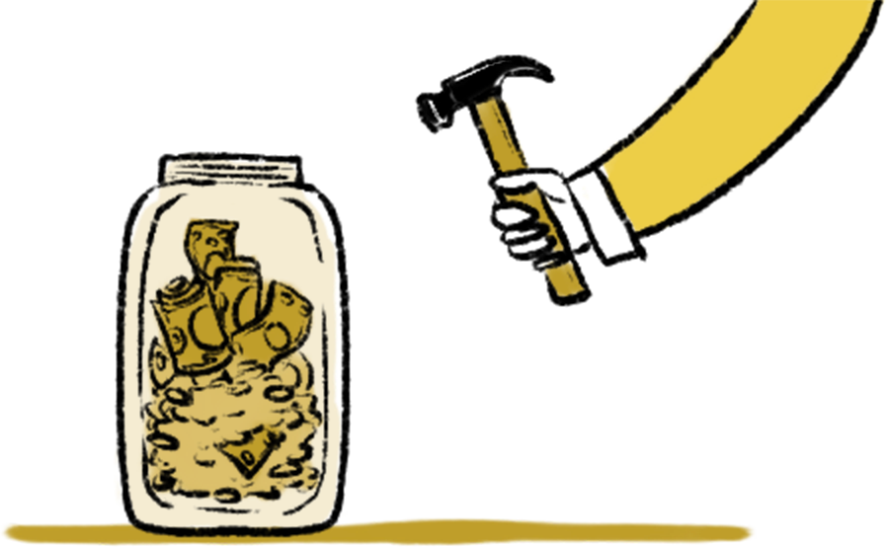
Get Out of Debt
Notes:
Take comfort, you’re not alone. Millions in the US have faced and overcome their debt. But that doesn’t happen by accident. Today, we’re going to go over some of the most efficient strategies to get out debt and on the path to financial wellness.

Slide 4
We’ll talk about…
First Steps
Debt Strategies
Snowball Method
Avalanche Method
Negotiate with Creditors
Debt Management Plan
Debt Consolidation
Your Logo Here
Notes:
This slide serves as a table of contents and can be used to introduce the presentation. These are the specific topics you’ll cover in the order you’ll present them in.

Slide 5
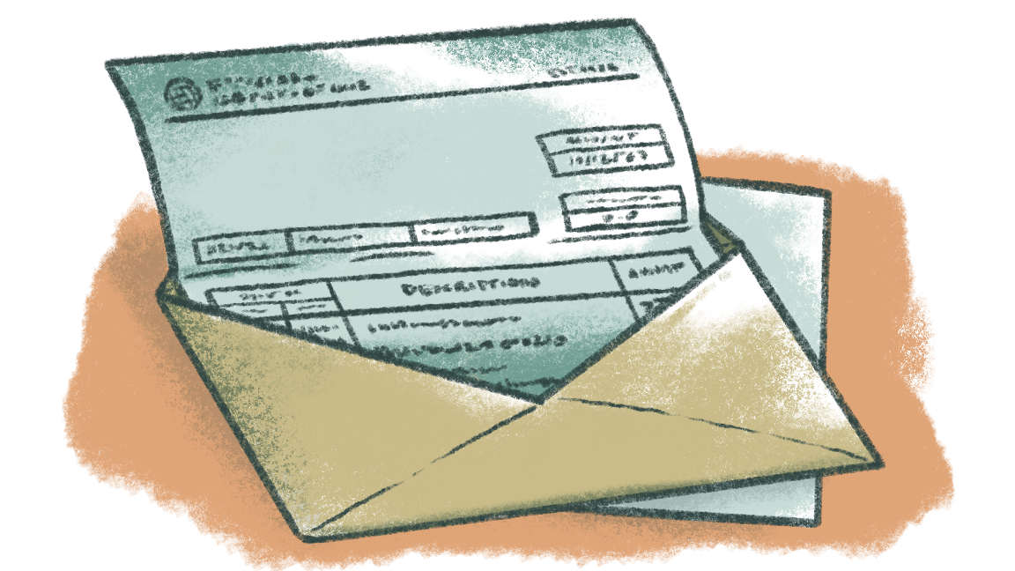
First Steps
Avoid accumulating more debt
Reduce expenses
Pay more than the minimum
Notes:
Let’s start with a few adjustments that can help you get a better handle on your debt.
(1) Avoid accumulating more debt - If you can, it’s key to stop adding to your debt. You don’t want to keep moving the goalpost. Stopping the use of credit cards will likely be the quickest way to do this.
(2) Reduce expenses - Take a hard look at your budget. Find the areas where you can save—even if it’s just a little—and make changes. That could mean cutting down on eating out, canceling subscriptions, or any number of reductions that can add up.
(3) Pay more than the minimum - Once you have some extra money in your budget, add that toward your monthly payment. Most minimums are a percentage of the total owed, but a fixed payment of more than the minimum can simplify your budget, help you pay your debt off sooner, and cost you less overall in interest.

Slide 6

Make a plan
Notes:
These steps can help you get ahead of debt and maintain control moving forward, but they may not be enough to get you out of debt on their own. Let’s get into some of the most effective strategies that you can incorporate into your plan.

Slide 7
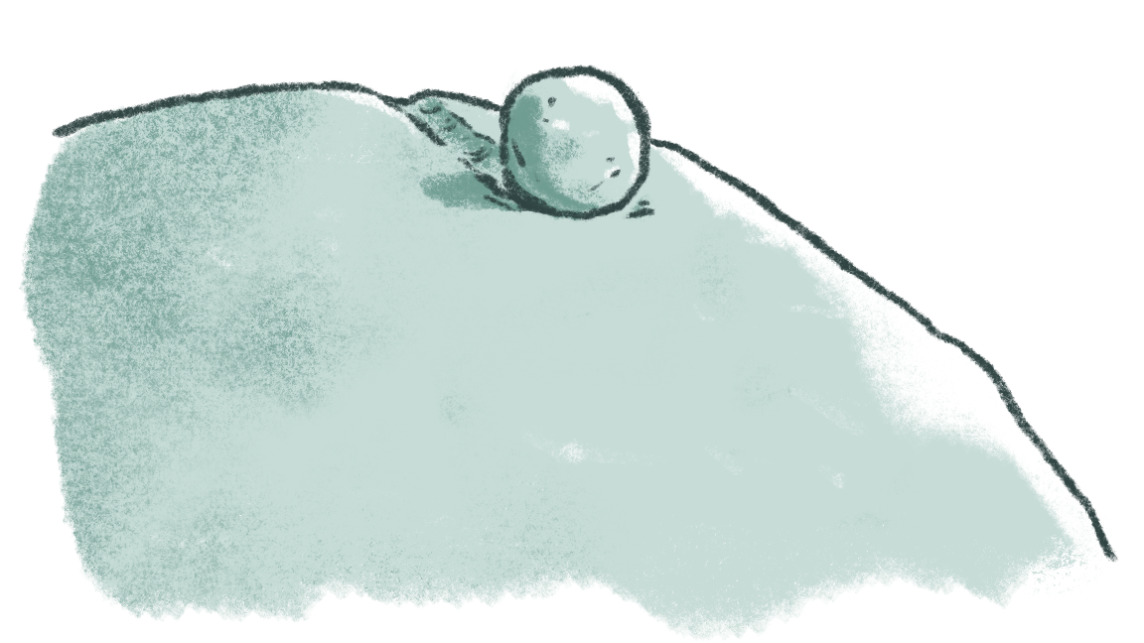
Debt Snowball Method:
Pay your smallest debt off first and work your way up.
Notes:
With this method, you focus on paying off your smallest debt first by adding extra to that payment while continuing to pay the minimum on all other debts. Once it’s taken care of, you take the amount you were paying toward that debt and add it to your payment for the next smallest debt, and so on, until everything is paid off. Think of it like a snowball getting bigger as it rolls down a hill.

Slide 8

Debt Avalanche Method:
Pay off your debt with the highest interest rate first and work your way down.
Notes:
Just like an avalanche, you knock out the big things first and then work your way down with this strategy. You focus on the debt with the highest interest rate, while still paying the minimums on everything else, then roll those funds into the next highest, and so on. This helps stop those big interest rates from continuing to add to your overall debt.

Slide 9

What will these strategies look like for you?
Notes:
The best way to find out how these strategies will work for you is to apply them directly to your situation.
Direct participants to the Get Out of Debt Coach and explain that they are going to take a few minutes to work through it. Encourage them to ask questions (even if it’s in a private message) as they go.
The Debt Snowball and Debt Avalanche plans are powerful, but if you need more guidance, outsidehelp may be the answer.

Slide 10
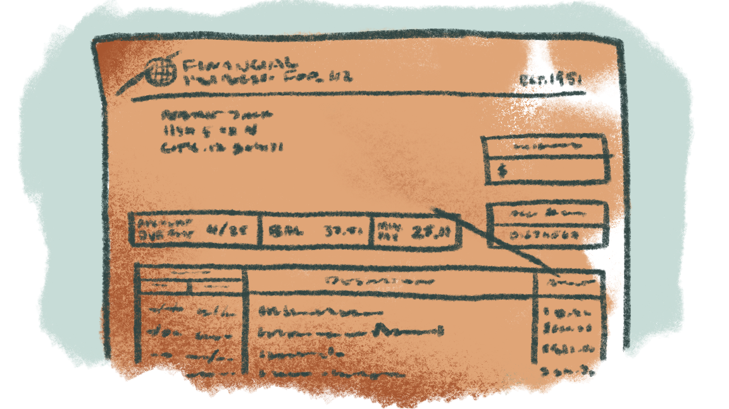
Negotiate With Your Creditors:
Adjust the terms of your agreement.
Notes:
If you can’t afford your minimum payment, even after simplifying your budget, you can ask your creditors to make adjustments to help you in your situation. If you’re going to take this approach, you’ll want to be prepared. Call as soon as possible
and have all of your information ready as well as an explanation of your situation. A few things you may ask about include lowering your minimum payment, decreasing your interest rate, or waiving late fees. Before agreeing to any changes, be
sure you understand all of the repercussions (for example: find out if your agreement will affect your credit score or understand that changing to a longer term with a lower minimum will mean paying more overall in interest, etc.).

Slide 11
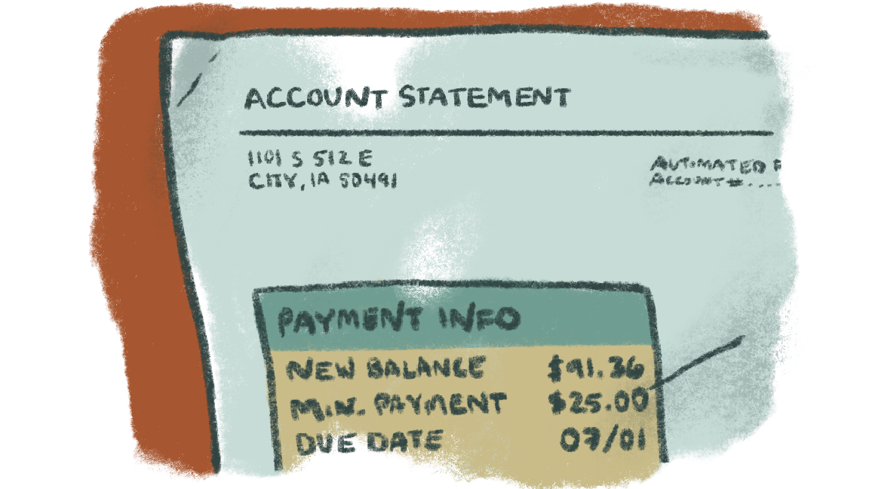
Debt Management Plan:
Work with a non-profit or credit counseling agency to create a plan.
Notes:
A debt management plan is a plan set up by a non-profit or credit counseling agency to help you pay off your debts. Your counselor negotiates and handles everything with your lenders, often helping you get a lower interest rate or waiving fees. Once it’s set up, you only need to make a
single payment to the agency, they handle the rest. It’s important to find an agency that you trust, so be sure to read reviews and ask lots of questions.

Slide 12
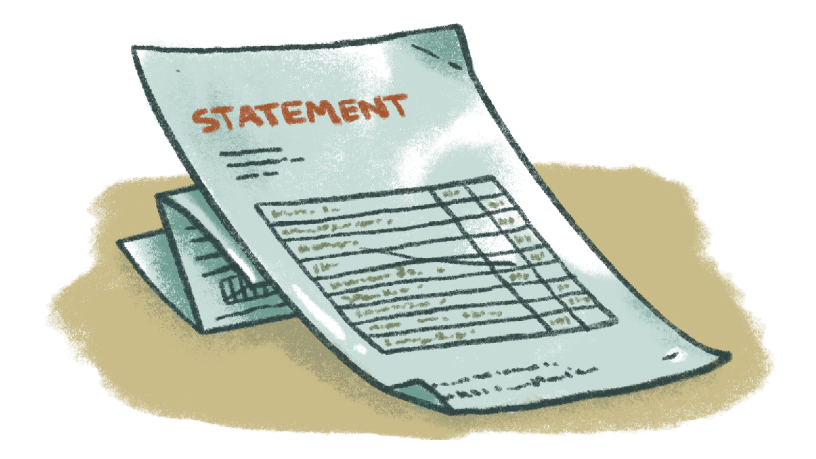
Debt Consolidation:
Combine all your debts into one payment.
Notes:
Debt consolidation allows you to combine all of your debts into one payment by taking out a new loan, ideally with a lower interest rate/minimum payment, and using it to pay off your debts. The benefit is that, now, you’ll only have one payment
to worry about, rather than managing multiple. Be careful though, sometimes you could end up being in debt longer and paying more interest overall.

Slide 13
Debt Strategies
Snowball Method
Avalanche Method
Negotiate with Creditors
Debt Management Plan
Debt Consolidation
Notes:
Go over the main points from the presentation and remind participants of the basics of each strategy.

Slide 14
Additional Resources:
Article: How To Manage Your Debt: Strategies & Tools
Debt Payoff Calculator
Article: When You Can’t Afford Your Minimum Payments
Coach: Navigating Debt Collections
Any questions?
Your Logo Here
Notes:
Check out these resources if you need more guidance. Encourage participants to ask questions. If they are uncomfortable discussing specifics in front of a group, they can send their question privately. You may even offer your email so that participants can reach out to you after the presentation.

Slide 15
Thank you!
Your Logo Here

